Slide 1
Integrating Academics and Student Support Services to Enable SPC Students to “Start Smart and Finish Strong”
National Higher Education Benchmarking Conference
Overland Park, Kansas
May 4, 2016
Ms. Margaret E. Bowman
Director of Curriculum Services
St. Petersburg College

Slide 2
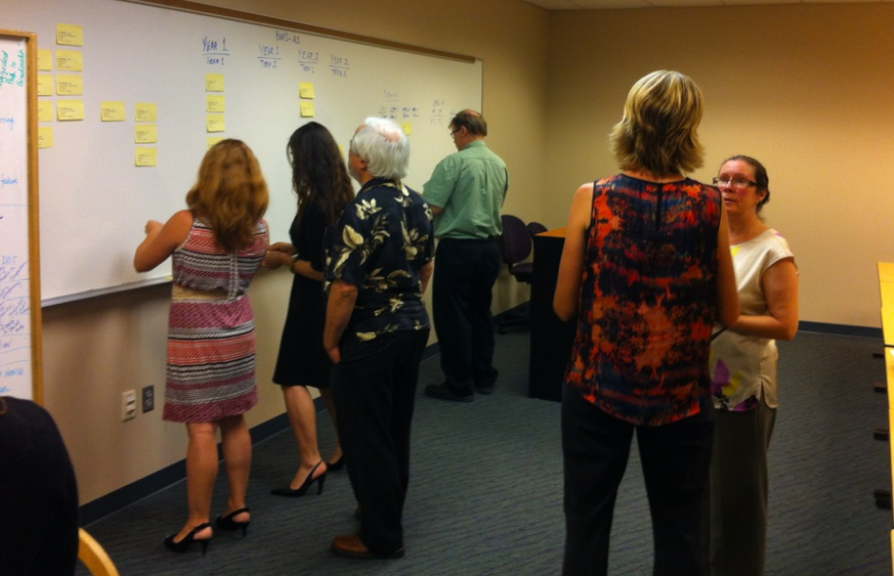
Integrating Academics and Student Support Services to Enable SPC Students to “Start Smart and Finish Strong”
Session Objectives:
Articulate the need for and purpose of Academic Pathways
Describe the role of Academics and of Student Services in creating Academic Pathways
Identify key questions to ask of your faculty, advisors, administrators, and other key stakeholders to begin building Academic Pathways at your institution
National Benchmarking Conference May 4, 2016

Slide 3
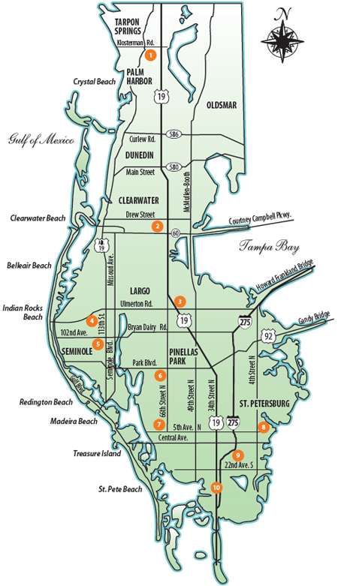
Integrating Academics and Student Support Services to Enable SPC Students to “Start Smart and Finish Strong”
7 campuses; 3 centers
Total enrollment: ~57,500:
PSAV – Baccalaureate
Lifelong Learning
~72% attend part-time
Average age: 27
First community college in Florida to offer baccalaureates
AACC Pathways partiipant
National Benchmarking Conference May 4, 2016

Slide 4
Evolution of Pathways at SPC
“Before”
“After”
Since 2010, SPC has focused its strategic efforts on student success using an
intentional data-driven way to help students “Finish What They Start”.
National Benchmarking Conference May 4, 2016

Slide 5
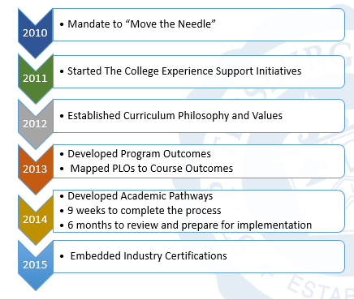
Integrating Academics and Student Support Services to Enable SPC Students to “Start Smart and Finish Strong”
Timeline
National Benchmarking Conference May 4, 2016

Slide 6
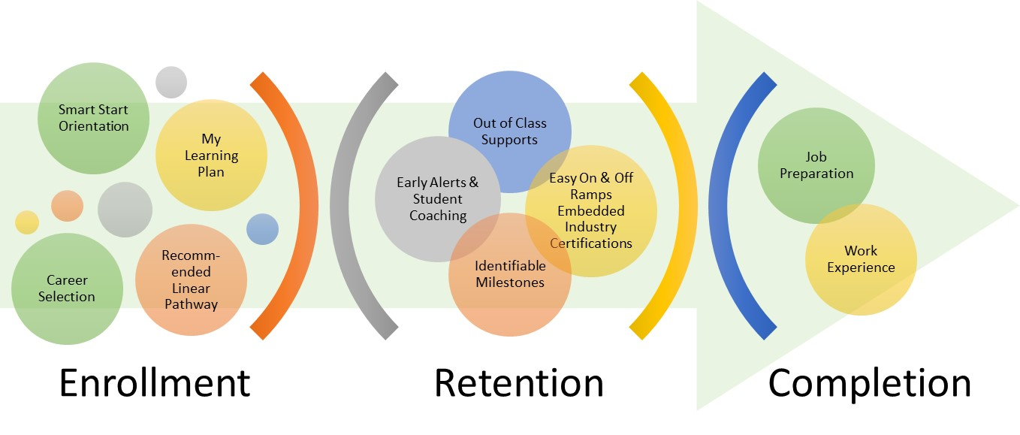
Integrating Academics and Student Support Services to Enable SPC Students to “Start Smart and Finish Strong”
Smart-Start Finish-Strong Model
The College Experience at SPC
JTC
National Benchmarking Conference May 4, 2016

Slide 7
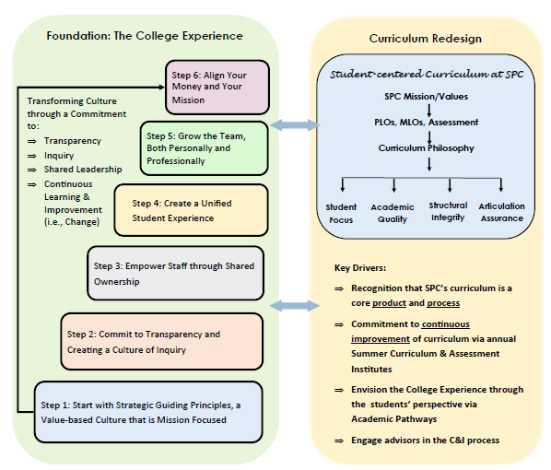
Integrating Academics and Student Support Services to Enable SPC Students to “Start Smart and Finish Strong”
Critical
Partnerships:
Academics &
Student Services
National Benchmarking Conference May 4, 2016

Slide 8
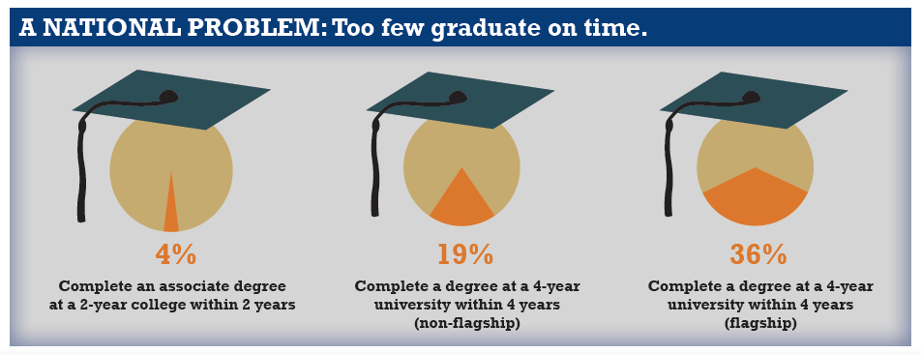
Integrating Academics and Student Support Services to Enable SPC Students to “Start Smart and Finish Strong”
Why are Academic Pathways necessary?
Source: Complete College America The Game Changers October 2013
National Benchmarking Conference May 4, 2016

Slide 9
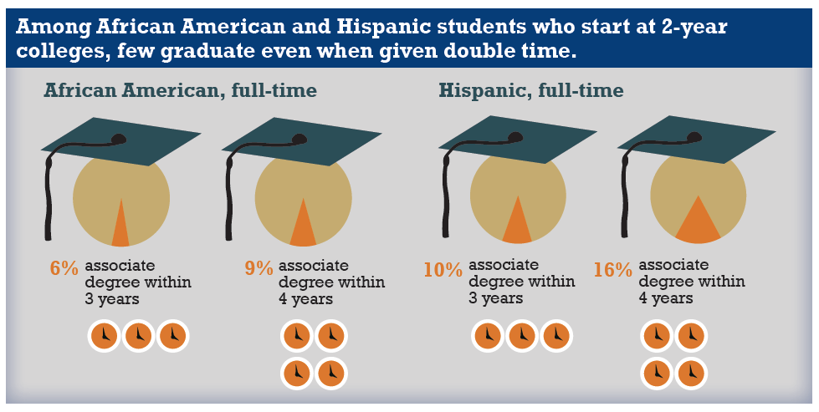
Integrating Academics and Student Support Services to Enable SPC Students to “Start Smart and Finish Strong”
Why are Academic Pathways necessary?
Source: Complete College America The Game Changers October 2013
National Benchmarking Conference May 4, 2016

Slide 10
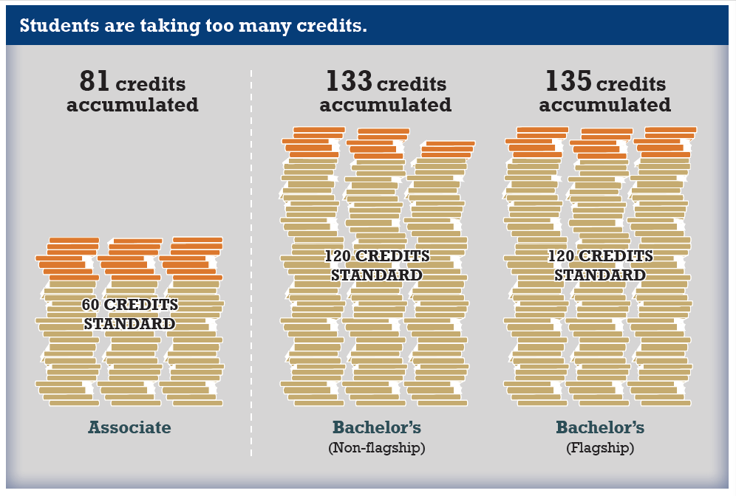
Integrating Academics and Student Support Services to Enable SPC Students to “Start Smart and Finish Strong”
Why are Academic Pathways necessary?
Source: Complete College America The Game Changers October 2013
National Benchmarking Conference May 4, 2016

Slide 11
Integrating Academics and Student Support Services to Enable SPC Students to “Start Smart and Finish Strong”
Why are Academic Pathways necessary?
Connection from interest to applications | Entry from entry to passing program gatekeeper | Progress from program entry to completion
Many students undecided Undecided default into GEN-AA | Many students drop out after 1-2 terms Students very confused by transfer process Performance in Math & English 101, & in ‘Gatekeeper’ | Students’ program progress not tracked Many students don’t follow recommended program curriculum Many students self-advise Enrollment continuity as important as enrollment intensity
Source: Complete College America The Game Changers October 2013
National Benchmarking Conference May 4, 2016

Slide 12
Integrating Academics and Student Support Services to Enable SPC Students to “Start Smart and Finish Strong”
Why are Academic Pathways necessary?
The Cheesecake Factory Experience
70 minute average wait time (Urban Spoon reviews)
20 page menu
200 menu items (or is it 250?)
Limited selection guidance
Is it worth it???
National Benchmarking Conference May 4, 2016

Slide 13
Integrating Academics and Student Support Services to Enable SPC Students to “Start Smart and Finish Strong”
Overview of Academic Pathways at SPC
What are Academic Pathways at SPC?
A chronological listing of all program courses in the order in which they should be completed by a student. Academic pathways are:
tools that enable students to successfully plan for, enter, progress through, and complete their academic goals
mapped out by faculty, advisors, and deans
highly prescriptive
educationally coherent (curricular relevance)
National Benchmarking Conference May 4, 2016

Slide 14
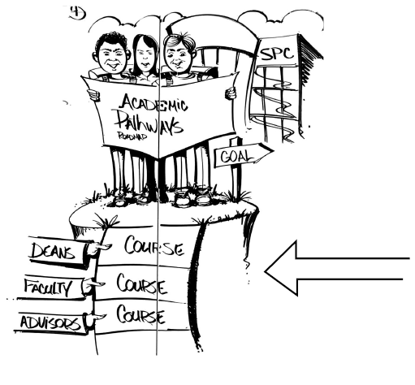
https://www.youtube.com/watch?v=jI9_kqgir9U

Slide 15
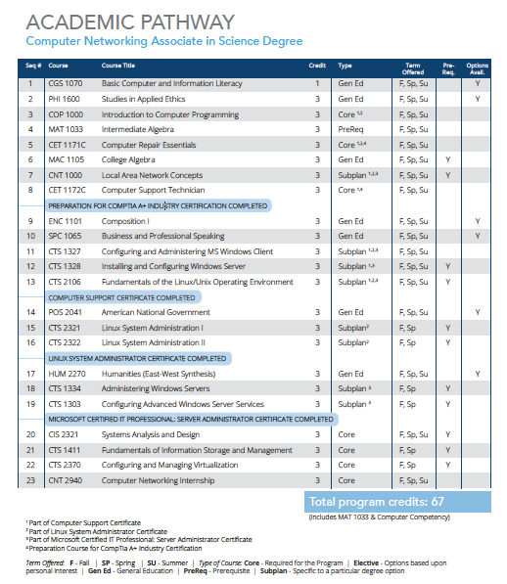
Academic Pathways

Slide 16
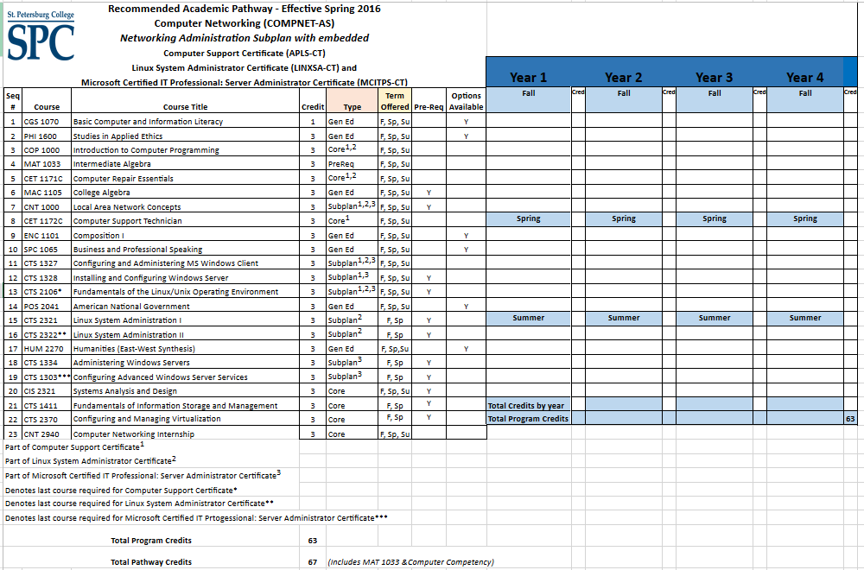

Slide 17
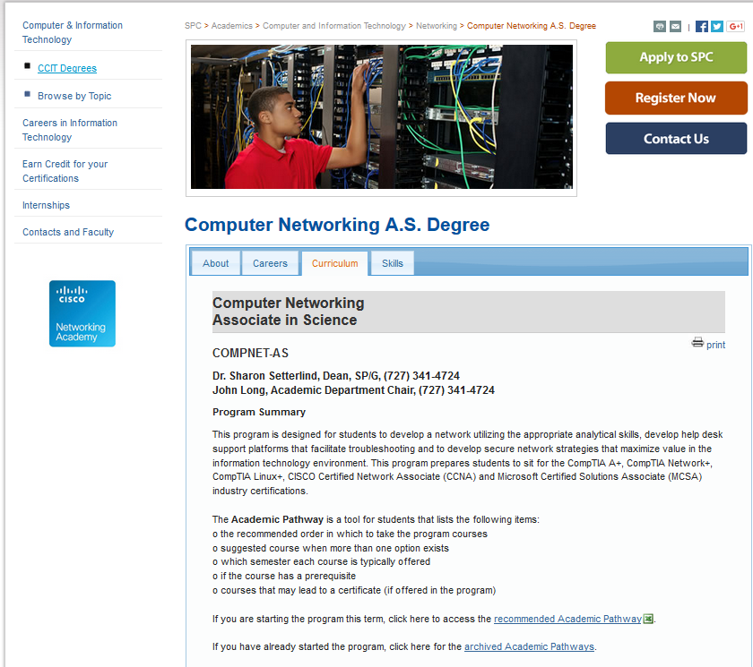
Academic Pathways
-7-

Slide 18
Integrating Academics and Student Support Services to Enable SPC Students to “Start Smart and Finish Strong”
Features of SPC Academic Pathways
Pathways Do: | Pathways Do NOT:
Present highly recommended courses and sequence with an “opt out” feature Recommend specific general education courses and elective courses, based on curricular relevance Identify “on” and “off” ramps via embedded certificates and industry certifications Allow for customization and flexibility based on each student’s unique situation
National Benchmarking Conference May 4, 2016

Slide 19
Integrating Academics and Student Support Services to Enable SPC Students to “Start Smart and Finish Strong”
Features of SPC Academic Pathways
Pathways Do: | Pathways Do NOT:
Present highly recommended courses and sequence with an “opt out” feature Recommend specific general education courses and elective courses, based on curricular relevance Identify “on” and “off” ramps via embedded certificates and industry certifications Allow for customization and flexibility based on each student’s unique situation | Replace professional guidance from faculty and advisors Limit students’ options of courses Require students to take any additional courses for a specific requirement that was previously satisfied Require students to be full-time or part-time, college-ready or college-prep, online or on campus Change due to scheduling or modality
National Benchmarking Conference May 4, 2016

Slide 20
Building the academic pathway
National Benchmarking Conference May 4, 2016

Slide 21
Designing Student-focused Curriculum Through Academic Pathways
Building the Academic Pathway
Steps:
Engage your stakeholders…ALL of them!
Determine the current “health” of your curriculum (Create Level 1 Academic Pathway)
Regroup and Reflect
Make necessary curriculum changes
Revise Academic Pathways based on Student Need (Level 2 Pathway)
Identify tools/systems/processes to sustain and continuously improve
Stiehl, R. & Lewchuk, L. (2012). The mapping primer: Tools for reconstructing the college curriculum. The Learning Organization, Corvallis, OR
National Benchmarking Conference May 4, 2016

Slide 22
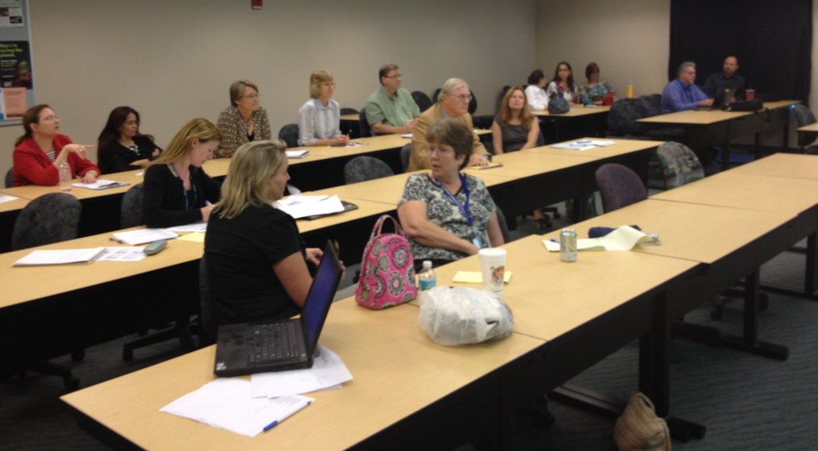
Designing Student-focused Curriculum Through Academic Pathways
Step 1: Engage Your Stakeholders
Program administrators: accreditation, State, institutional requirements, student success rates across sections/campuses
Program faculty: Industry requirements; student success rates by course; writing/ math-intensive courses; field experiences
Advisors: Gateway courses; student feedback; general education requirements
General education faculty/deans: Recommendations on general education courses, based on curricular relevance of programs
Collaboration from program administrators, faculty, and advisors is essential to make sure all factors of student progression and success are considered.
National Benchmarking Conference May 4, 2016

Slide 23
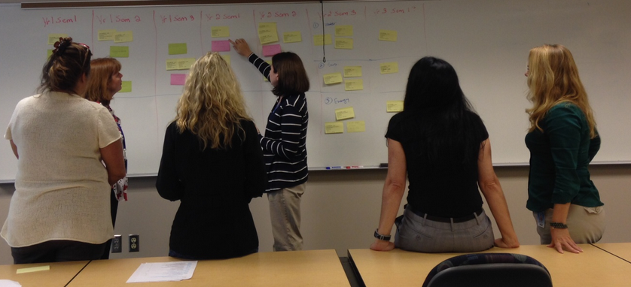
Designing Student-focused Curriculum Through Academic Pathways
Step 2: Determine the Current “Health” of Your Curriculum
Document a baseline snapshot (Pathway) of how students move through a program of study and identify:
Progression patterns
Early GEN ED competency areas
Hidden prerequisites
Overlapping requirements
Stiehl, R. & Lewchuk, L. (2012). The mapping primer: Tools for reconstructing the college curriculum. The Learning Organization, Corvallis, OR
National Benchmarking Conference May 4, 2016

Slide 24
Designing Student-focused Curriculum Through Academic Pathways
Step 2: Determine the Current “Health” of Your Curriculum
(Creating a Level 1 Academic Pathway)
~Continued~
Once all courses are posted, step back from the map and review it:
Are general education competencies/courses identified at appropriate points in the curriculum to allow students to successfully progress through future courses?
Are all prerequisite courses identified and sequenced accordingly (before the courses for which they are required)?
Is there a balance between theory and application courses each term?
Are there any terms in which there is a heavy concentration of writing, math, or critical thinking courses?
Are there any support, core or elective courses that also satisfy a general education requirement (e.g., STA 2023)? If so, place a pink dot on that course label.
Are there any support, core or elective courses that also satisfy a competency requirement (e.g., CGS 1100/EME 2040)? If so, place a green dot on that course label.
Capture your Level 1 Academic Pathway in a picture to ensure it gets documented on paper exactly how it is at this point.
Stiehl, R. & Lewchuk, L. (2012). The mapping primer: Tools for reconstructing the college curriculum. The Learning Organization, Corvallis, OR
National Benchmarking Conference May 4, 2016

Slide 25
Designing Student-focused Curriculum Through Academic Pathways
Step 2: Determine the Current “Health” of Your Curriculum
(Creating a Level 1 Academic Pathway)
Tips for Staying Out of “the Weeds”
Assume that all students are college-ready and begin the program in a Fall semester.
Remember that this exercise is to identify a default sequence of courses in an order that promotes student success and seamless progression through a program. Avoid the urge to discuss scheduling at this time.
Students will still receive credit for courses that they transfer in to SPC.
Avoid identifying specific general education courses at this time; instead, focus on competencies students need to successfully enter subsequent courses.
National Benchmarking Conference May 4, 2016

Slide 26
Designing Student-focused Curriculum Through Academic Pathways
Step 3: Regroup and Reflect
Identify key learnings from the process and discuss implications to the curriculum and student success:
Did you discover any hidden prerequisites or other required courses that are not listed on the Program of Study? How did this impact your curriculum?
Did you identify course overlaps and possibly make room for additional courses?
What worked/didn’t work with the process?
What was your most surprising/valuable finding?
What was your greatest challenge?
What advice do you have for other colleges engaging in this process?
National Benchmarking Conference May 4, 2016

Slide 27
Designing Student-focused Curriculum Through Academic Pathways
Step 3: Regroup and Reflect
SPC Key Learnings: Institution-wide
In addition to communications and math, computer competency needs to be met early in most programs
Need more courses to meet the World View Requirement
Shared courses have different prerequisites for students in different programs
Confusion over support courses and articulation rules may cause students to take additional, unnecessary courses
GEN ED courses tie to National, State, and SPC competencies and need to be considered and reinforced in all programs
Some accreditation requirements mandate maximum semesters, making it difficult to build Academic Pathways to Graduation
We offer too many course choices; we try to meet a variety of career options through one program
Many findings can be fixed with system changes and training & communication
Findings are reinforcing Articulation Assurance and Structural Integrity of SPC’s Curriculum
National Benchmarking Conference May 4, 2016

Slide 28
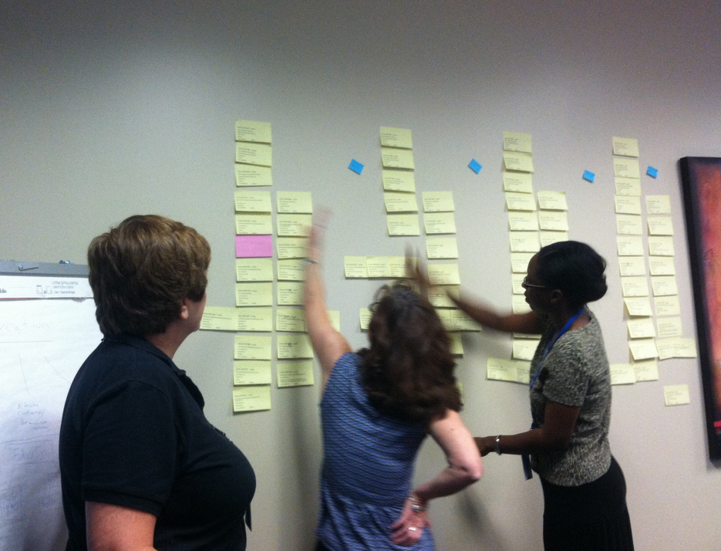
Designing Student-focused Curriculum Through Academic Pathways
Step 3: Regroup and Reflect
SPC Key Learnings: The Process
The organized process helped us to see our programs from a different perspective
The process provided a vehicle for cross-program dialogue
Using Post-It notes made the process interactive
Both our AS and BAS programs were already well mapped
We found our former BACC Advisor’s review invaluable
Working with advisors to see what student trends are and what students take was very helpful
National Benchmarking Conference May 4, 2016

Slide 29
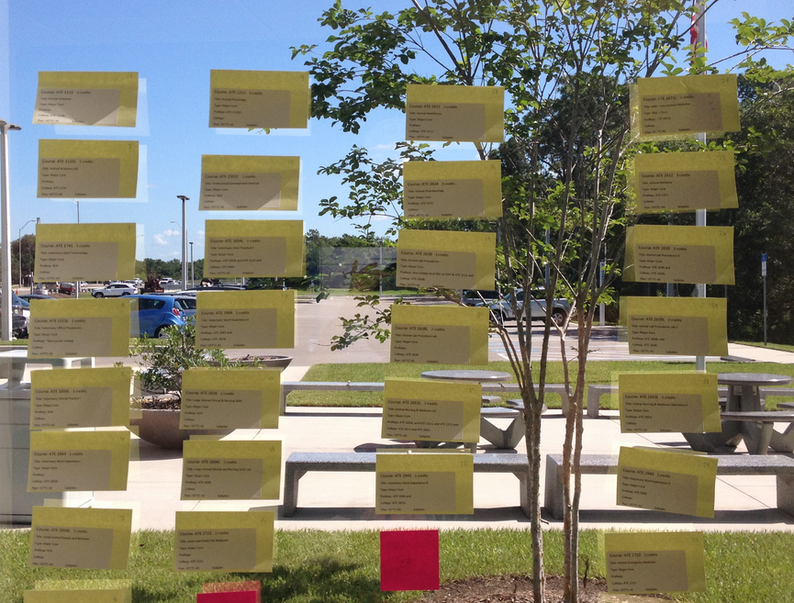
Designing Student-focused Curriculum Through Academic Pathways
Step 3: Regroup and Reflect
SPC Key Learnings: Surprising/Valuable Findings
Sequencing courses is valuable
The exercise was beneficial in placing GEN ED requirements into the sequencing
Being able to identify Math as a major component to be taken early in the sequence
Our program takes much longer to complete than we thought
We were able to create multiple pathways based upon career options
We established a balanced sequence to promote progression and graduation
Selecting a course from a list of options is hard and confusing!
We discovered our certificates aren’t really embedded.
National Benchmarking Conference May 4, 2016

Slide 30
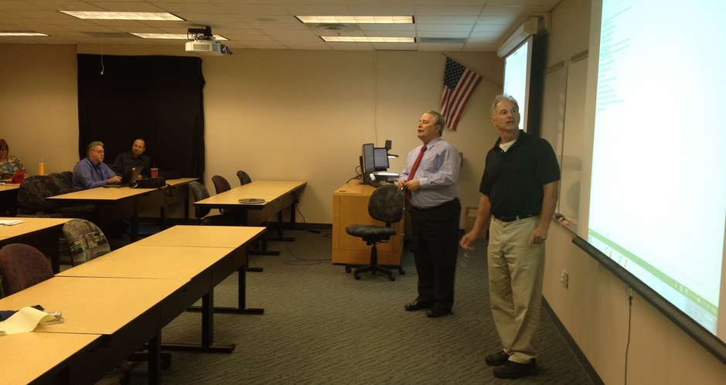
Designing Student-focused Curriculum Through Academic Pathways
Step 3: Regroup and Reflect
SPC Key Learnings: Greatest Challenges
Shifting Paradigms:
We had to get over thinking that we’d already done the sequencing
Believing that this wouldn’t work for our program
Not thinking about scheduling, especially given GAS
Listing courses without identifying those offered only once a year or that could not be taken in the summer
Selecting Electives:
Choosing specific courses from a list of open electives
Determining what course was best when presented with multiple courses that satisfy the same requirement
Defining specific electives in specific slots
National Benchmarking Conference May 4, 2016

Slide 31
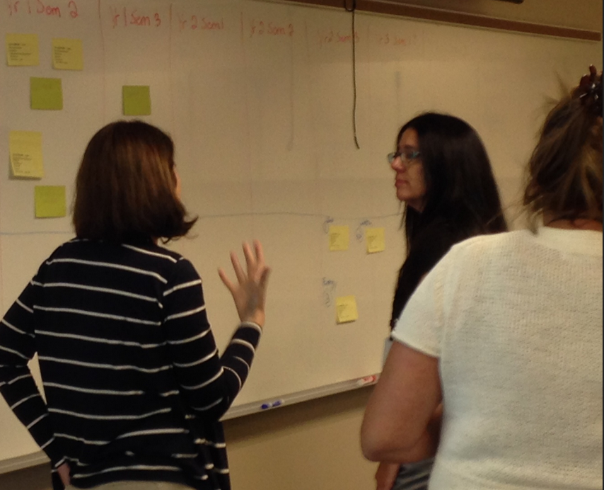
Designing Student-focused Curriculum Through Academic Pathways
Step 3: Regroup and Reflect
SPC Key Learnings: Greatest Challenges
Sequencing:
Creating better defined tracks
Coming to consensus on order (sequencing) of courses
Prerequisites:
Discovering hidden prerequisites and figuring out how to build them into the program
Mapping prerequisites; they make it difficult for students to graduate in two years
We have a large number of AS feeder programs that prepare students in different ways
Imposing admissions criteria (competencies) without hurting enrollment
National Benchmarking Conference May 4, 2016

Slide 32
Designing Student-focused Curriculum Through Academic Pathways
Step 3: Regroup and Reflect
SPC Key Learnings: Advice to Other Colleges
Engage faculty, advisors and other stakeholders in the process.
Assign tasks that involve faculty during the academic year when possible.
Involve everyone from the beginning.
Follow the process; Post-It notes were helpful to get all involved.
Sell it—give examples of how the process will benefit faculty and students.
Know the right questions to ask…and ask them.
Schedule follow-up faculty meetings for continued dialogue and review
Don’t overthink the process.
Engage in open discussions of multiple student scenarios.
Use facilitators throughout the process.
Trust the process…it works!
National Benchmarking Conference May 4, 2016

Slide 33
Designing Student-focused Curriculum Through Academic Pathways
Step 4: Make Necessary Curriculum Changes
National Benchmarking Conference May 4, 2016

Slide 34
Designing Student-focused Curriculum Through Academic Pathways
Step 6: Identify Tools/Systems/Processes to Sustain and Continuously Improve
Build pathway revision into normal C&I process – “Begin with the end in mind.” Jenkins, D. 2014
Ask: How will this curriculum change impact your Academic Pathway?
Make pathways visible and accessible to advisors and students
https://info.spcollege.edu/Community/AP/SitePages/Home.aspx
Program of Study
Automate the updating process
Train all student-facing staff
National Benchmarking Conference May 4, 2016

Slide 35
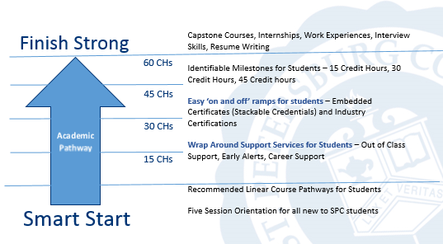
Designing Student-focused Curriculum Through Academic Pathways
The Guided Pathway Model at SPC
National Benchmarking Conference May 4, 2016

Slide 36
Questions?

Slide 37
Thank you!
Margaret E. Bowman
Director, Curriculum Services
Bowman.Margaret@spcollege.edu
“Curriculum development is a conversation, not a technology.”
--Ruth Stiehl & Les Lewchuk
“The key part of (academic pathways) approach is to start with the end in mind…earning a degree that enables (students) to prepare for further education and advancement in the labor market.”
--Davis Jenkins, Ph.D.
CCRC

Slide 38
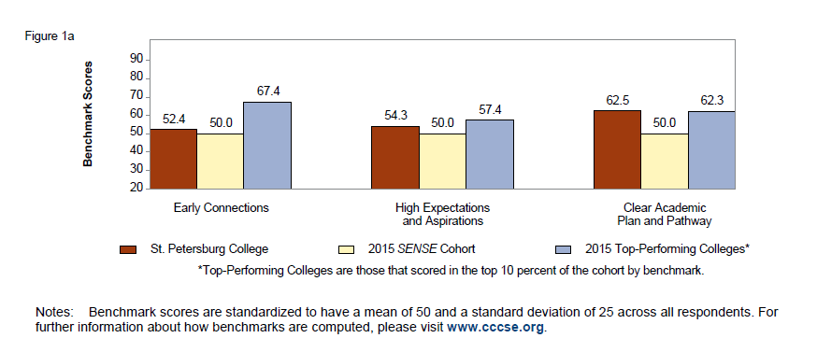
Addendum
(Information obtained and added after conference)
Early Connections
High Expectations/Aspirations
Clear Academic Plan/Pathway
2015 SENSE Benchmark Areas:

