Slide 1
Implementing Higher Education Decision Cost and Revenue Best Practices at JCCC
May 2, 2017

Slide 2
Agenda
JCCC Model Objectives
Model Design
Model Reporting Capabilities
JCCC Model Use

Slide 3
JCCC Model Objectives

Slide 4
JCCC Higher Education Cost and Revenue Model - Objectives
Maximize resources to deliver quality of education outcomes to students
Provide insight into the revenue-cost margins and performance of the institution not previously available
Provide fuller understanding of how various aspects of the institution's operations impact margin and performance

Slide 5
JCCC Higher Education Cost and Revenue Model - Objectives
Maximize resources to deliver quality of education outcomes to students
Ask more informed questions as to why resources are consumed as described in the model
Analyze class sizes and durations
Determine capacity utilization

Slide 6
JCCC Higher Education Cost and Revenue Model – Desired Outputs
Insight into Program Margin
Support the Instructional Program Review Process
Insight into Facility Utilization
Support Existing Reporting
Support the new Administrative and Service Area Review Process

Slide 7
Model Design

Slide 8
Higher Education Cost and Revenue Model - Design
College Management Model
GL Resources
HR Resources
Activities
Courses by School/Dept.
Programs by School/Dept.
Assets
Data Sources
Payroll / HR
Payroll structure
Personnel
Student Records
Course by Program
Program
School/Dept.
Campus
Teaching Period
Course & Program Level
Fee Type
Asset / Space Data
Entity
Campus
Buildings
Rooms
Room Type
Floor Area
General Ledger
GL structure and expenditure
GL activity assignments
Timetable Information
Room Class Type
Hours by Course

Slide 9
Higher Education Cost and Revenue Model - Cost Flow (Academic Example)
RESOURCES
ACTIVITIES
PRODUCTS
University Level
Auxiliaries
Auxiliaries
Student Serv.
Rev
Exp
Facilities
# STUDENTS
FULLY LOADED
COST & REVENUE
BY MAJOR
School Level
IT
Rev
Exp
Finance / HR
SQ. FEET
Department Level
Administrative
Activities
Research
Non-Labor
FTE
FTE
Non-Academic
Administrative
Activities
Course A
Physics Major
Professor
FTE
Course B
Adjunct
Research
Activities
Course C
English
Major
TA
Teaching Activities
Tutor
Course D

Slide 10
Model Reporting Capabilities

Slide 11
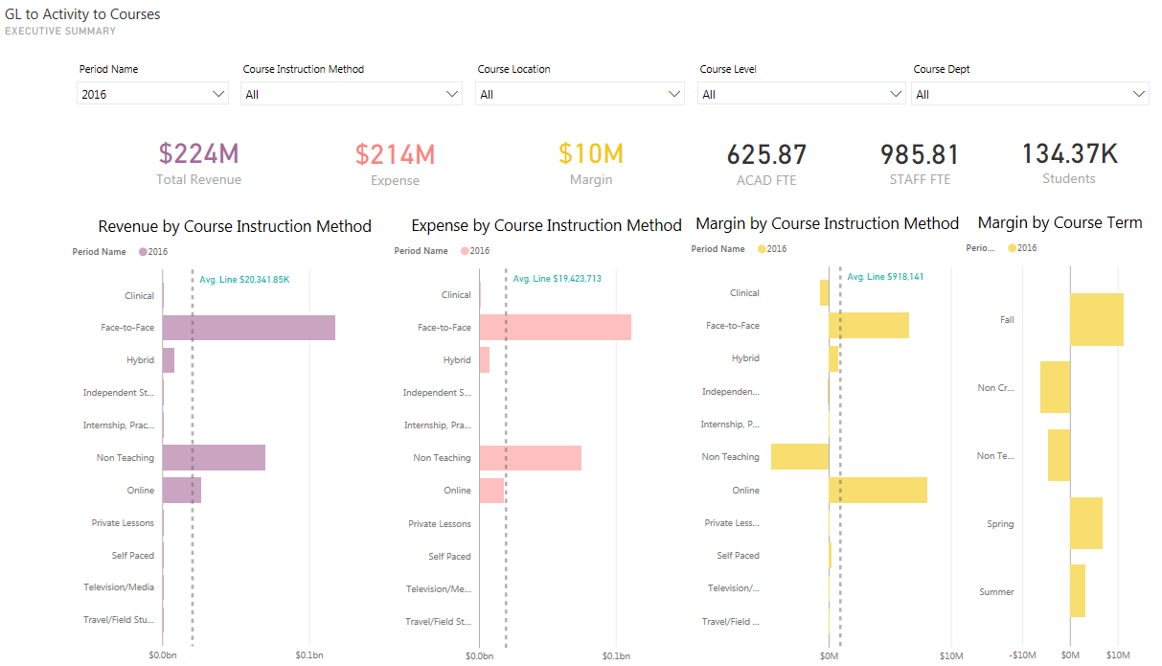
Example Reports: Executive Summary

Slide 12
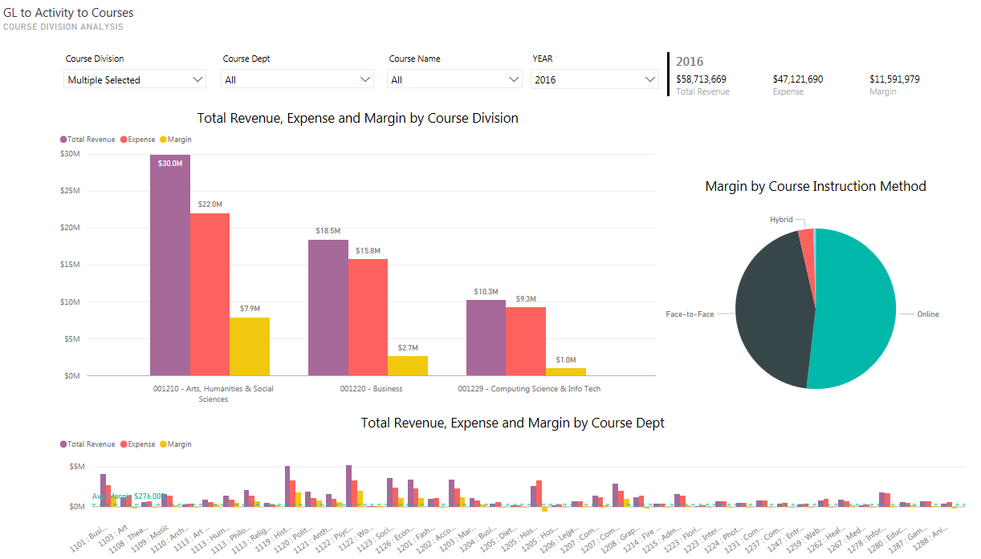
Example Reports: Course View

Slide 13
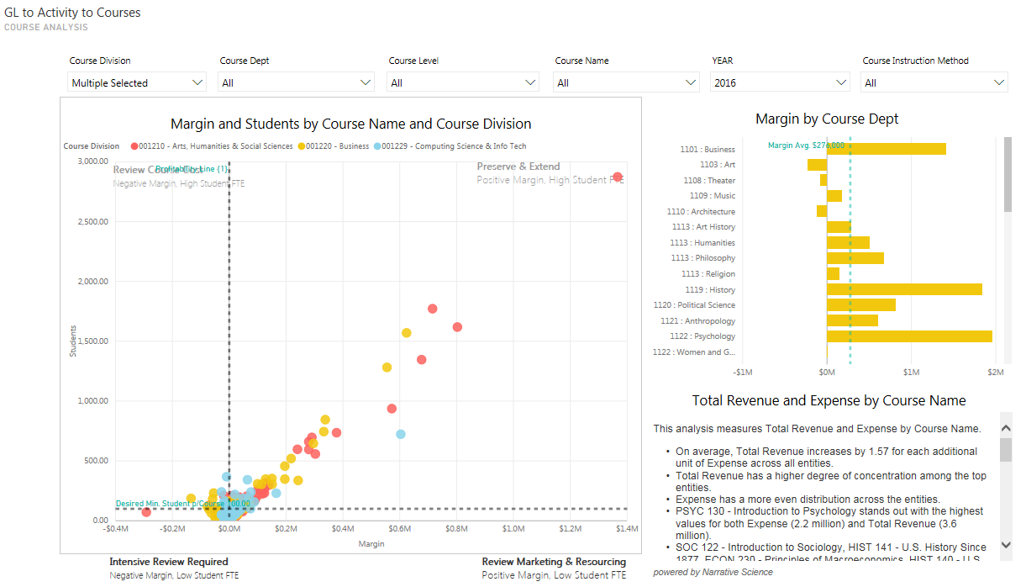
Example Reports: Course Margin

Slide 14
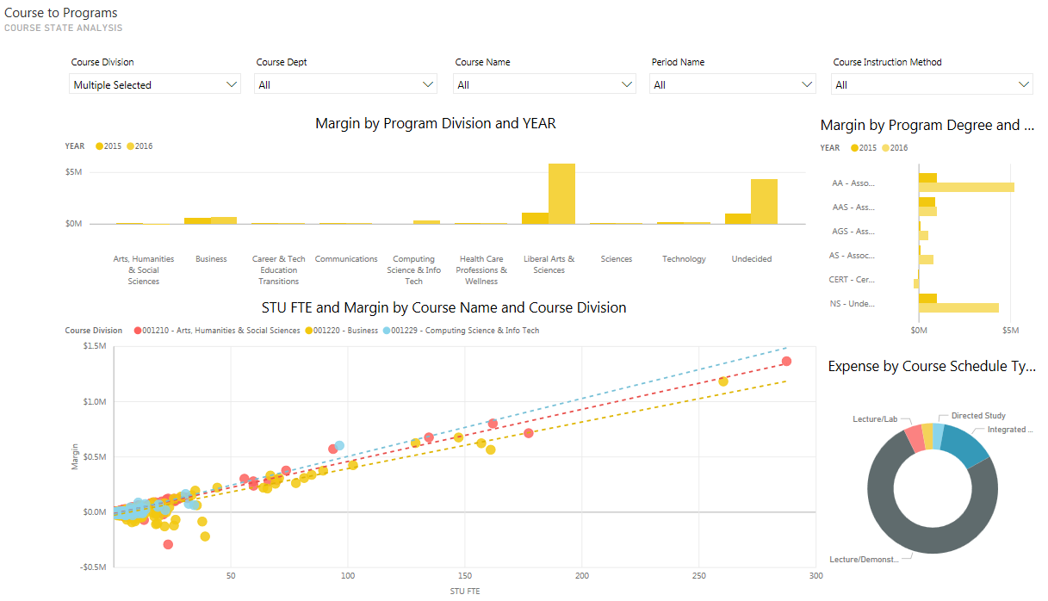
Example Reports: Course Analytics

Slide 15
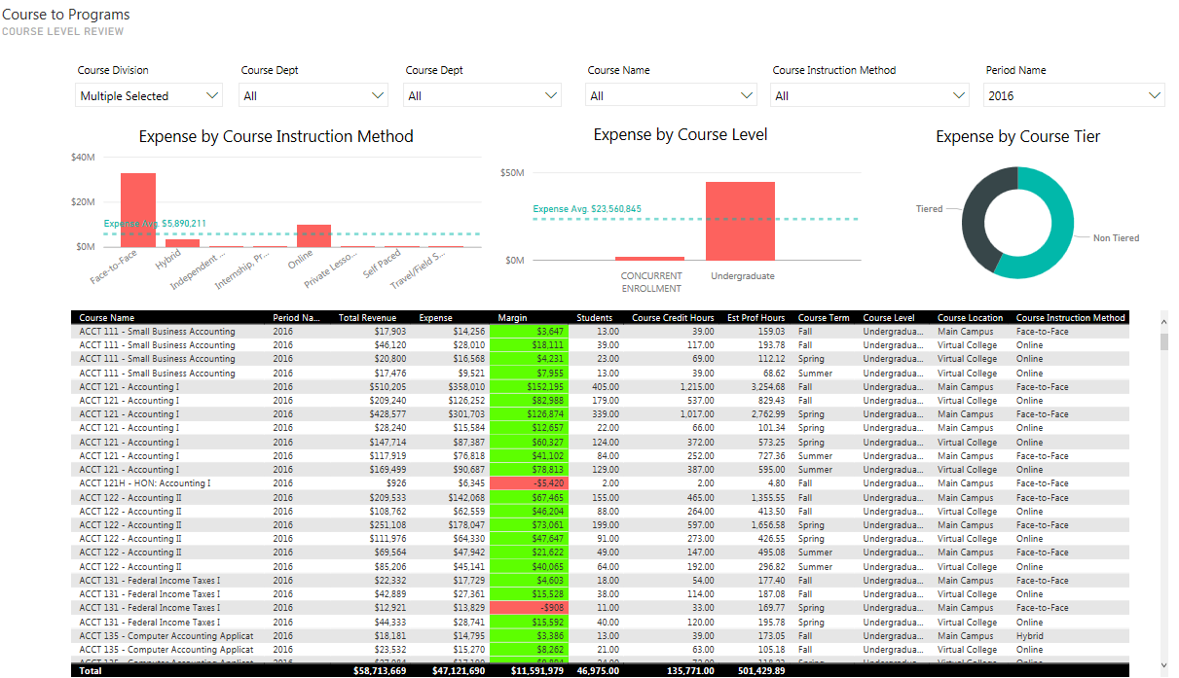
Example Reports: Course Level Review

Slide 16
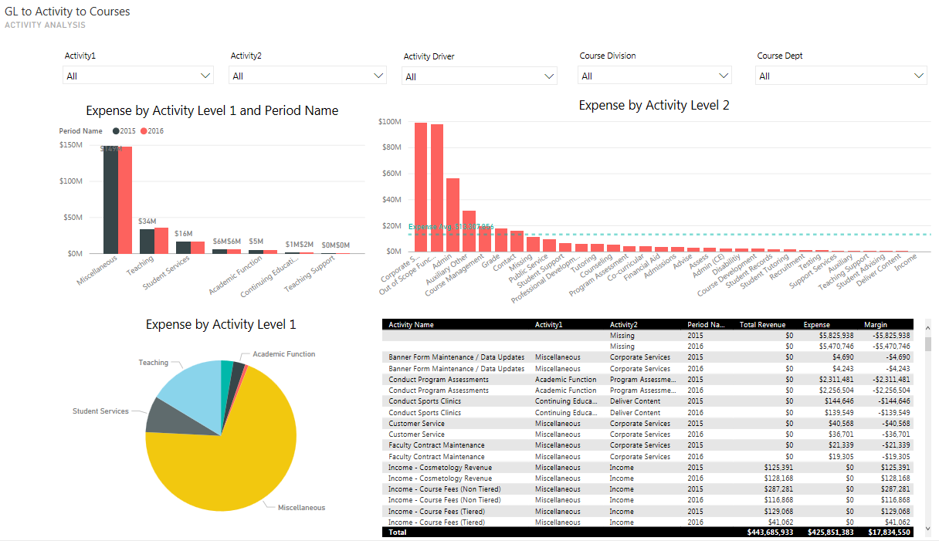
Example Reports: Cost by Activity

Slide 17
JCCC Cost and Revenue Model Use

Slide 18
JCCC Higher Education Cost and Revenue Model - Uses
New insights into program margin
New insights into facility utilization
Ability to compare course delivery methods
Support existing reporting
Understand impact of different allocation scenarios for ad-valorem tax revenue

Slide 19
JCCC Higher Education Cost and Revenue Model – Lessons Learned
Consider the goals of the institution
Academic leadership is key
Data was in silos; helped standardize data dictionary
Address the fear
Things to prepare for and consider before you jump in

Slide 20
JCCC Higher Education Cost and Revenue Model – Future Vision
Simple Allocations
Transparency and Improved Analysis
Limited or no allocation ability
Rules hard coded
Spreadsheet based
Only covers partial set of data (e.g. covers labor only)
Accurate Overhead Allocations
Costing performed using model that allows transparency back to source of the allocation
Allows 'what-if' analysis to determine impact of allocation factor decision
Full Costing and Advanced Analysis
Cause and Effect relationship established between resources and activities based on overhead and indirect costs
Ability to determine fully burdened cost with consistency and transparency
Revenue inclusion allows inclusive margin analysis
Predictive Planning
Cause and Effect relationship established along entire value chain
Use model as basis for conducting:
Pricing analysis
Marginal cost analysis
Capacity analysis and management
Fixed and variable cost analysis
Benchmarking
Portfolio optimization
Cost-to-serve analysis
Use cost and capacity analysis to predict and plan resource allocation requirements based on demand
Ensure the costs of producing a service are meeting strategic objectives
Evaluate plans to reorganize and/or discontinue programs that do not align to strategy
20

Slide 21
Have Questions?
We've got nswers!

