Slide 1
SPEED DATAing
Benchmarking Conference 2017

Slide 2



Speed Dataing: Measuring Student Success
Dr. Lou Guthrie, Benchmarking Institute
Notes:
IPEDS and NCCBP: Measures graduation rates by cohorts. Unduplicated headcounts (meaning someone that graduates with an AA and a certificate gets counted only once).
First-time: start in summer, yes I count in the cohort. Start in the summer, time out for a year, and start again in fall, then I am not first-time
Full-time: 12 hours – but if you go to college “full-time – taking 12 hours each semester– you can not graduate in 2 years”
Co-horts:
Does it includes certificates. 150% of “normal time” or 3 year rates.
Transfers not included.
How many students are actually included in this number: degree-seeking only, part-time not counted, if you don’t “fit” in a cohort you are not counted
This metric is a hot mess.
Business example: if a client told me they wanted to use % of product failures, rejects or seconds produced as a KPI, then said they would define that as only production on the first-shift, only count products produced by full-time people, only count one type of product even though the factory produces 4 products, etc. I would tell them they were crazy. They were not measuring their production effectiveness, efficiency or their true costs.
But in higher ed. We have graduation rates.

Slide 3
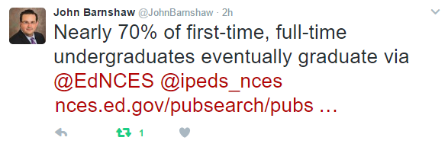

Sounds better…

Slide 4
Graduation Rates are not a good measure of student success for CCs.
Cover only approximately 13% of your students – FT, FT, degree-seeking
Do not cover your part-time students
Do not cover your transfer mission
Do not cover your Continuing Education Students
Do not always cover your high school (dual enrollment) students
Sometimes covers certificates sometimes not
Notes:
You know this –Why are you using graduation rates as a KPI.
Are unfair when you try to compare 4-year to 2-year institutions. Or even various kinds of two-year institutions.

Slide 5
Balanced Scorecard Approach with Benchmarking
Requires additional metrics
Start by choosing your five most critical performance metrics
You can then weight them by relative importance

Slide 6
Other KPIs for Student Success
On-time graduation rates for full-time (15 credit hours), first-time, major selected (take out all undecided), and take out all that indicate they plan to transfer.
Undecided students tracked. % that have chosen major after one semester and one year.
Transfer out students: % of those that plan to transfer when admitted that actually do transfer.
Notes:
I have suggested one but there are many more possibilities. A combination of graduation, certificate completions and transfer rates might work.
Or you might go back and look at success from the student’s perspective with satisfaction measures..
These might not be key performance indicators for the whole college, but might be KPIs for your chief academic officer, or advising, etc.
Stop here and ask if they have KPIs for all areas of their college. The President’s office, student services, etc. KPIs cascade throughout the organization.
So as we look at some ideas for KPIs that might be important

Slide 7
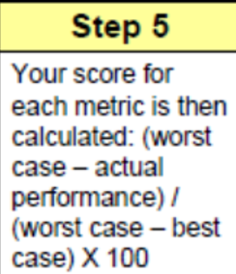
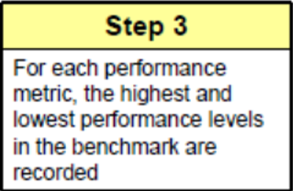
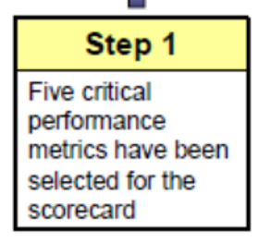
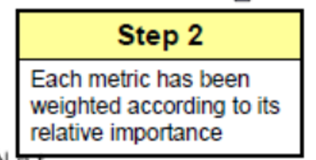
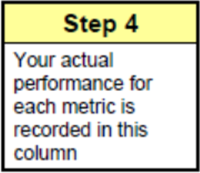
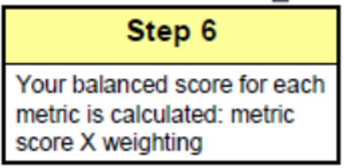

Slide 8
Creating Index Metrics
 | Scorecard with Multiple Metrics
using PERCENT RANKS | COLLEGE
 | A | Y | L | P | J
Student Satisfaction | 93% | 64% | 43% | 86% | 100%
Grad Rates | 93% | 57% | 43% | 79% | 86%
Transfer Rates | 100% | 92% | 46% | 69% | 0%
Undecided Decision Rates | 86% | 67% | 56% | 11% | 92%
Economic Impact | 18% | 50% | 75% | 0% | 75%
Continuing Education | 25% | 78% | 63% | 92% | 38%
Total | 4.15 | 4.08 | 3.26 | 3.37 | 3.91
Average | 69% | 68% | 54% | 56% | 65%

Slide 10

Contact Information
Lou Guthrie
louguthrie@jccc.edu | @LouAGuthrie
www.benchmarkinginstitute.org
@EdBenchmark

Slide 11
Trending Data Model
Melissa Giese
Director of Institutional Research & Assessment
melissa.giese@mcckc.edu

Slide 12
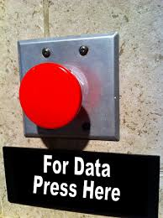
Changing
Expectations
PERCEPTION
Notes:
Snapshot

Slide 13

Building a Data Culture
Blackboard Analytics
Self Service model
Empowering employees
Interactive Dashboards
  Factbooks
  Enrollment KPI’s

Slide 14
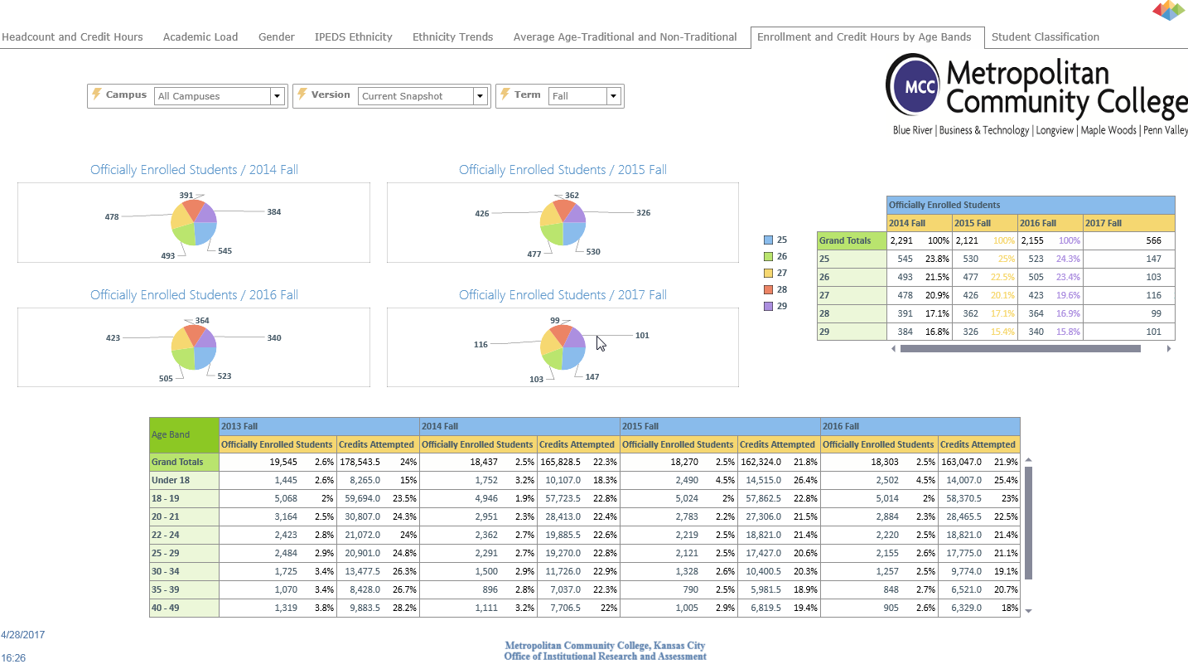

Slide 16
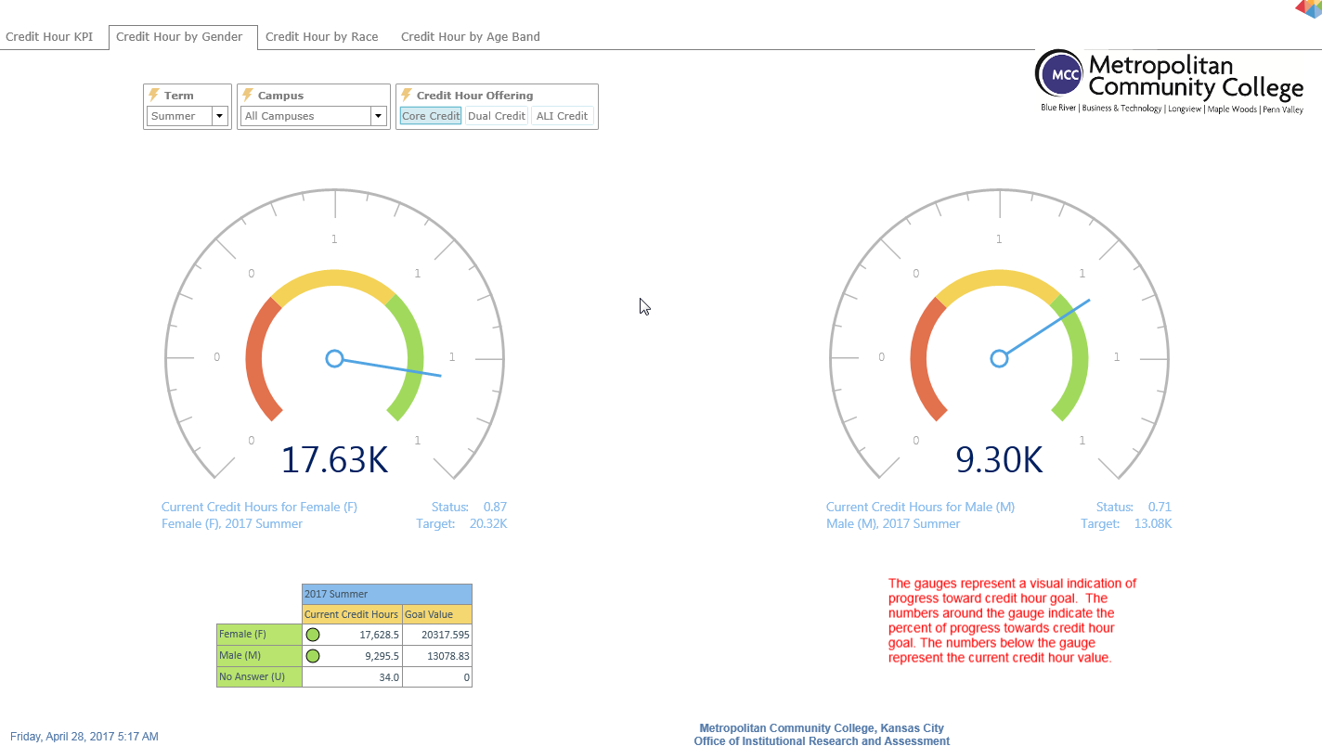

Slide 17

District Wide Training
  Data “help desk”
Performance Funding Measures
  NCCBP MO 66th percentile benchmarks
Strategic Planning
  Dashboards with KPI’s
  NCCBP benchmarks
Notes:
Board

Slide 18

IR Forecast
Predictive Analytics
  Enrollment forecasting
  Holistic approach
  Student Success
    Non cognitive
  Starfish data
  Blackboard Learn data
Notes:
Not just focus on displaying current data but a shift to use the data to forecast/predict what will happen.
Big data integrating IR data with our Starfish CRM holistic approach

Slide 19
Tracking Continuing Education Performance
Mike Souder
Dean of Continuing Education

Slide 20
Setting Goals
Continuing Ed Performance Metrics
Enrollment | XX,XXX
Revenue | $ X,XXX,XXX
Operating Margin | $ XXX,XXX
Allocating Goals
Program A Performance Metrics
Enrollment | X,XXX
Revenue | $ XXX,XXX
Operating Margin | $ XX,XXX
Program A Performance Metrics
Enrollment | X,XXX
Revenue | $ XXX,XXX
Operating Margin | $ XX,XXX
Program A Performance Metrics
Enrollment | X,XXX
Revenue | $ XXX,XXX
Operating Margin | $ XX,XXX
Program A Performance Metrics
Enrollment | X,XXX
Revenue | $ XXX,XXX
Operating Margin | $ XX,XXX
Program A Performance Metrics
Enrollment | X,XXX
Revenue | $ XXX,XXX
Operating Margin | $ XX,XXX

Slide 21
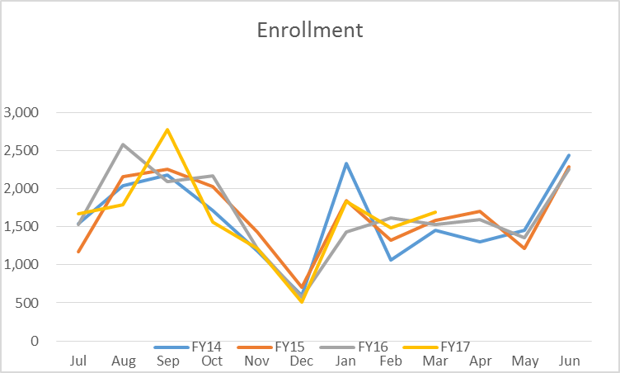
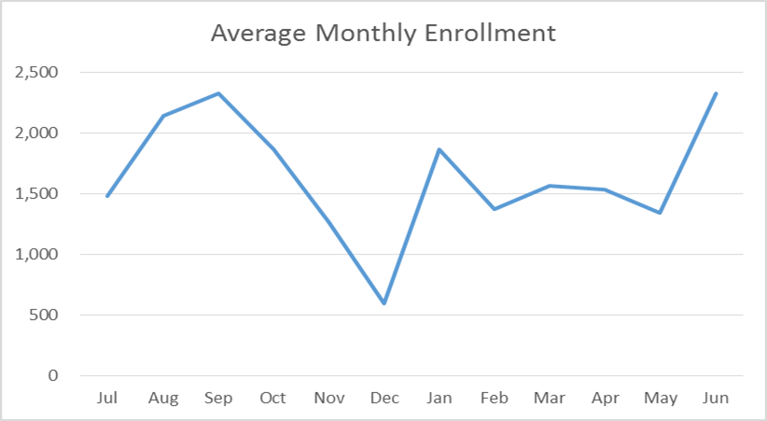
Creating Models to Track Performance
Enrollment

Slide 22
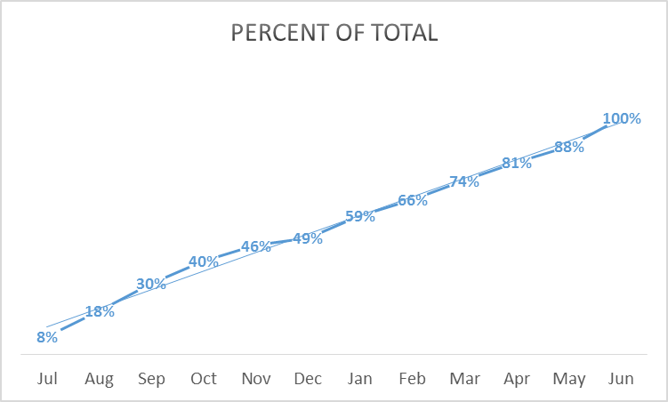
Creating Models to Track Performance
Enrollment
CE Performance | Projected thru March (74% of Goal) | Actual thru Mar
Enrollment | XX,XXX | YY,YYY

Slide 23
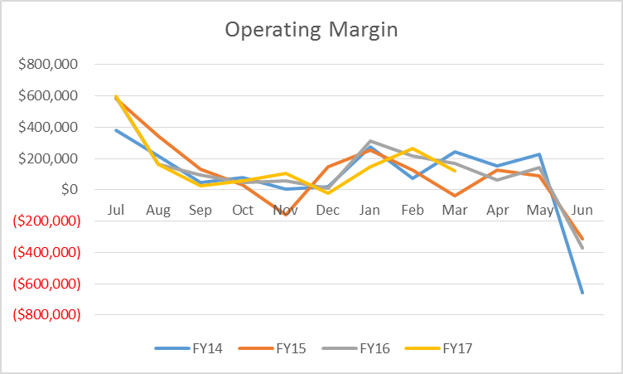
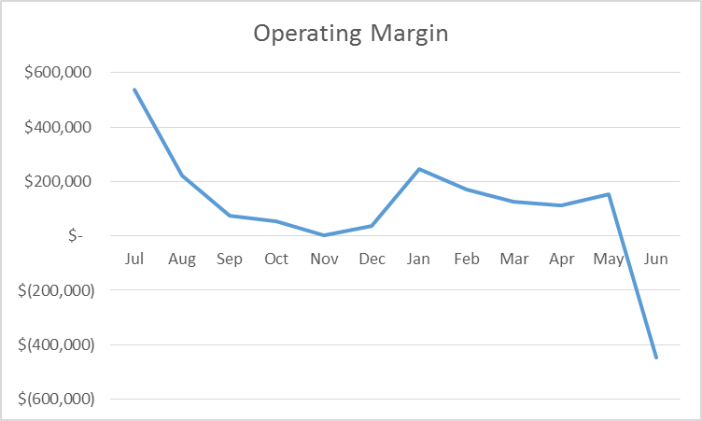
Creating Models to Track Performance
Operating Margin

Slide 24
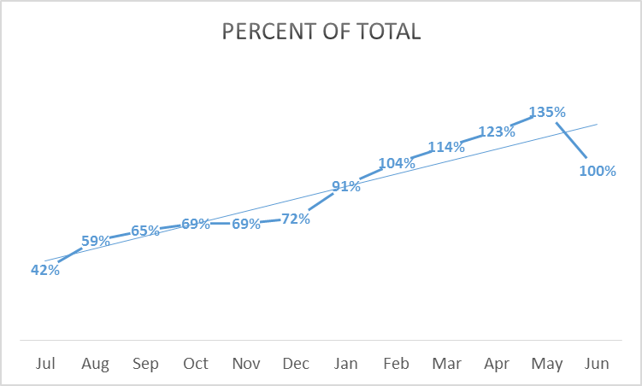
Creating a Model to Track Performance
Operating Margin
CE Performance | Projected thru March (114% of Goal) | Actual thru Mar
Operating Margin | $ XXX,XXX | $ YYY,YYY

Slide 25
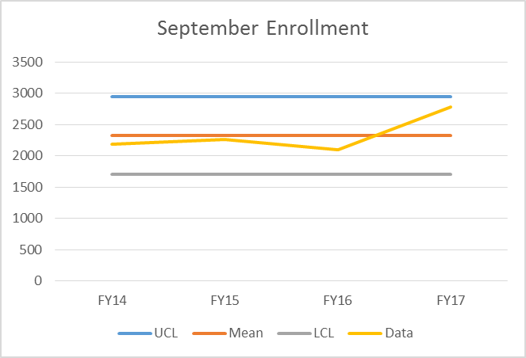
Control Chart for Enrollment?
Just for Fun
How do you check enrollment today?
CE Performance | September FY17 | September FY16
Enrollment | XX,XXX | YY,YYY

Slide 26

Thank You
www.jccc.edu/ce
Phone: 913-469-3205
Email: msouder@jccc.edu

Slide 27
Data Visualizations, Forward Looking Metrics, Scorecards & KPIs OH MY
Natalie Alleman Beyers
Director Institutional Planning & Research
May 2, 2017

Slide 28
Overview
  Performance measures are essential
    Good metrics provide the right information to inform discussion
Notes:
Stakeholders want/need accurate, concise, easy to understand, up to date data and information about organizational performance
PO Box example – We are creating our PO box system with the Pulse/scorecard. Rather than going off to various departments/resources – key metrics now included within Pulse/scorecard for quick reference. Pulling the best metrics from different depts.
Operational success on todays work & strategic success in preparing for future.

Slide 29
Aligning to Goals
JCCC Pulse
Institutional focus
Students
Employees
Resources/Finance
Strategic Plan (represented by KPIs)
JCCC Scorecard
Notes:
Scorecards provides the information tied to strategic goals to build awareness and inform discussion
Measures institutional characteristics that are important and meaningful.
Measures performance in areas in which it must be successful to survive.

Slide 30
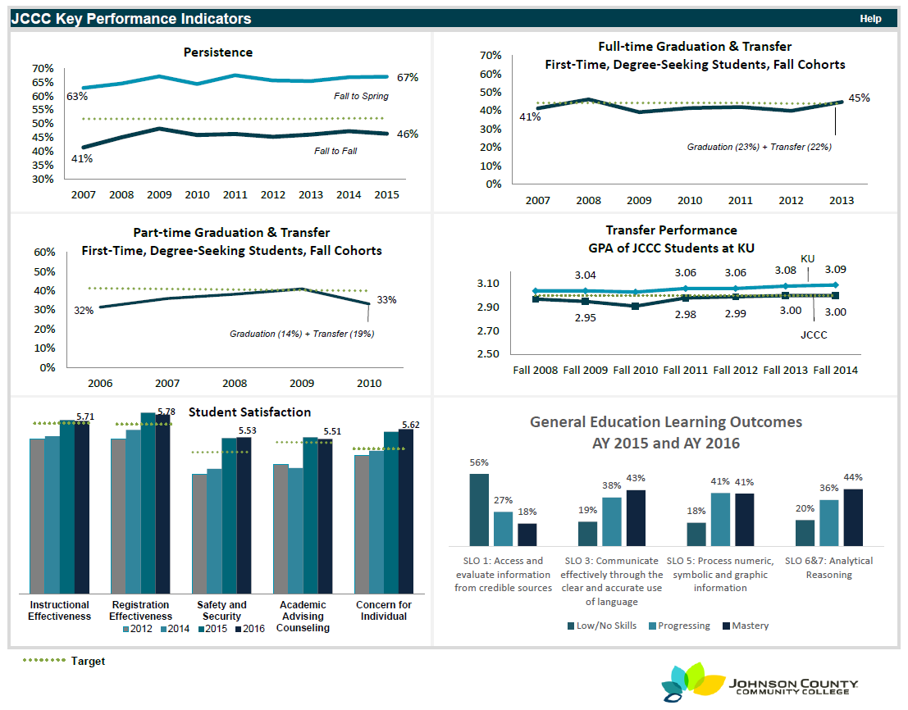
Key Performance Indicators
Notes:
Working to build in drill down/through capabilities using Cognos

Slide 31
JCCC Pulse – Introduction & Highlights
Current metric vs. Same Time Last Yr. vs. Previous year
Trendline: downward trend in enrollment
Continuous measure of enrolled students – Enrollment increased 5.5% (1,049) from Census to Nov 1st (compared to 5.1% Fall 2015 (978)
Notes:
Does not measure Everything!
Credit hours increased 3.0% from Census to EoT compared to 2.3% fall 14 (initiatives of more short term courses & winterim)
Percent students withdrawing declined.

Slide 32
JCCC Pulse – Introduction & Highlights
Notes:
Continuing Ed seats occupied up compared to same time last year (+14)

Slide 33
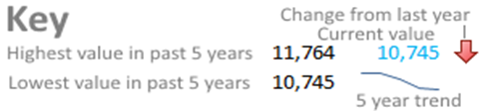
JCCC Scorecard
Five year trend snapshot – Trend metrics at a glance
Notes:
Again not measuring everything – but those metrics we can tie to our monthly pulse – KPI’s & strategic direction/plan
Need to have good understanding of historical data to design good forward-looking metrics
Pulse allows us to identify and adjust where needed to impact trends directions.

Slide 34
JCCC Scorecard - Highlights
Notes:
Again not measuring everything – but those metrics we can tie to our monthly pulse – KPI’s & strategic direction/plan
Need to have good understanding of historical data to design good forward-looking metrics
Pulse allows us to identify and adjust where needed to impact trends directions.

Slide 35
JCCC Scorecard - Highlights

Slide 36
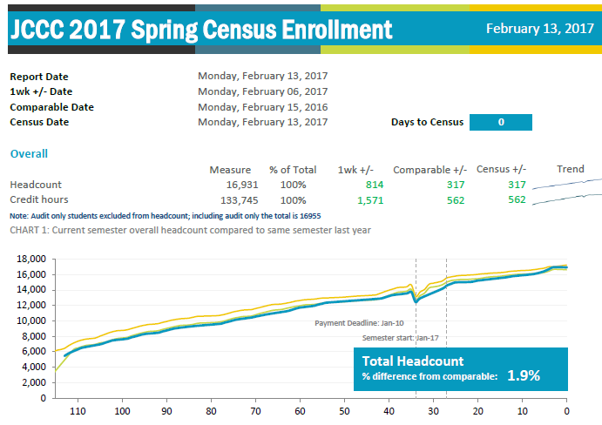
Enrollment Tracking
Begin Tracking registration from Day 1 of open enrollment

Slide 37
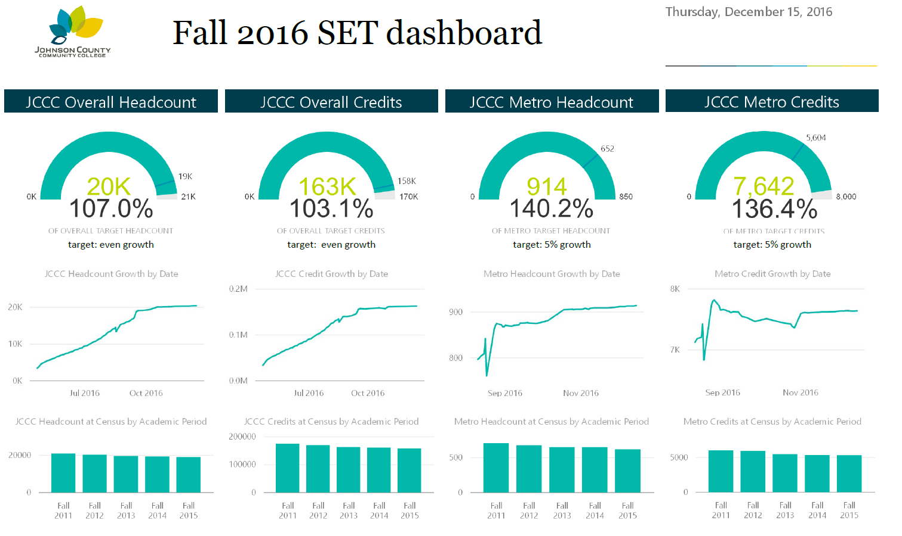
Strategic Enrollment Management Dashboard

Slide 38
Up Next
Self Service Reporting
Predictive Analytics
Student Success – Guided Pathways

Slide 39
Tracking Continuing Education Performance
Mike Souder
Dean of Continuing Education

Slide 40
Setting Goals
Continuing Ed Performance Metrics
Enrollment | XX,XXX
Revenue | $ X,XXX,XXX
Operating Margin | $ XXX,XXX
Allocating Goals
Program A Performance Metrics
Enrollment | X,XXX
Revenue | $ XXX,XXX
Operating Margin | $ XX,XXX
Program A Performance Metrics
Enrollment | X,XXX
Revenue | $ XXX,XXX
Operating Margin | $ XX,XXX
Program A Performance Metrics
Enrollment | X,XXX
Revenue | $ XXX,XXX
Operating Margin | $ XX,XXX
Program A Performance Metrics
Enrollment | X,XXX
Revenue | $ XXX,XXX
Operating Margin | $ XX,XXX
Program A Performance Metrics
Enrollment | X,XXX
Revenue | $ XXX,XXX
Operating Margin | $ XX,XXX

Slide 41
Creating Models to Track Performance
Enrollment

Slide 42
Creating Models to Track Performance
Enrollment
CE Performance | Projected thru March (74% of Goal) | Actual thru Mar
Enrollment | XX,XXX | YY,YYY

Slide 43
Creating Models to Track Performance
Operating Margin

Slide 44
Creating a Model to Track Performance
Operating Margin
CE Performance | Projected thru March (114% of Goal) | Actual thru Mar
Operating Margin | $ XXX,XXX | $ YYY,YYY

Slide 45
Control Chart for Enrollment?
Just for Fun
How do you check enrollment today?
CE Performance | September FY17 | September FY16
Enrollment | XX,XXX | YY,YYY

Slide 46
Thank You
www.jccc.edu/ce
Phone: 913-469-3205
Email: msouder@jccc.edu

