Slide 1
Change Management: Using Data to Create Action
Presentation to: 2017 National Higher Education Benchmarking Institute
Johnson County Community College
May 4, 2017

Slide 2
Successful Data Use....
Creates Action
To....
Continue Effective Practice or
Initiating Change (improvement)

Slide 3
Data INFORM Decisions
People Make Decisions.

Slide 4
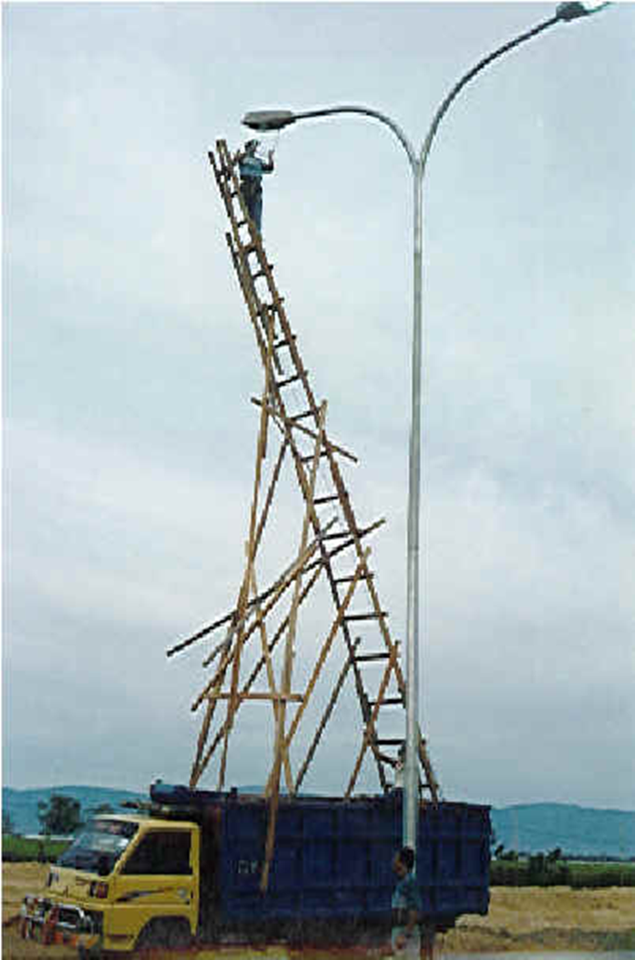
IR has developed over 50 years… “Running hard but falling behind.” Incremental rather than intentionally built

Slide 5
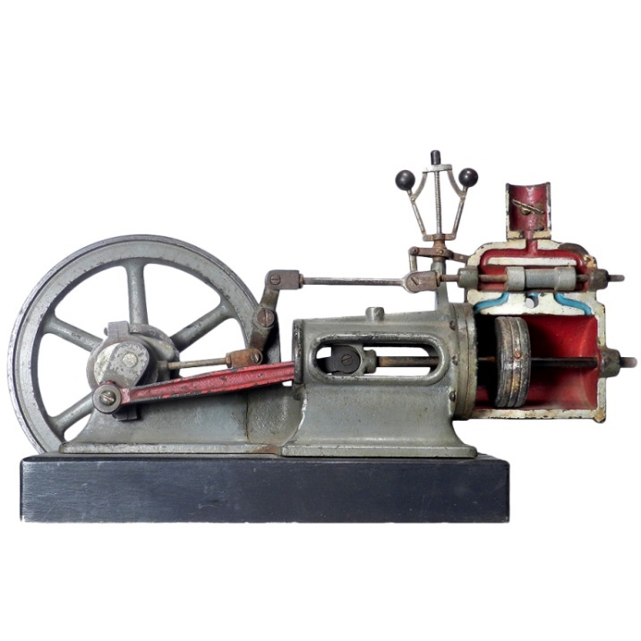
Steam Engine, One of Many Designs . . .
Acknowledgment to Bill Gates Letter to Grantees

Slide 6
Disruptive Innovation (DI)
Disruptive innovators target their service or product at the needs of a new group of customers.
DI uses enabling technologies
DI leads to a new business model (over time)
Mark E. Raynor and Clayton M. Christensen, The Innovator’s Solution, Harvard Business School Press, 2003.

Slide 7
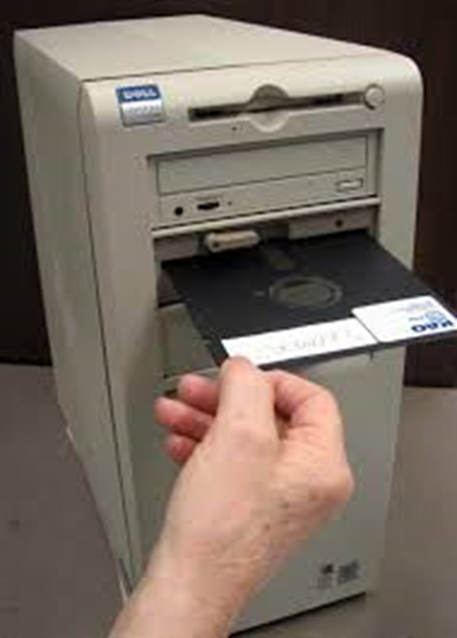
Once Upon A Time . . .
…every college had a print shop with a powerful overlord. Only “officially approved” materials could be printed. The rules were clear – and spelled out in detail in a set of 3-ring binders – “The Print and Publications Policies”.
Then one day. . .

Slide 8
Hybrid Model of Institutional Research
Includes:
Office of Institutional Research (IR)
&
Function of institutional research (i.r.)

Slide 9
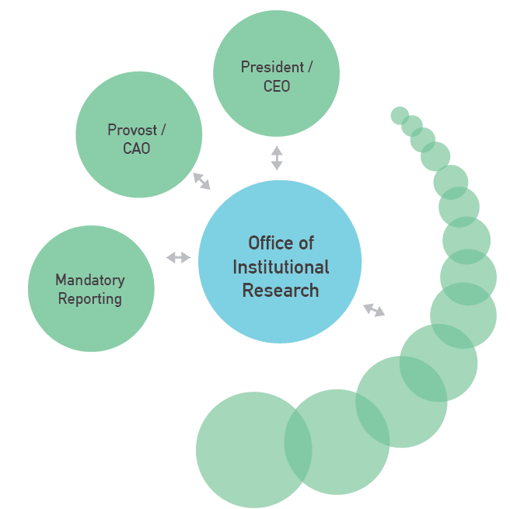
IR Office - Centralize Gateway to Data Resources
One Source
of the
Truth

Slide 10
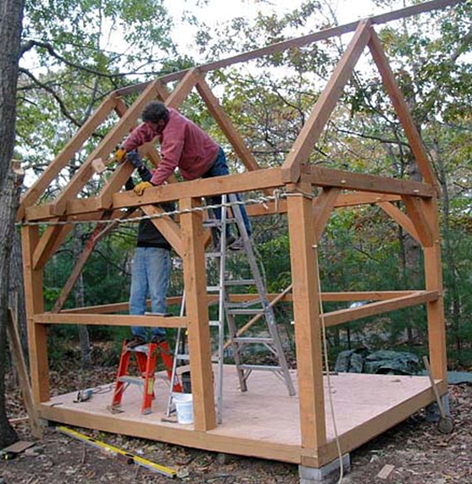
IR Shop
Talented Craftspeople
Based on Precision
Limited Production
Hand Made Quality

Slide 11
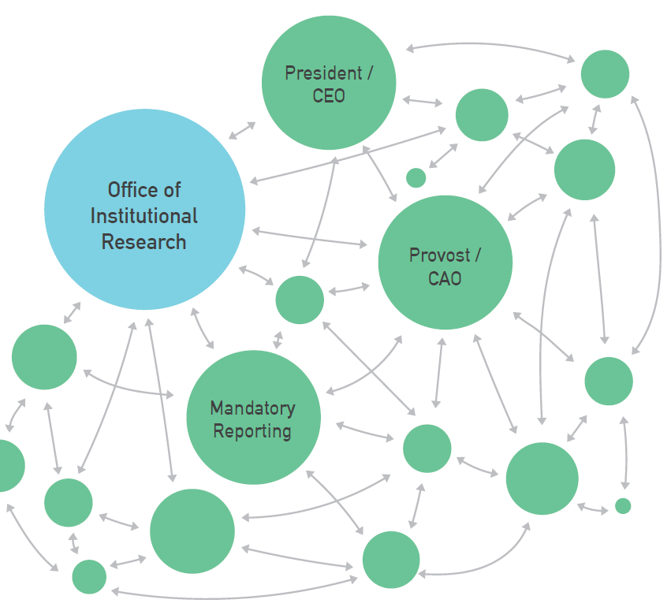
Networked Institutional Research Function
Informed and Shared Discovery of Truths

Slide 12
Many
hands
make
light
work.

Slide 13
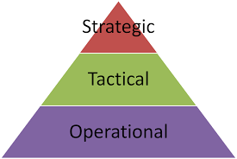
Grassroots & Top/Down Data Use
Strategic – Where are we going?
Tactical- What are we doing to get where we’re going?
Operational – How are we doing it today?

Slide 14
Decision Makers at Every Level
Department Chairs
Faculty
Advisors
STUDENTS

Slide 15
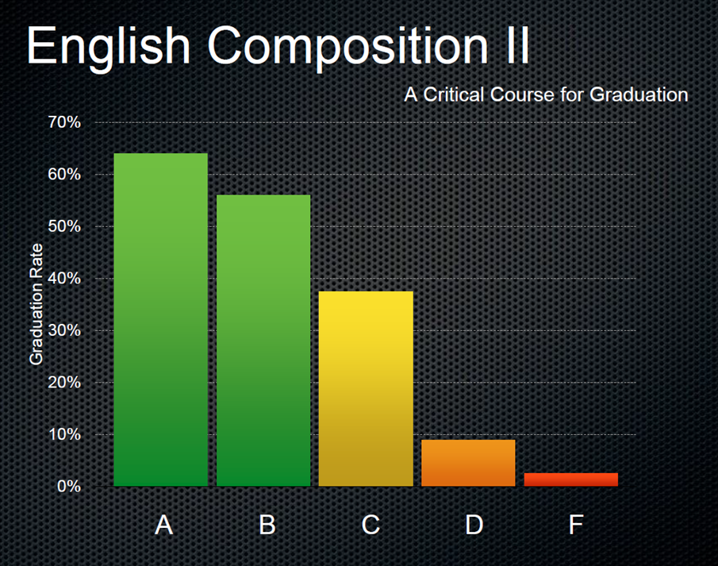
Decision Support: Gateway Courses
Source: Tristan Denley, Tennessee Board of Regents

Slide 16
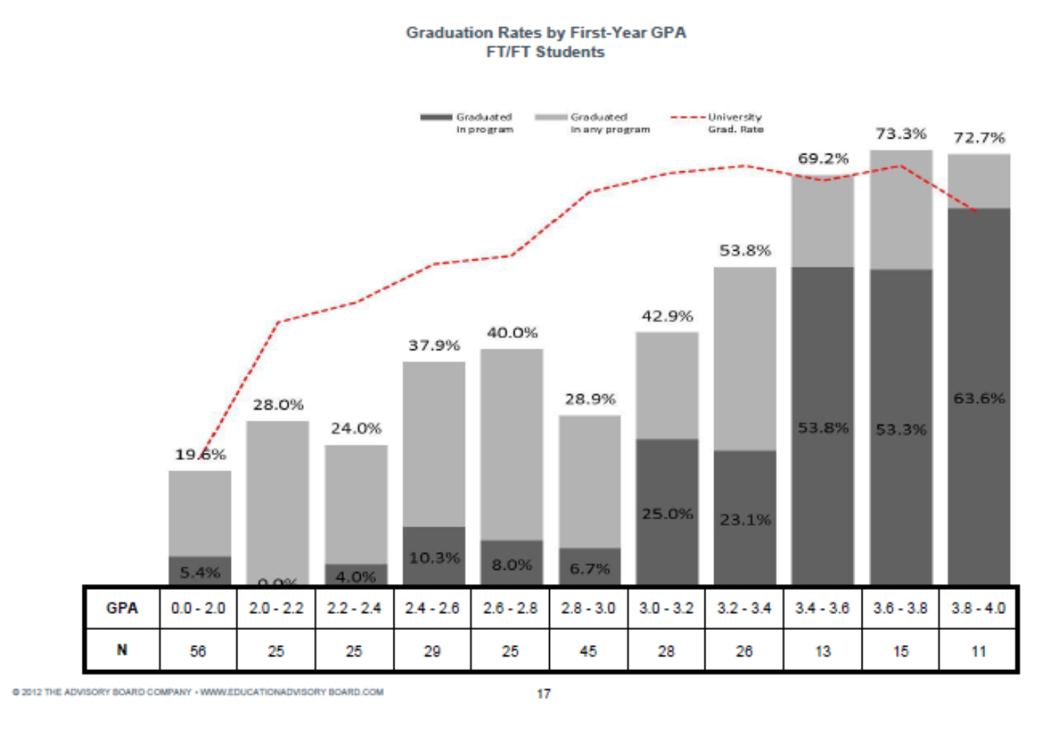
Decision Support Example: Nursing
Degree Attainment by First-Year GPA
source: Georgia Southern University

Slide 17
Decision Support: Intentional Student Support
Predictive Analytics
in Advising and
Schedule Planning
Source: Tristan Denley, Tennessee Board of Regents

Slide 18
Professional Development to Build IR Capacity Data skills in ALL job descriptions
Just as office computing skills are ubiquitous…
Explicit about data literacy
Codify in job descriptions and performance reviews
Professional Development Workshops
Coaching and Consulting

Slide 19
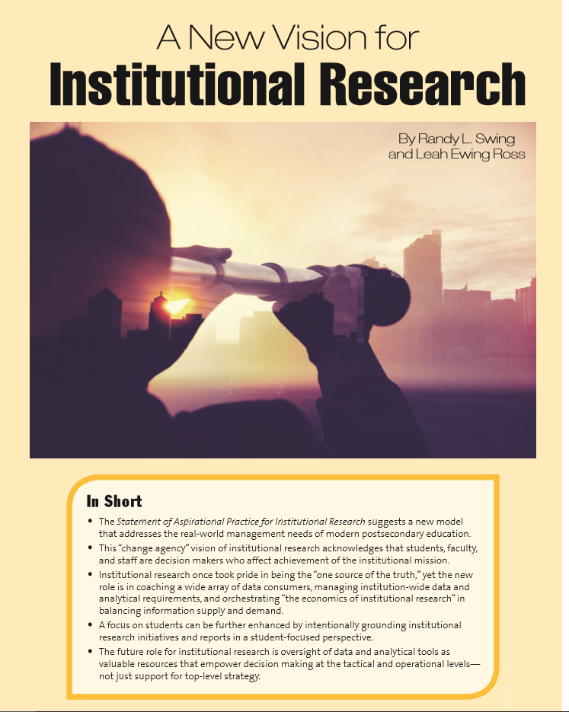
Resources: Building a Data Strategy for Student Success
Data used broadly by decision makers…
administrators, front-line staff and administrators
https://www.airweb.org/Resources/IRStudies/Pages/A-New-Vision-for-Institutional-Research.aspx

Slide 20
Change Management:
No more Pilot Programs…
We don’t have a knowledge problem,
we have a “will” problem.

Slide 21
Change Management: Focused Treatments
No more Mandatory One-size-fits-all Interventions.
Targeted and Intentional
“Right intervention, at the right time, for the right students…”

Slide 22
Data don’t speak for themselves!
And they never talk to strangers. . .
Randy L. Swing, Ph.D.
swingrl@outlook.com
(850) 264-7846 (Eastern Time Zone)

