Slide 1
MISSOURI CC’s
VS
USA
Lou Guthrie
Director
National Higher Education Benchmarking Institute

Slide 2
Session Agenda
What’s new in 2017
The Missouri Report
Missouri Student Success compared to USA
Persistence & Other Measures
Missouri Social Mobility Data
Building a Custom Report

Slide 3
2017
242 Institutions
13 Missouri Colleges
New for 2017
Financial Metrics
Social Mobility
Percent Change Report
Non-Credit Module
Submitted Values
Show me the data!

Slide 4
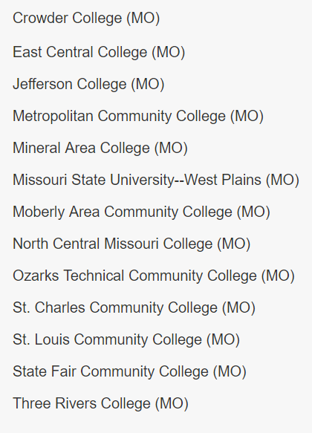
Missouri:
Non-Credit Module

Slide 5
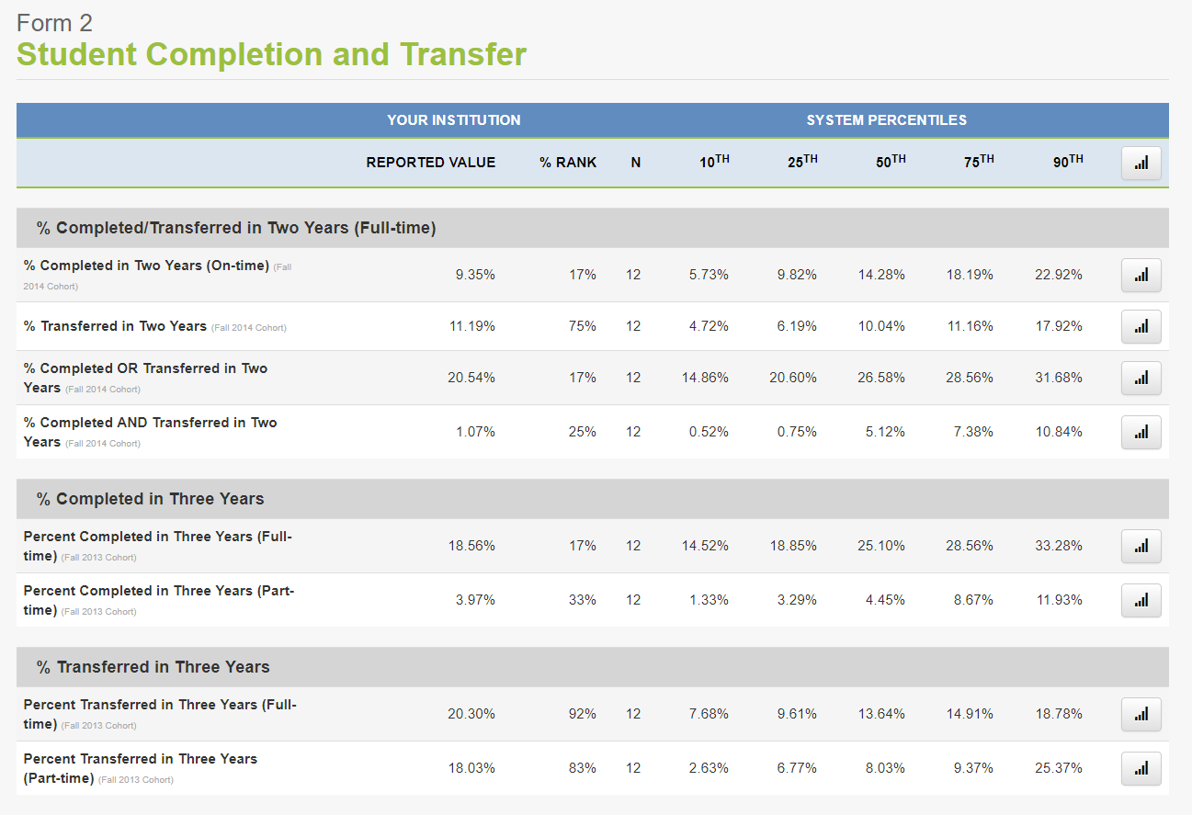
Missouri
Report
Your college compared to the other Missouri institutions.

Slide 6
How Does Missouri Compare to the US?
Completions & Transfers:
Full-Time,
First-Time, Degree Seeking

Slide 7
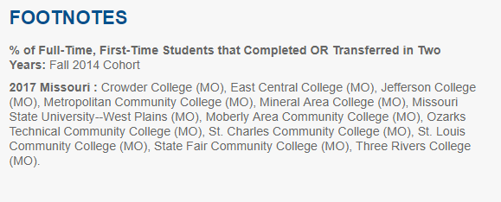
National 66th Percentile: 29.21%
National Median: 24.95%

Slide 8
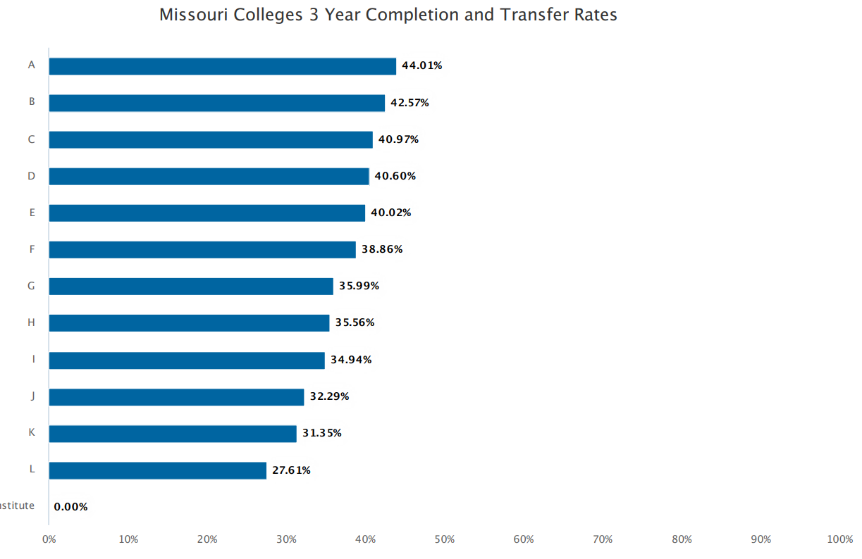
National 66th Percentile: 43.91%
National Median: 39.29%

Slide 9
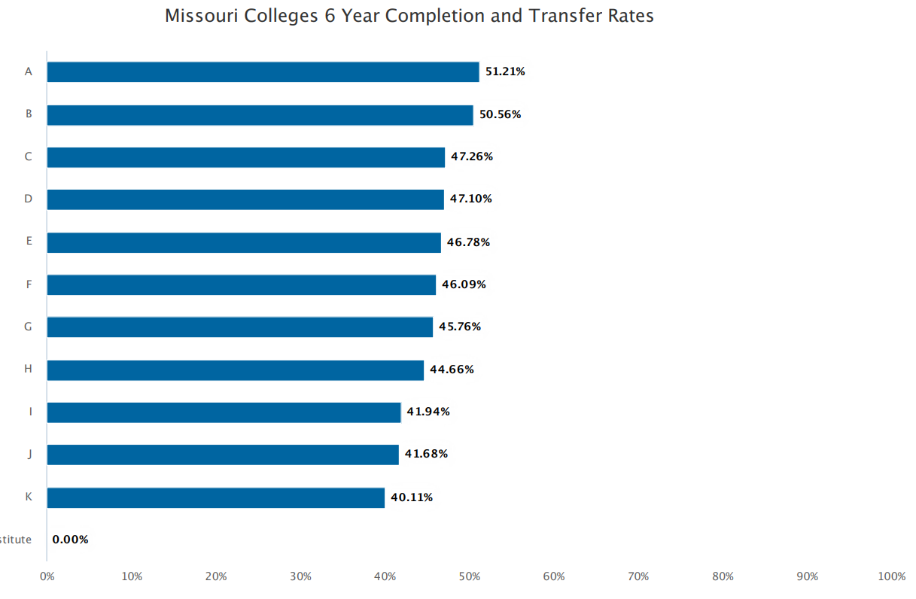
National 66th Percentile: 52.43%
National Median: 47.07%

Slide 10
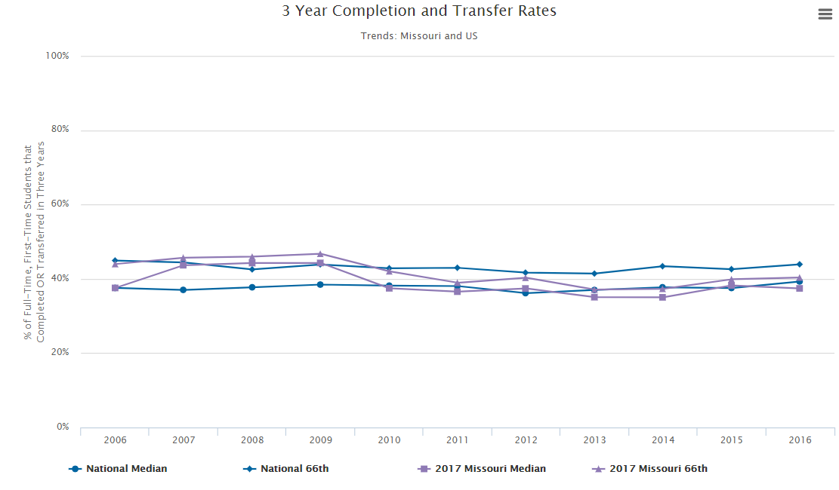

Slide 11
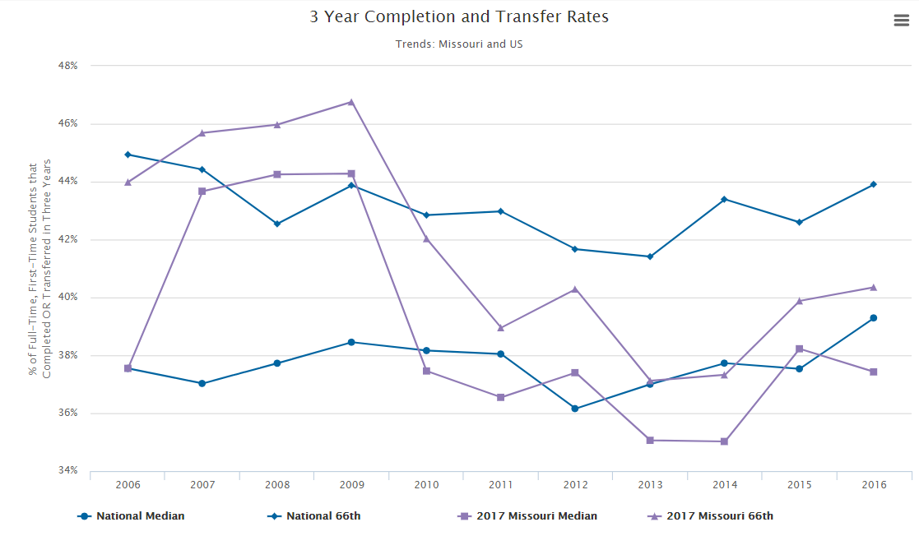

Slide 12
How Does Missouri Compare to the US?
Completions &
Transfers:
Part-Time,
First-Time, Degree Seeking

Slide 13
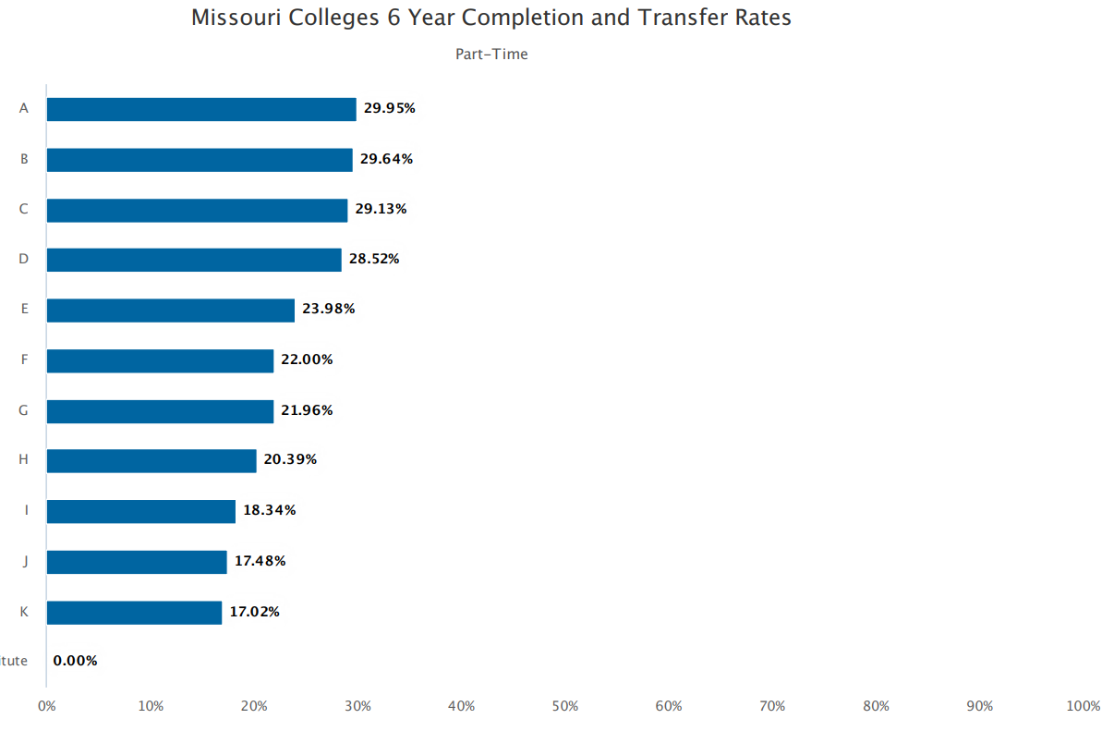
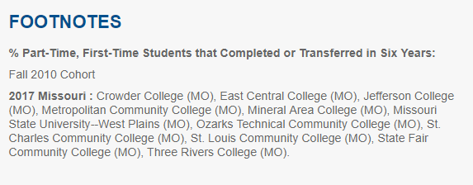
National 66th Percentile: 33.51%
National Median: 29.29%

Slide 14
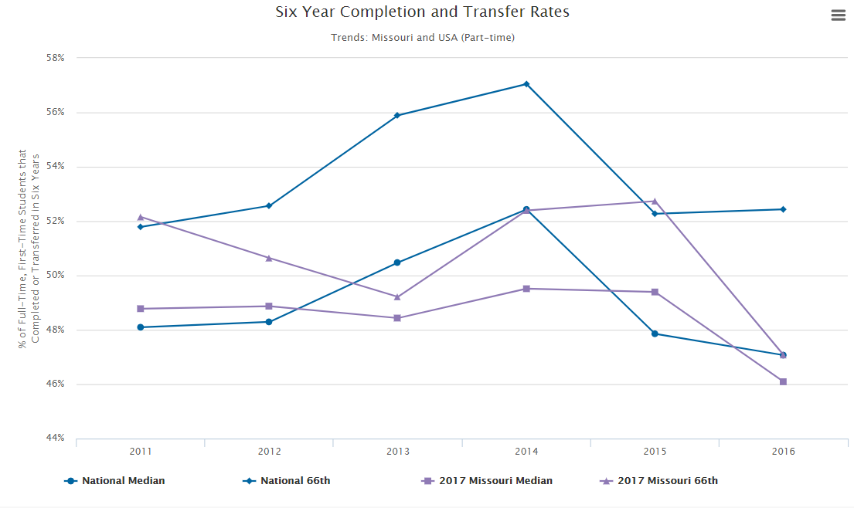

Slide 15
How Does Missouri Compare to the US?
Persistence

Slide 16
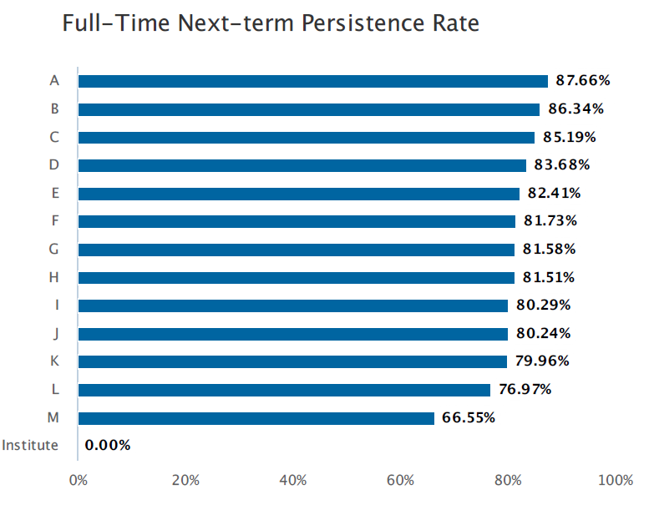
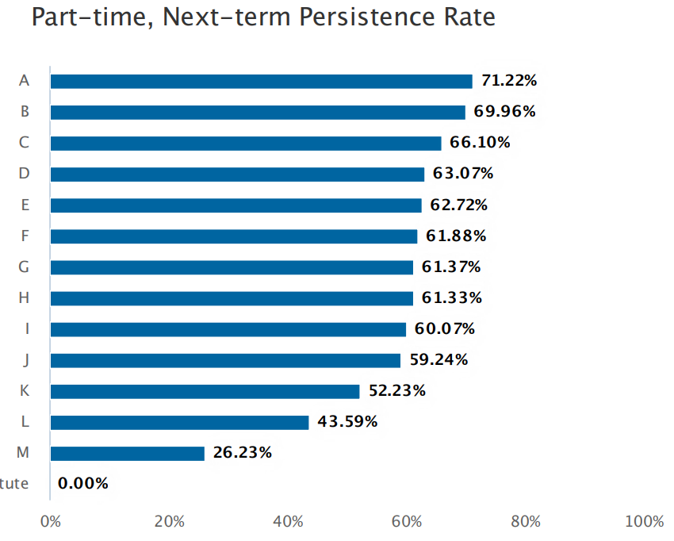
83.88%
65.10%
82.11%
62.70%

Slide 17
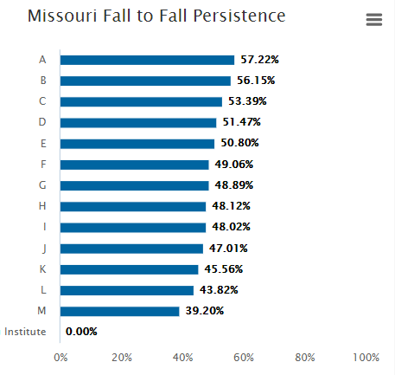
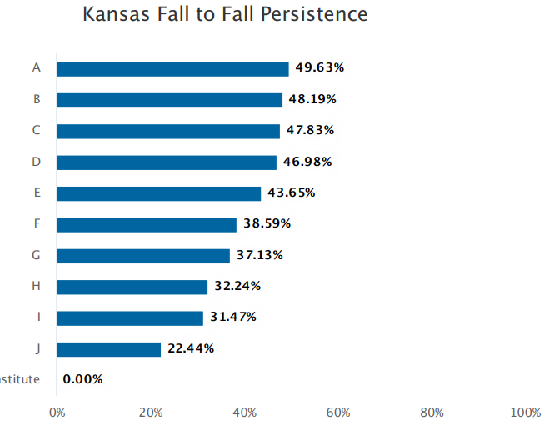
48.40%
50.43%
48.40%

Slide 18
How Does Missouri Compare to the US?
Other Measures for Missouri Performance Funding

Slide 19
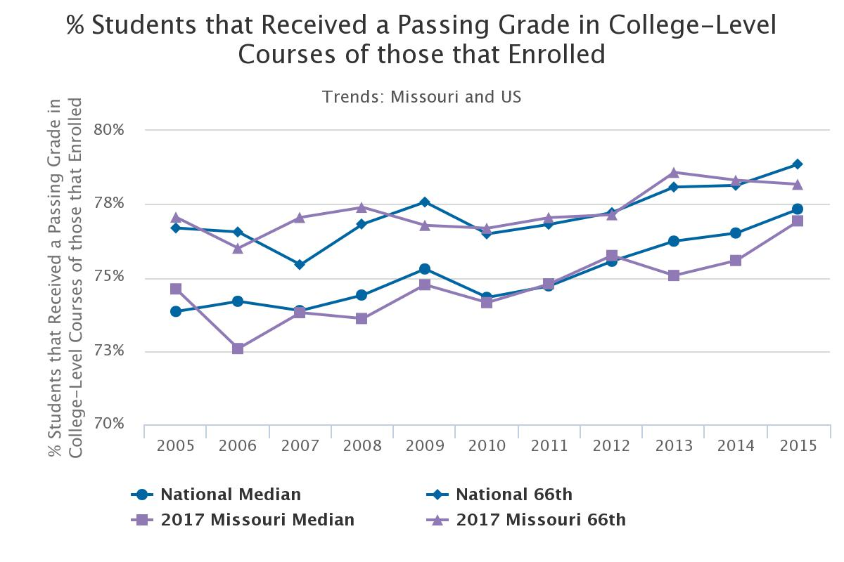

Slide 20
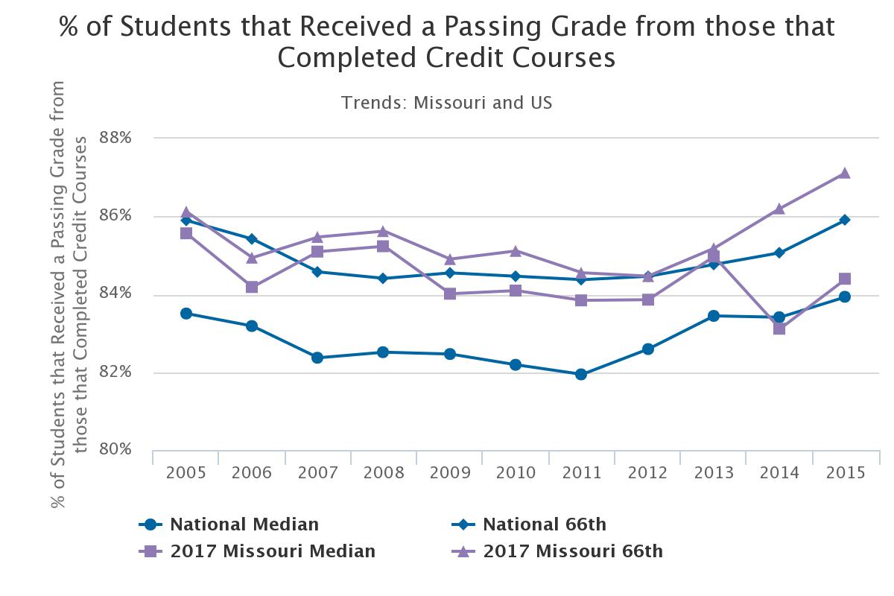

Slide 21
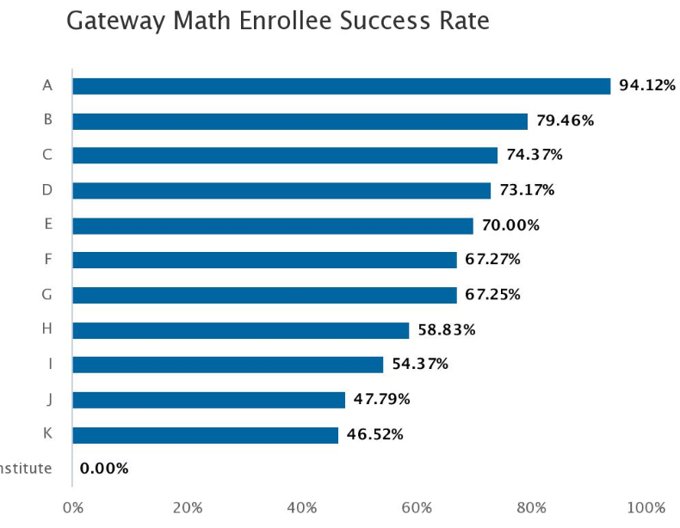
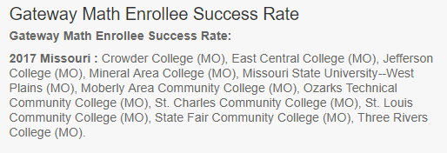
National Median: 66.72%

Slide 22
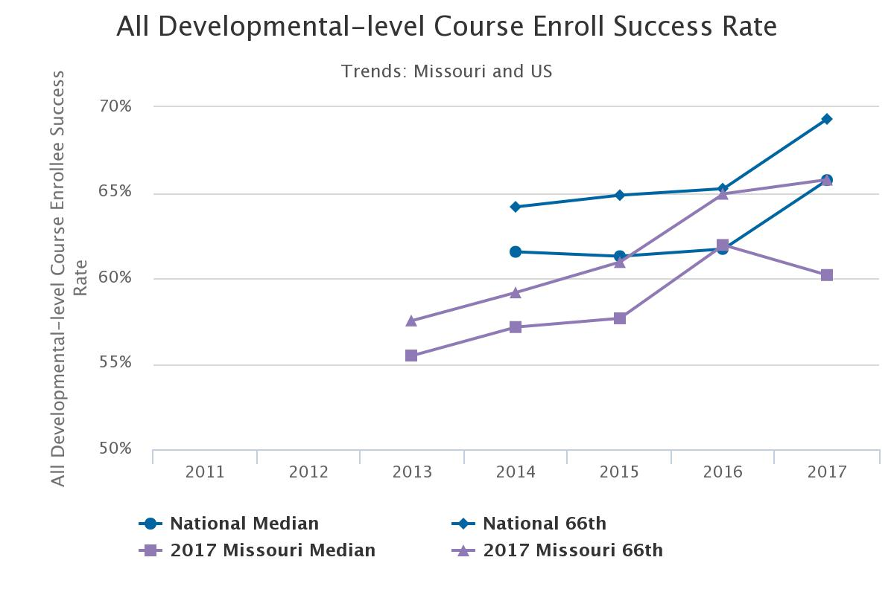

Slide 23
Missouri
Social Mobility Data

Slide 24
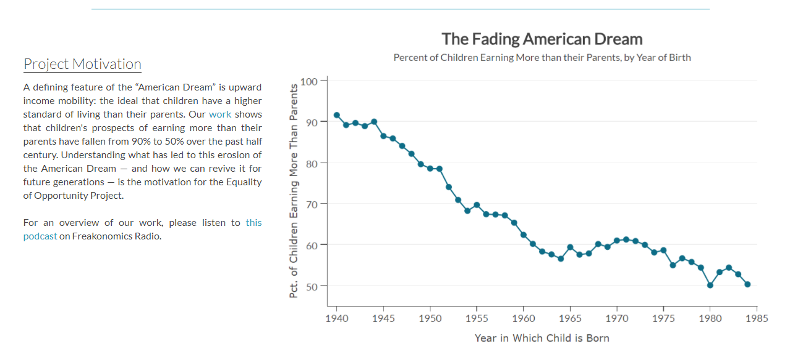
http://www.equality-of-opportunity.org/

Slide 25
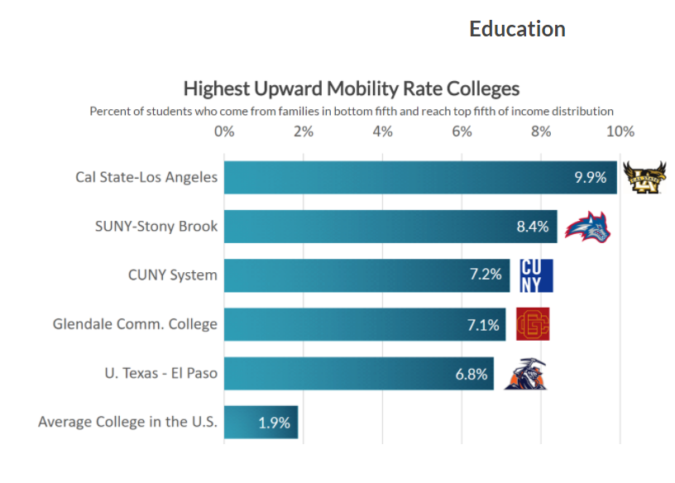

Slide 26
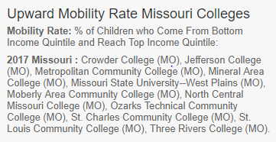
% of students who come from families in the bottom fifth and reach top fifth of income distribution.
National 75th%: 1.70%

Slide 27
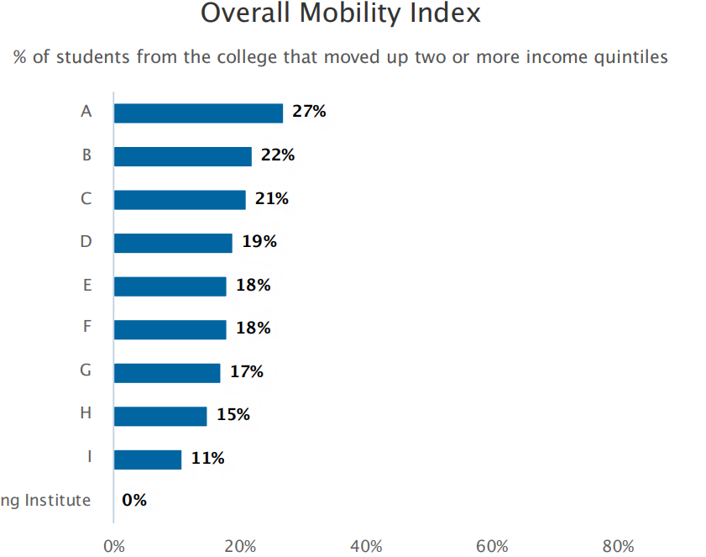
National 90th%: 24%
National 75th%: 20%
National Median: 18%

Slide 28
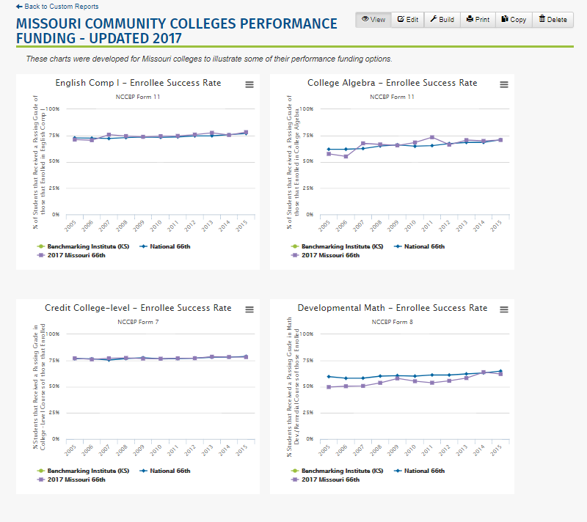
Custom Reports:
Sign in to NCCBP
Go to Reports menu
Drop down and click on Custom Reports
I have copied two custom reports to all Missouri colleges

Slide 29
Conclusions

Slide 30
Lou Guthrie
913-469-8500, ext. 4019
louguthrie@jccc.edu

