Slide 1
Measuring the Success of your Continuing Education Programs
MidAIR
Michelle Taylor| Senior Research Analyst
National Higher Education Benchmarking Institute

Slide 2
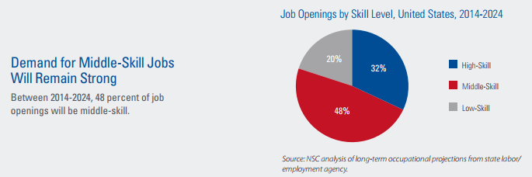
Current Issues for Continuing Education
National Skills Coalition

Slide 3
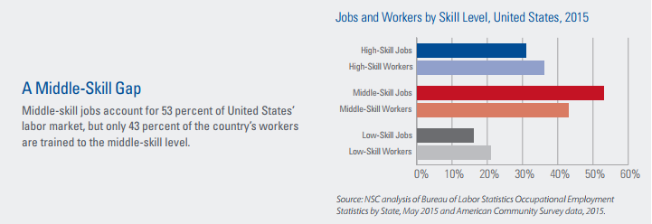
Current Issues for Continuing Education
National Skills Coalition

Slide 4
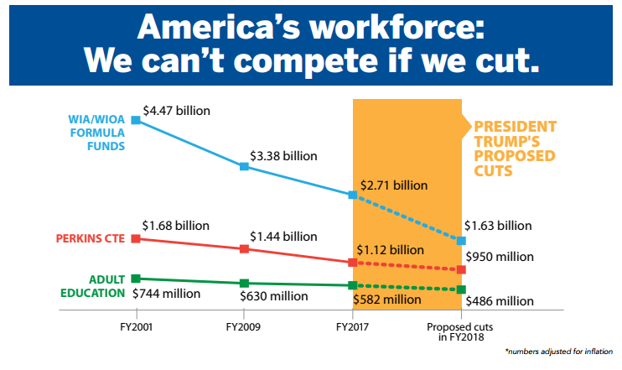
Current Issues for Continuing Education
National Skills Coalition

Slide 5
Why Benchmark Continuing Education?
Little to No national norms or KPIs in Continuing Education
Continuing education programs can not demonstrate their effectiveness vis-à-vis other continuing education programs
Continuing education has no “benchmarks” to use for strategic planning and decision-making

Slide 6
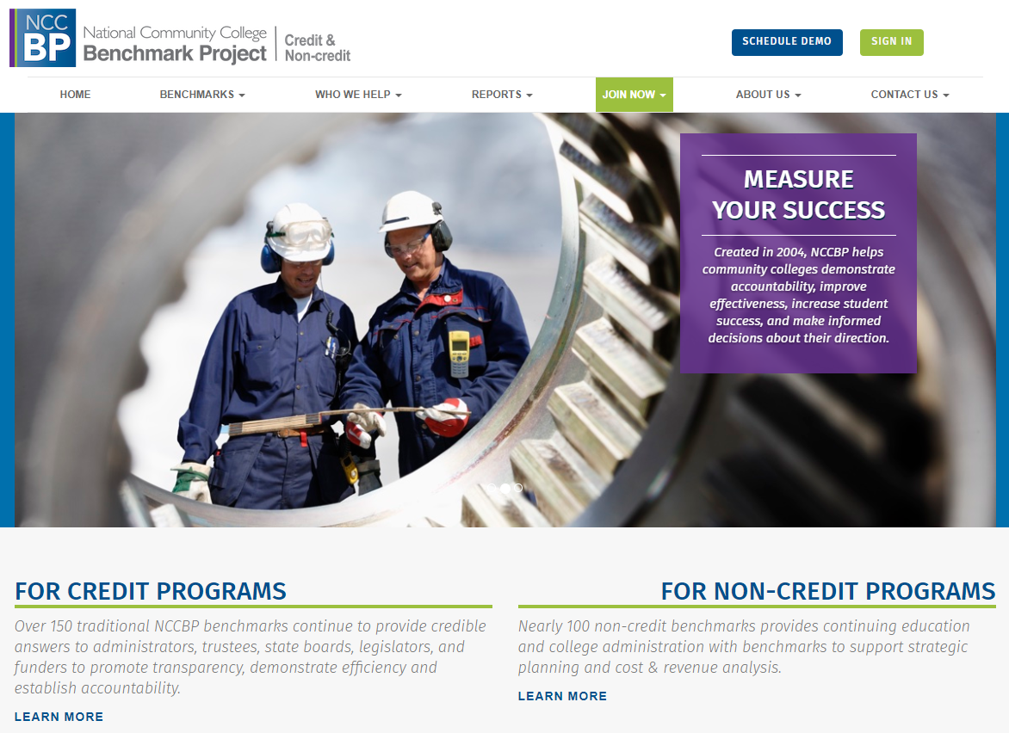

Slide 7
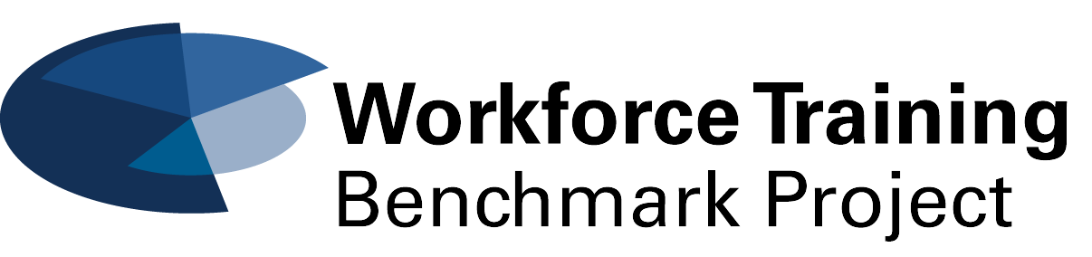
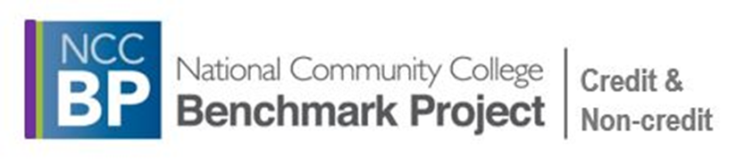
History of the Non-Credit Benchmark Project
Created in 2012-2013
Advisory board of over 20 community colleges across the country
Piloted in 2013
Data collection begin in 2014
Evolved and grew each year 2014-2016
Merged with the NCCBP: credit in 2017 as an separate opt-in module
Notes:
Mission: Improving higher education through benchmarking.
Vision: Impacting higher education to maximize student success.
In this case we are using data from the NCCBP. You could find this data from IPEDS or from your
.

Slide 8
Goals of the NCCBP: Non-credit Project
To collect standardized information from community college continuing education divisions
To provide member institutions with consistent measures to express continuing education productivity and successes to internal & external stakeholders
To provide “data” you can use to improve your programs
Notes:
The data can show you where you are doing really well and where you need to improve.

Slide 9
Benchmark Categories
Student Enrollment
  Workforce Training
  Life & Leisure
  Adult Basic Education
Corporate Client Enrollment/Contract Training
Course Information
  Offered/Cancellation Rate
Retention
Financial Data
Staffing Data
Industry-recognized credentialing
Transition from non-credit to credit instruction
Student Satisfaction
Client Satisfaction

Slide 10
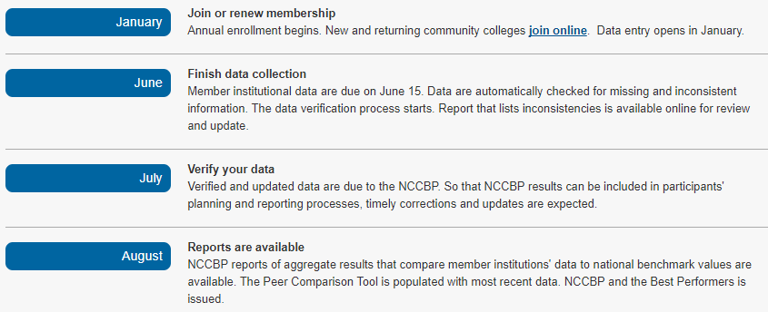
Timeline

Slide 11
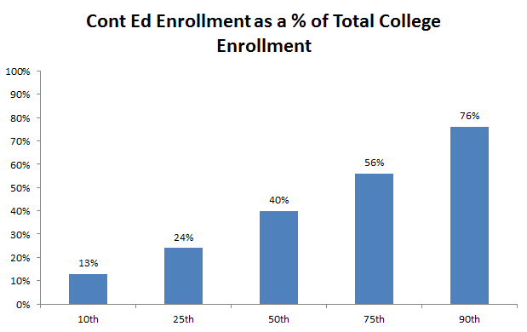
Continuing Education Program Size

Slide 12
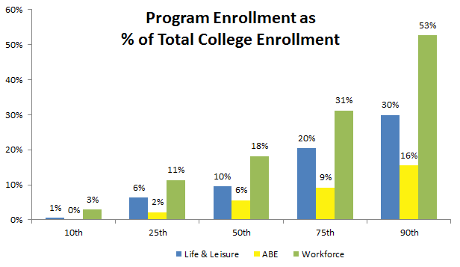
Continuing Education Program Size

Slide 13
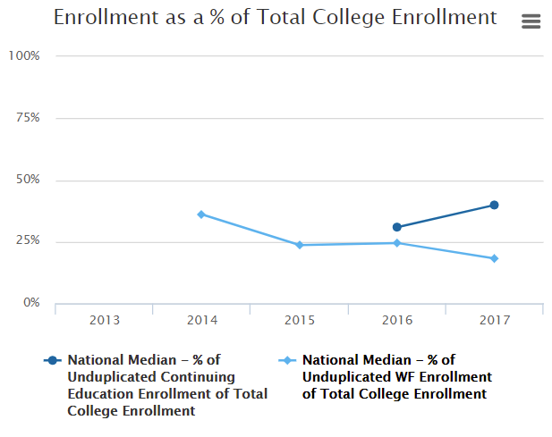
Continuing Education Program Size

Slide 14
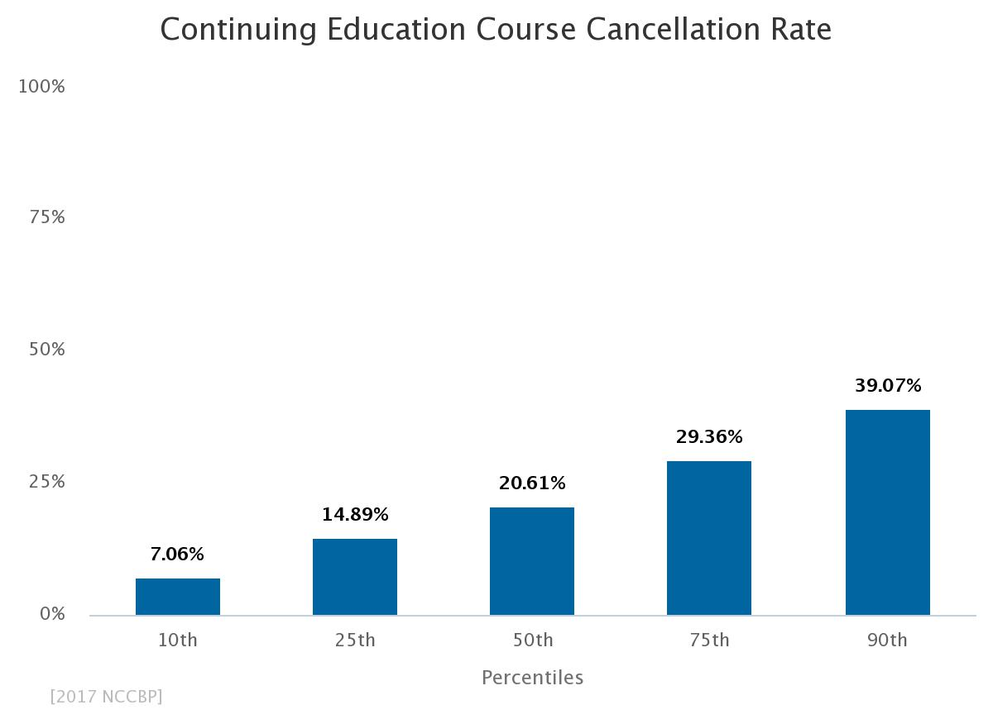
Course Cancellation Rate
Continuing Education

Slide 15
Course Cancellation Rate
By Program

Slide 16
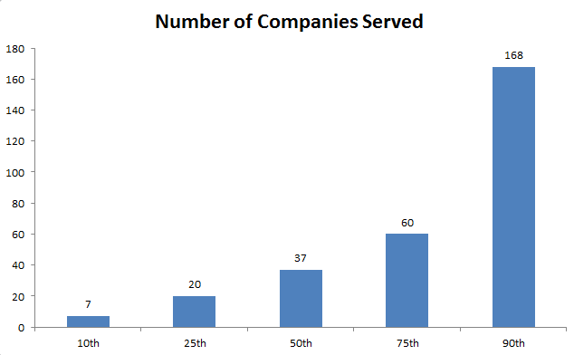
Contract Training

Slide 17
Market Penetration
Contract Training

Slide 18
Retention by Program

Slide 19
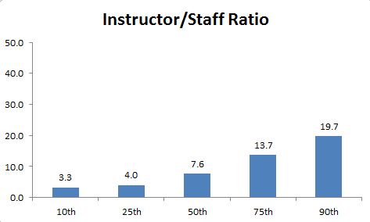
Staffing

Slide 20
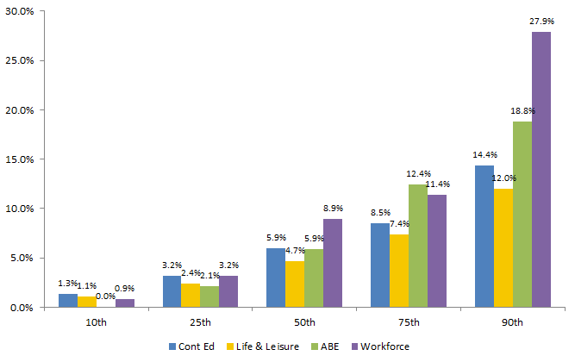
Transition from Non-credit to Credit

Slide 21
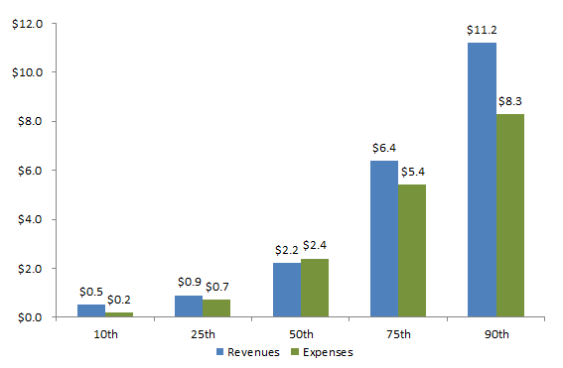
Revenues & Expenses
Continuing Education

Slide 22
Revenue & Expenditures
by Program

Slide 23
Revenue Sources

Slide 24
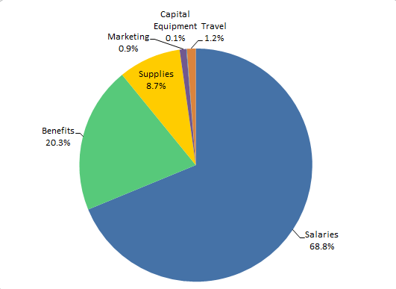
Expenditures by Category

Slide 25
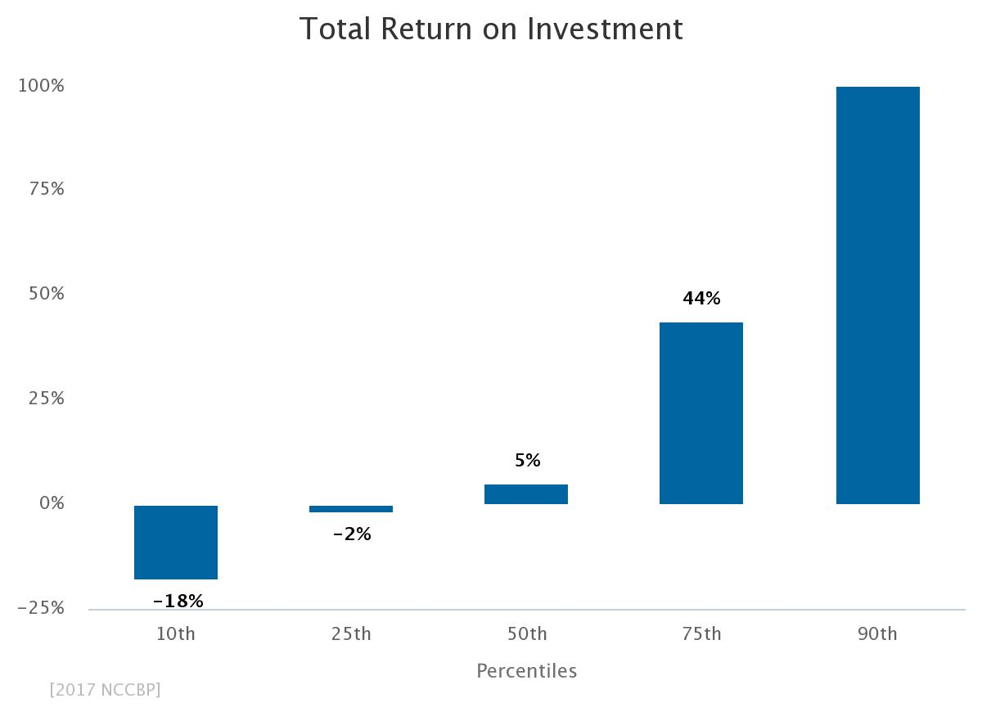
Total Return on Investment
Continuing Education
104%

Slide 26
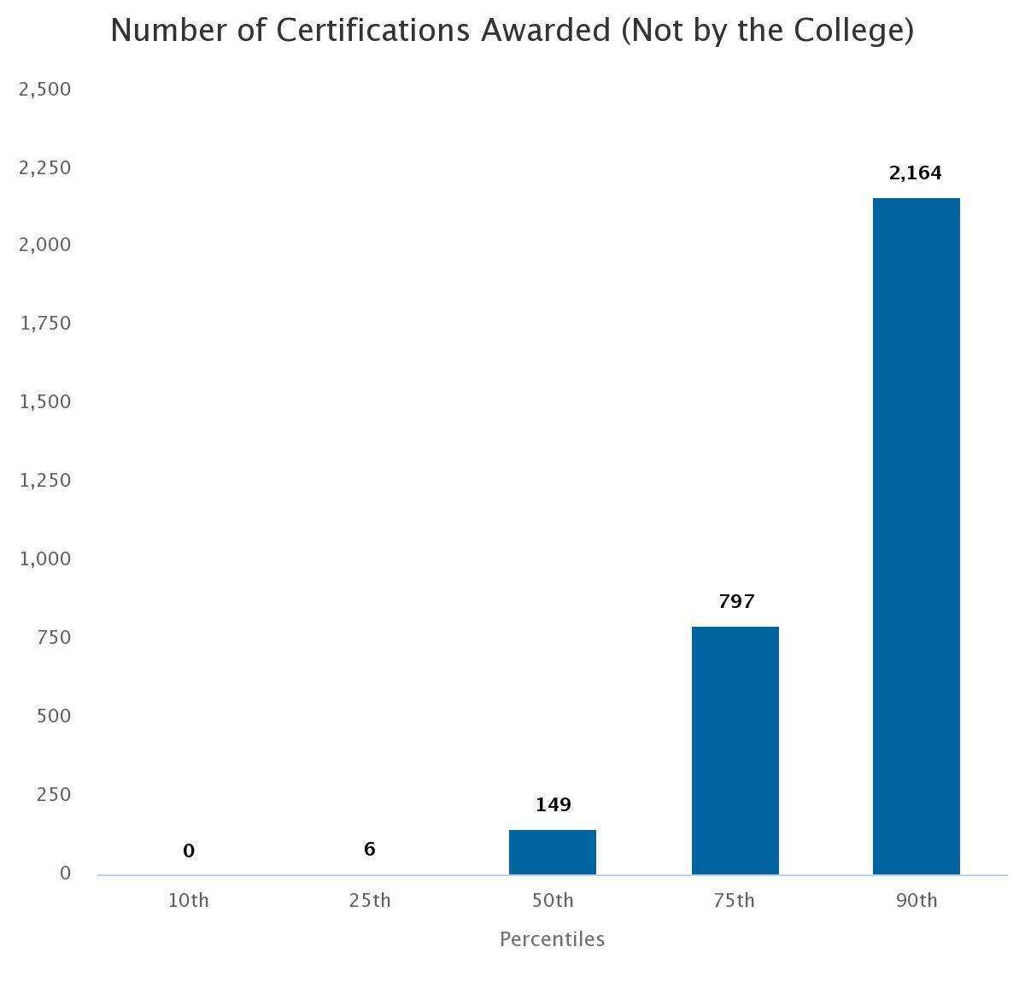
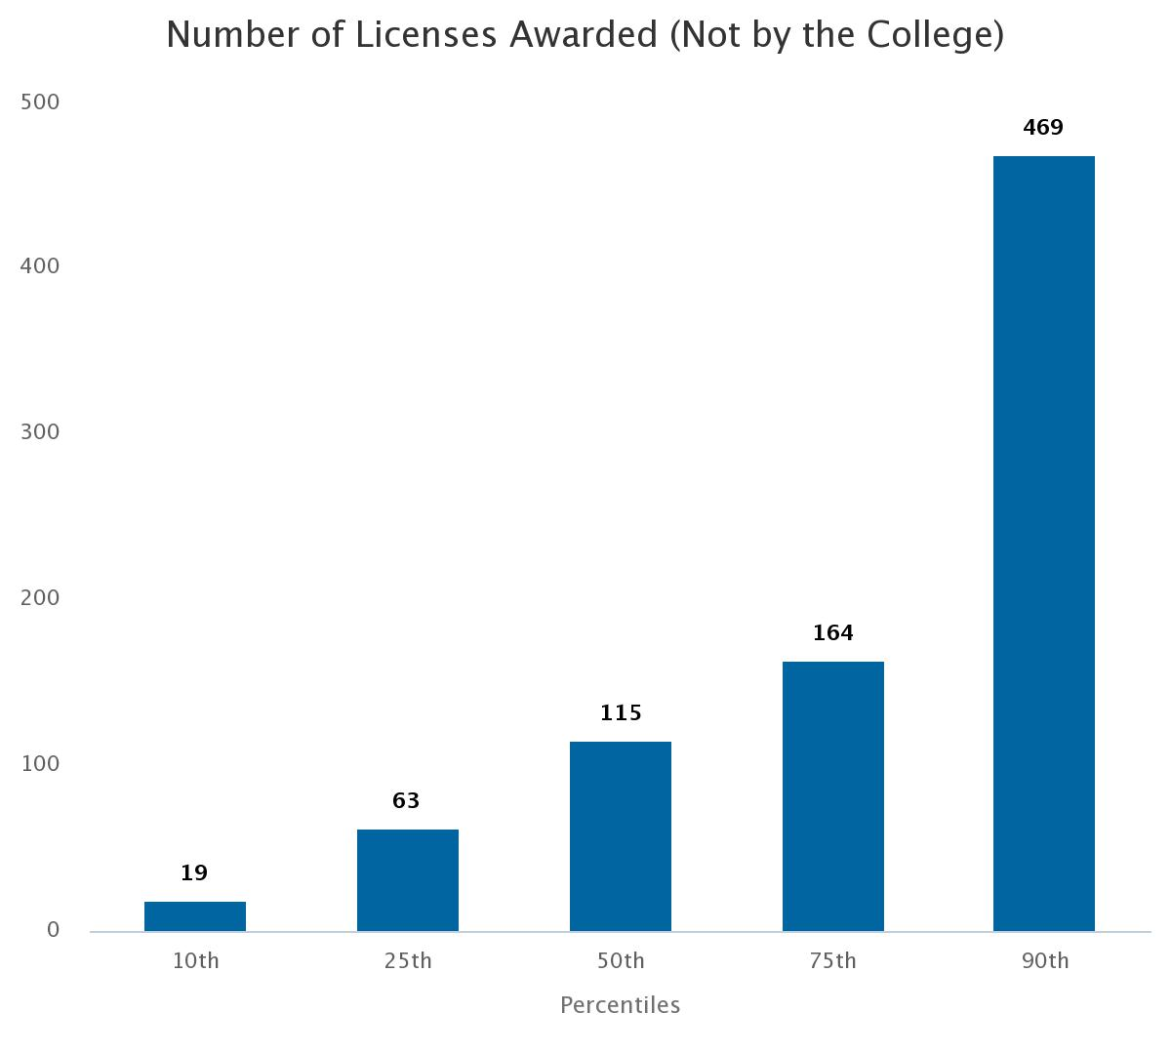
Credentials Awarded

Slide 27
Limited Availability of Credentials Data

Slide 28
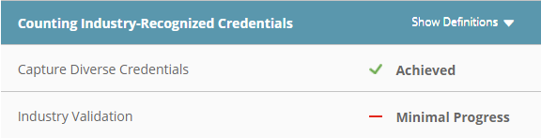
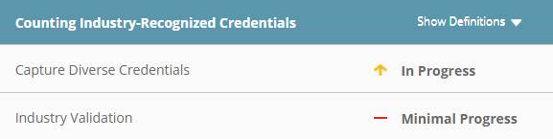
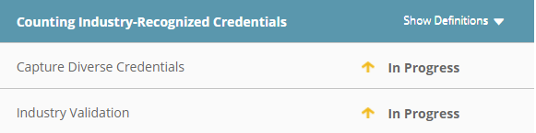
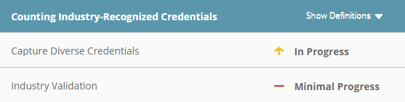
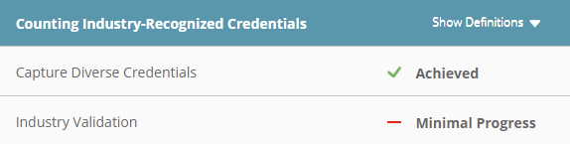
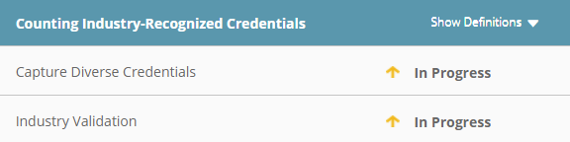


Progress on Counting Credentials
Workforce Data Quality Campaign
Kansas
Iowa
Missouri
Nebraska
Oklahoma
Arkansas

Slide 29
Using Benchmarking for Continuing Ed
Shows you where you need to improve the most
Helps you find good examples or colleges with programs that are contributing to success
Helps you focus on your KPI and mission
Helps set realistic goals
Provides data to use for strategic planning
  Building partnerships

Slide 30
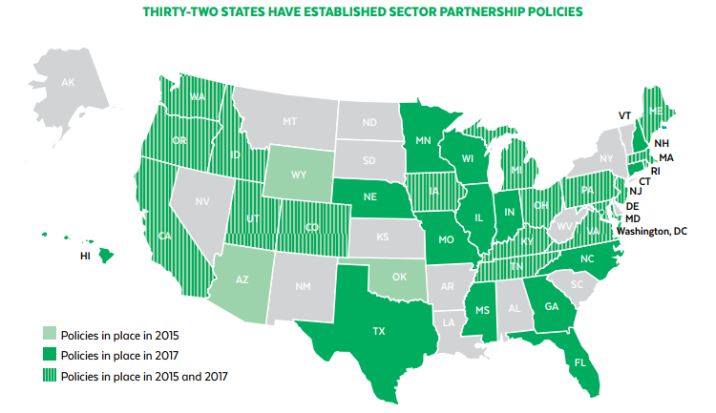
Sector Partnerships by State
National Skills Coalition

Slide 31

Learn More about Benchmarking and
Best Practices
Benchmarkinginstitute.org

Slide 32


Keep up with the Benchmarking Institute and all of our projects by joining us on LinkedIn and following us on Twitter.
@EdBenchmark
Join the National Higher Education Benchmarking Institute Group

Slide 33
Michelle Taylor
Senior Research Analyst | National Higher Education Benchmarking Institute
Johnson County Community College|12345 College Blvd. | Overland Park, KS 66210
Phone: 913-469-8500 Ext. 3831| michelletaylor@jccc.edu
http://www.nccbp.org/
Notes:
Contact Info

