Slide 1
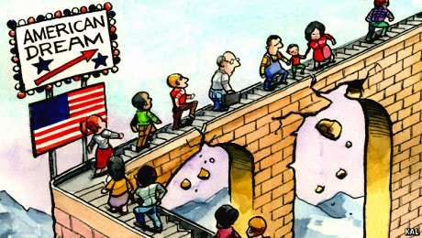
Say Goodbye to the American Dream
Lou Guthrie
Director
National Higher Education Benchmarking Institute

Slide 2
Session Agenda
What is the American Dream
Equality of Opportunity Project
Building a Custom Report

Slide 4
What is the American Dream?
"The American Dream is that dream of a land in which life should be better and richer and fuller for everyone, with opportunity for each according to ability or achievement.“
--James Truslow Adams, Epic of America, 1931
"... a focus on more of what really matters, such as creating a meaningful life, contributing to community and society, valuing nature, and spending time with family and friends.“
--Center for a New American Dream

Slide 5
What is social mobility?

Slide 7
http://www.equality-of-opportunity.org/

Slide 10
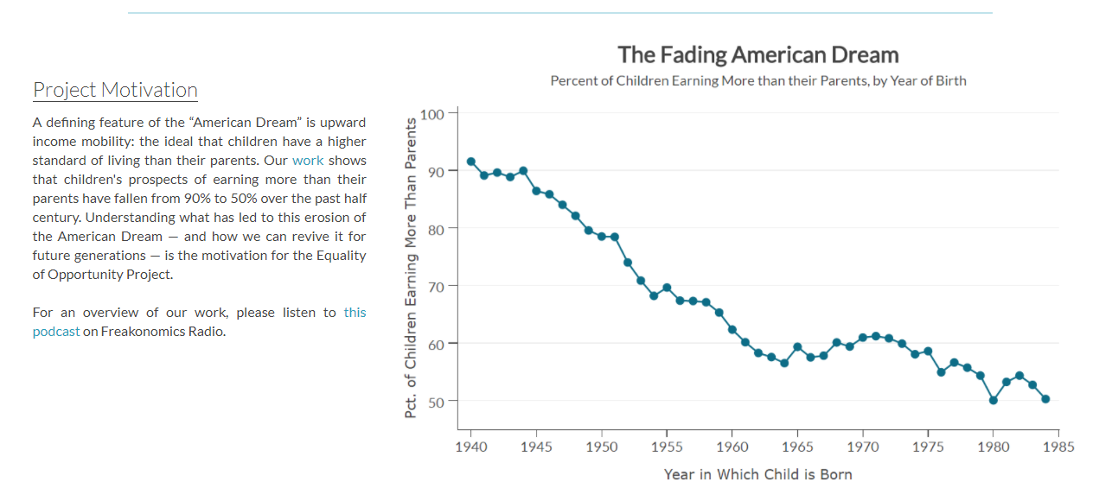
http://www.equality-of-opportunity.org/

Slide 11
Household Income Quintiles

Slide 12
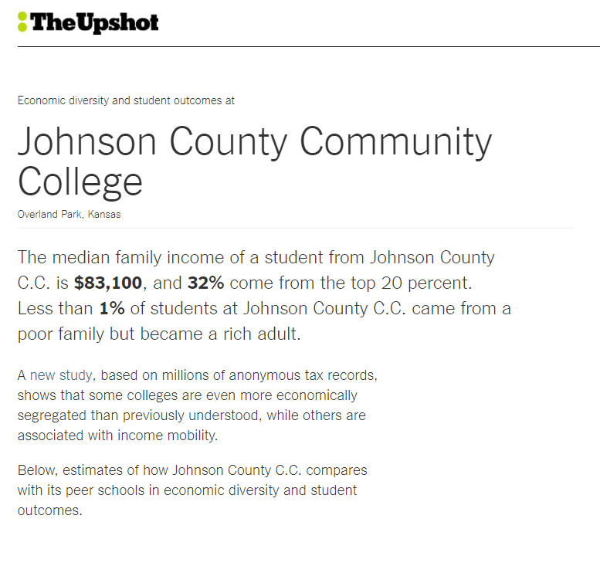
https://www.nytimes.com/interactive/projects/college-mobility/

Slide 13
Social Mobility and the NCCBP

Slide 14
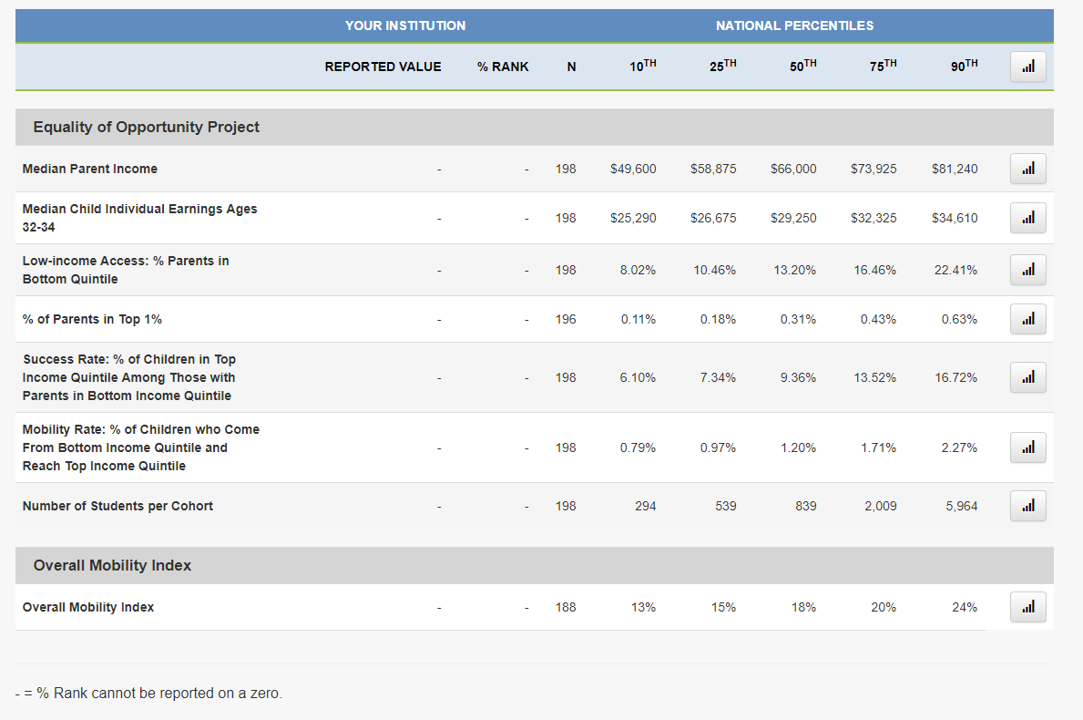

Slide 15
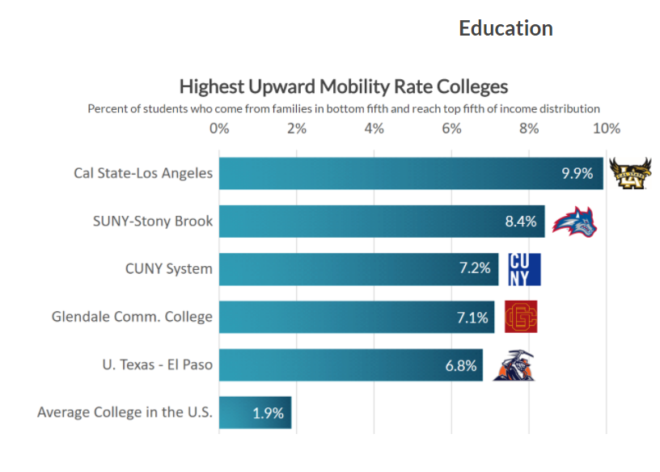

Slide 16
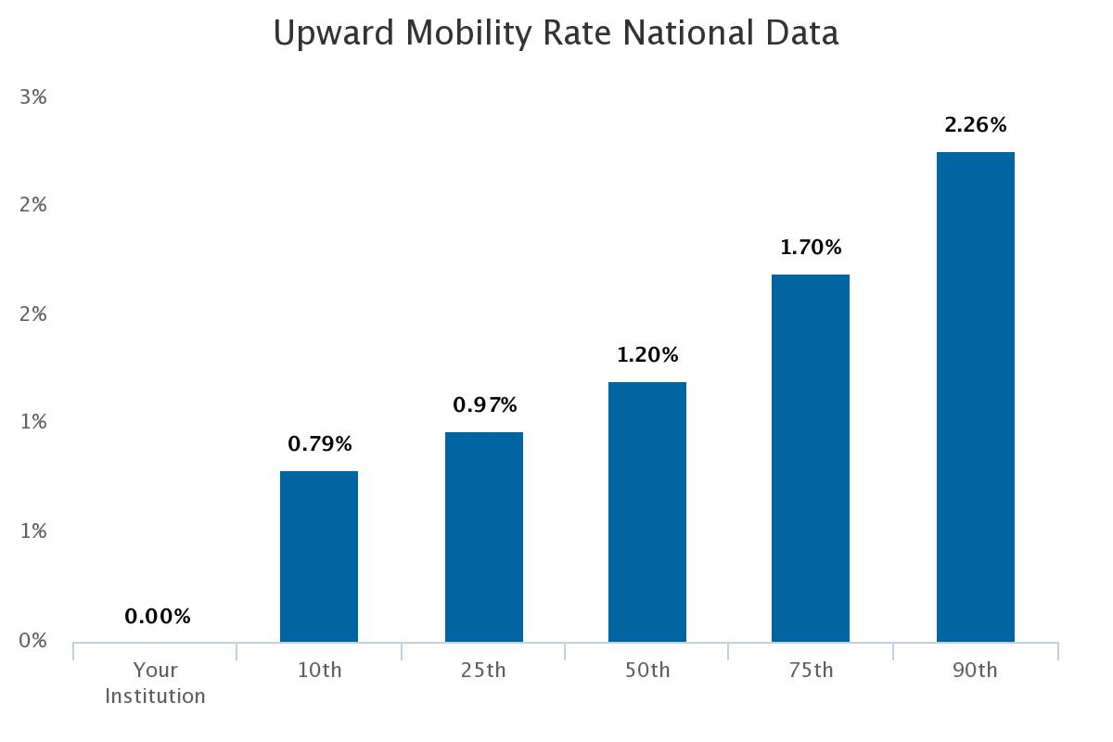

Slide 17
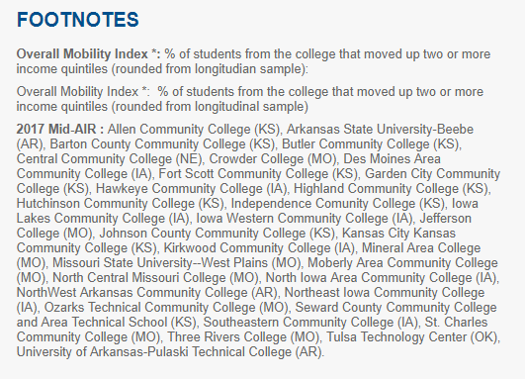

Slide 18
% of students who come from families in the bottom fifth and reach top fifth of income distribution.

Slide 19
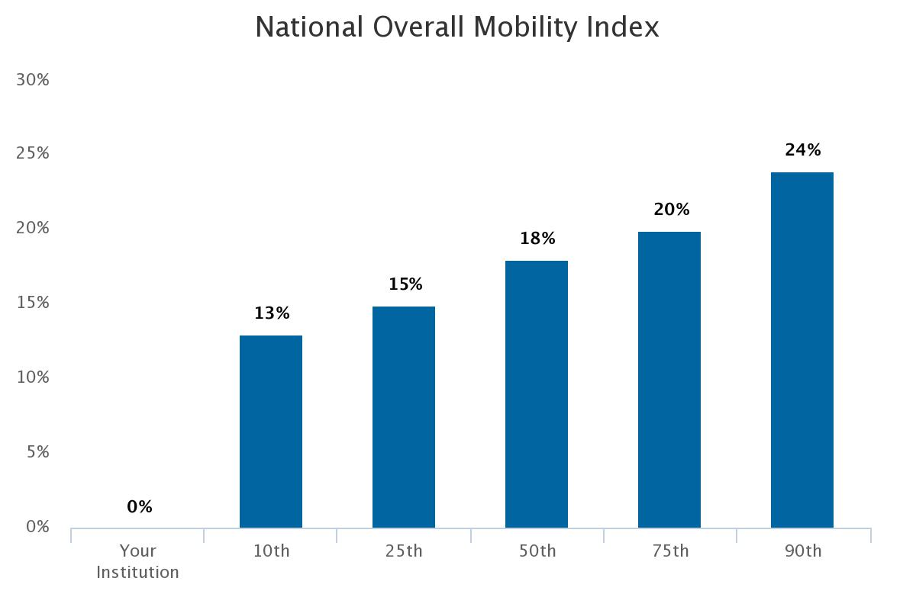

Slide 20
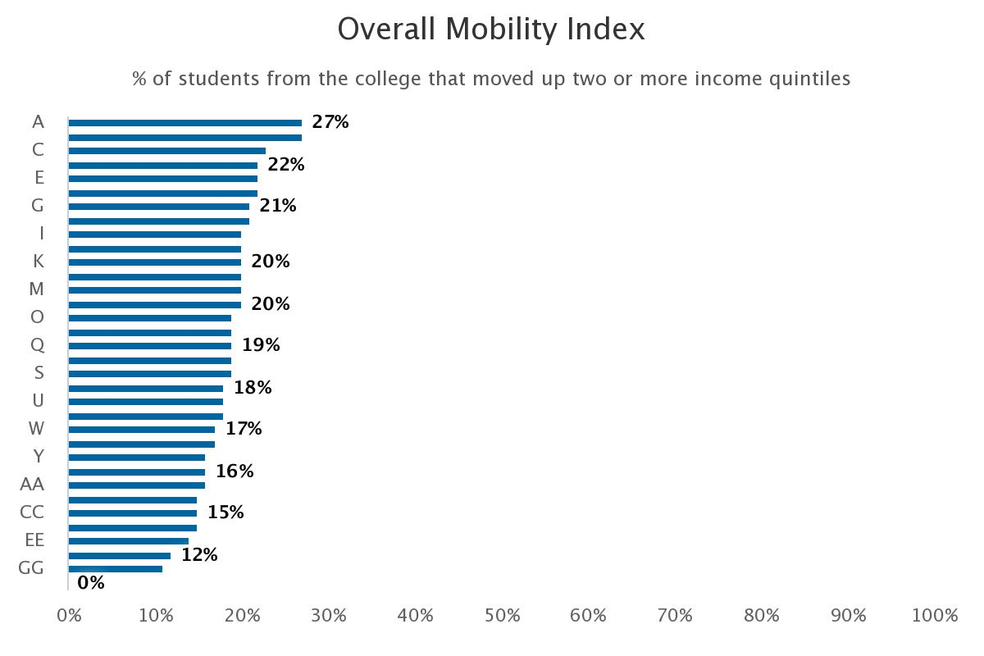
MidAIR Peer Group
National 90th%: 24%
National 75th%: 20%
National Median: 18%

Slide 21
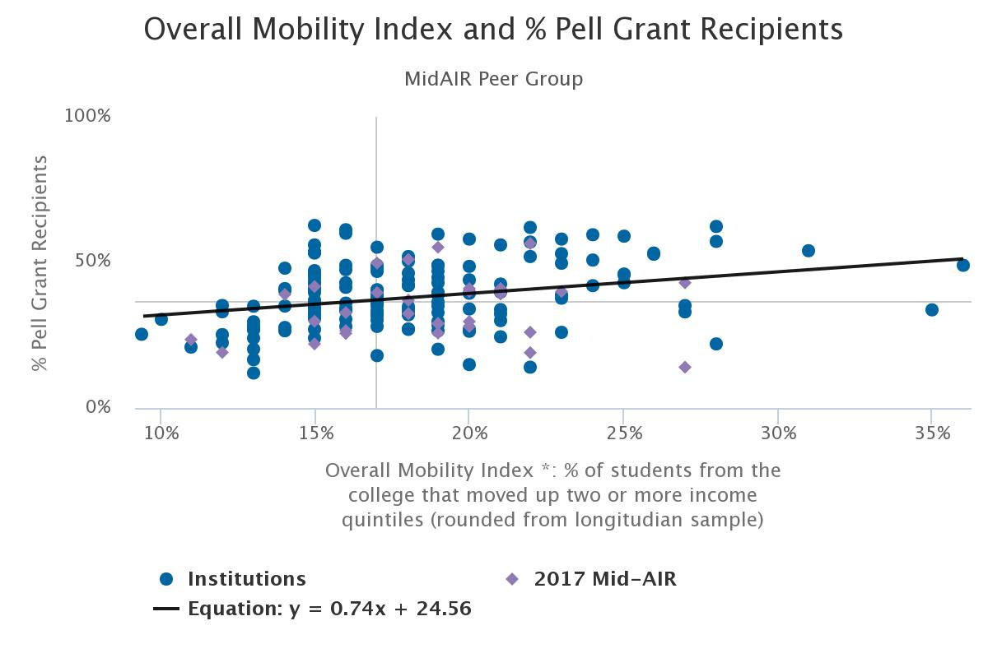

Slide 22
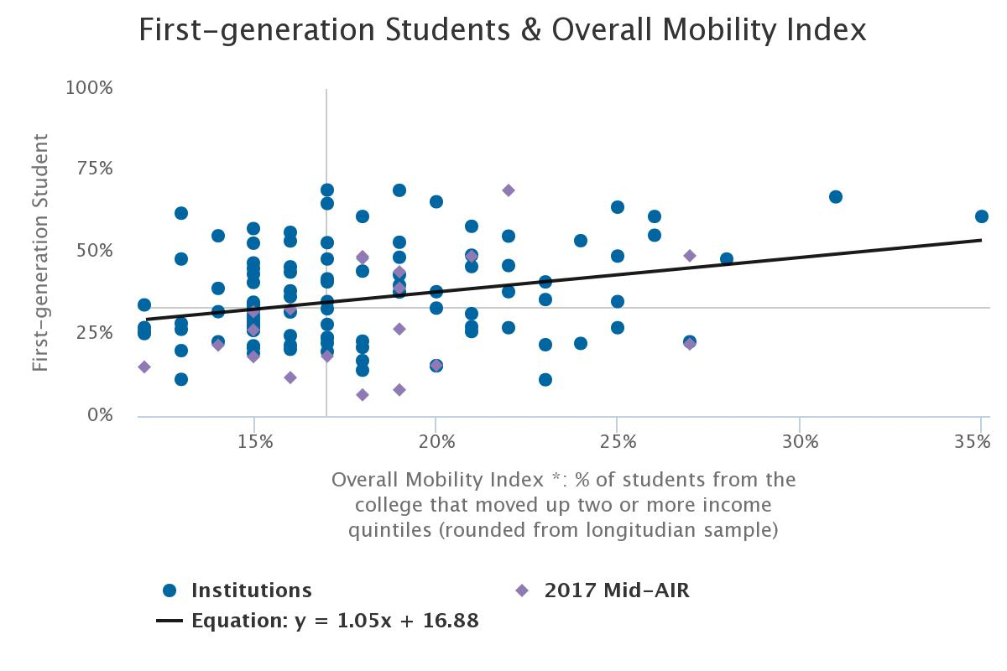

Slide 23
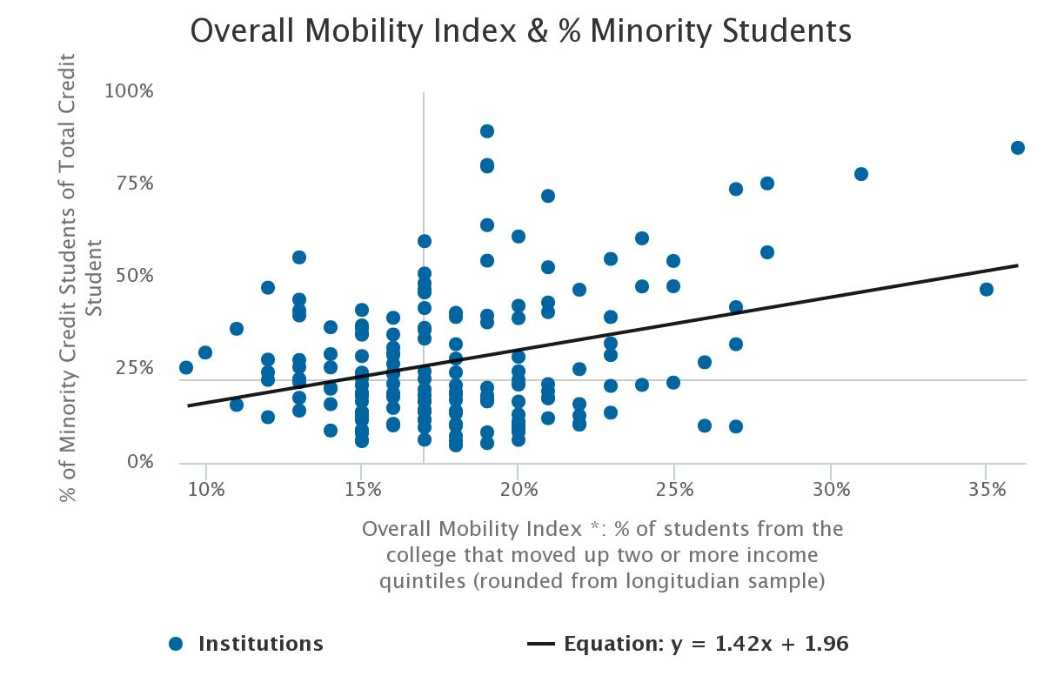

Slide 24
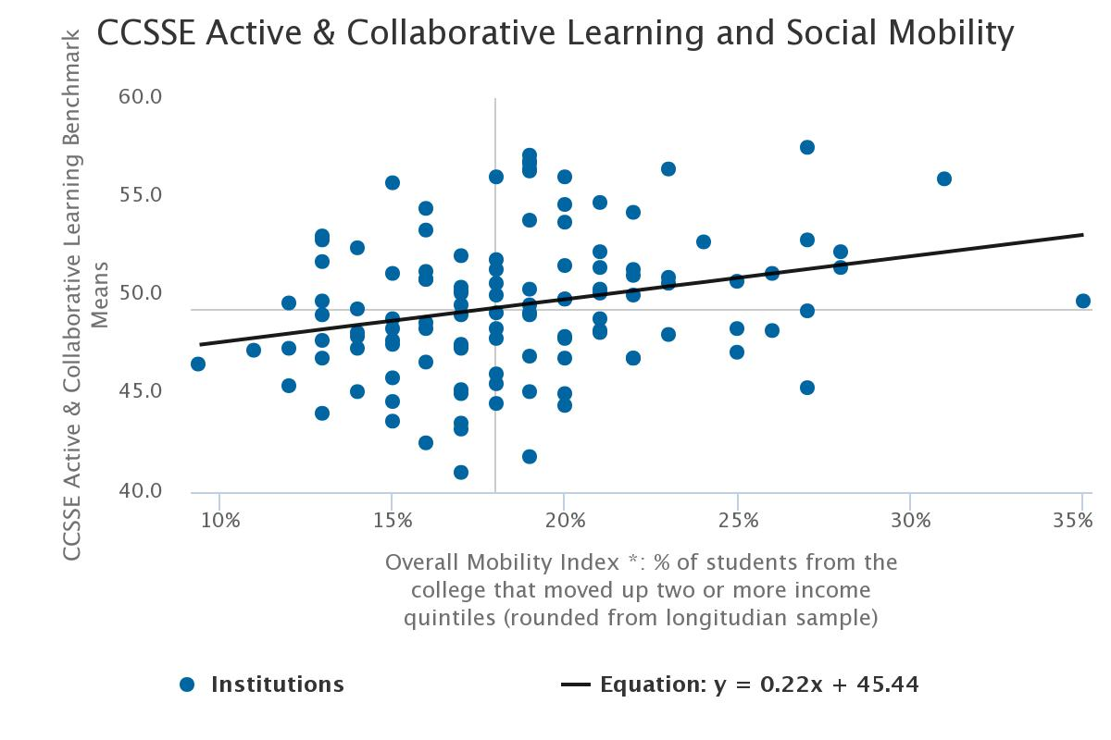

Slide 25
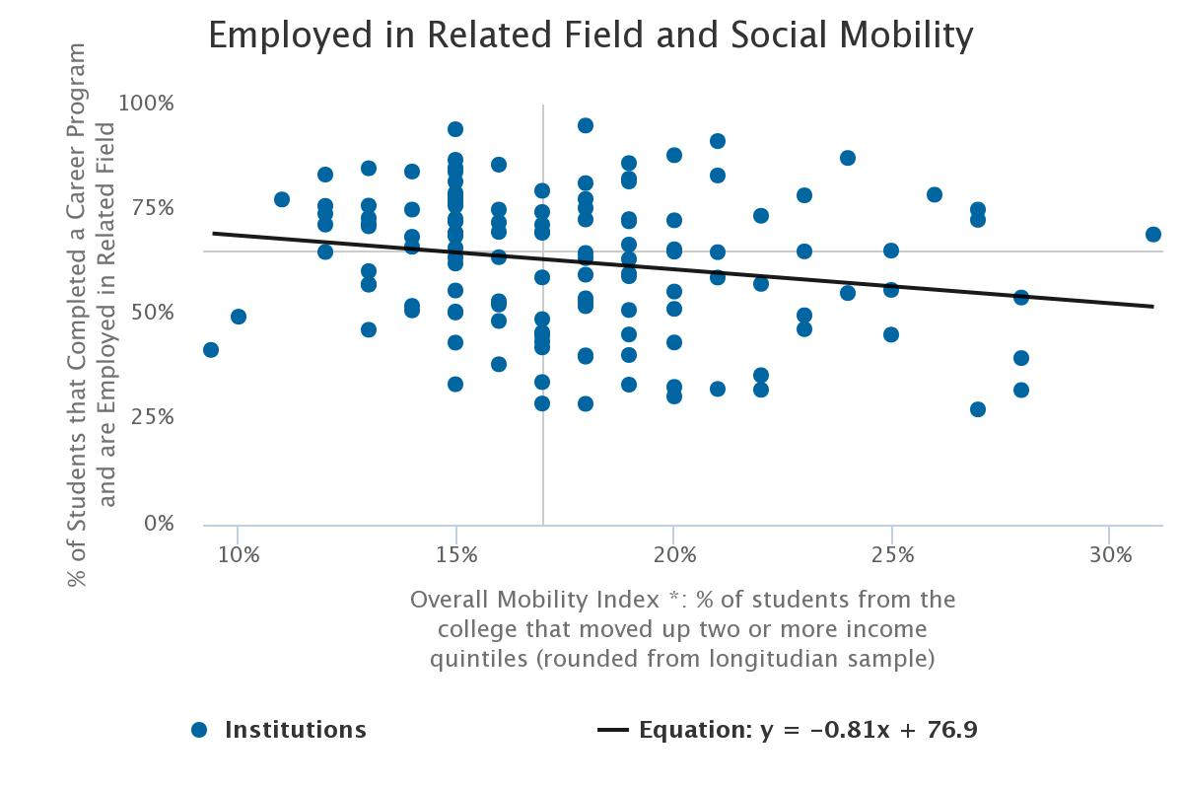

Slide 26
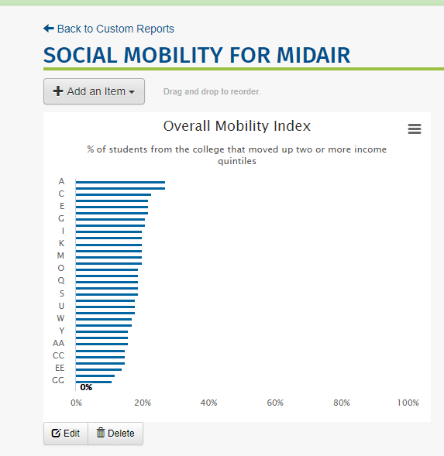
Custom Reports:
Sign in to NCCBP
Go to Reports menu
Drop down and click on Custom Reports
I have copied a custom reports to all the MidAIR peer colleges

Slide 27
Conclusions:
Social mobility may be another way to evaluate the success of your college in preparing students for the future.

Slide 28
Lou Guthrie
913-469-8500, ext. 4019
louguthrie@jccc.edu

