Slide 1



CC Continuing Education Divisions Provide Adult Education Opportunities
2018 National Policy Summit
“Addressing the Adult Learner”
Lou Guthrie
Director
National Higher Education Benchmarking Institute

Slide 2
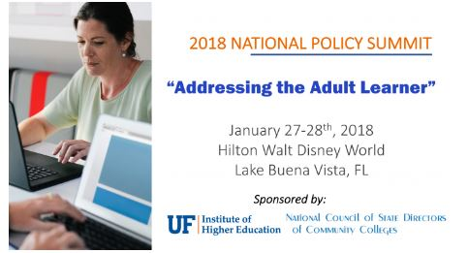
Session Agenda
Who are the “adult learners” in continuing education classes?
Why benchmark continuing education?
Share data from NCCBP-non-credit module
What do continuing education divisions offer?
Are these programs successful?

Slide 3

Who are the adult learners taking continuing education classes?
Students at community colleges taking credit classes
62 % are part-time students
40% are Pell eligible
Median age is 22
58% Female
38% First-generation students
26% Minority students

Slide 4

Students at community colleges taking non-credit classes
Median age is 34
47% Female
38% First-generation students
46% Minority students
N=9 community colleges
Our answer: We don’t know.
Guesses?
% Part-time
% Female
% Minority
Data from: “Noncredit Education in Community College: Students, Course Enrollments, and Academic Outcomes”
by Di Xu and Xiaotao Ran. Community College Research Center, 2015

Slide 5
Why Benchmark Continuing Education?
To get data you can use to improve your programs and inform your decision-making
To provide continuing education programs with results that show their effectiveness vis-à-vis other continuing education programs
To establish national norms or KPIs for continuing education
To provide data for the numerous grants available to college’s continuing education programs

Slide 6
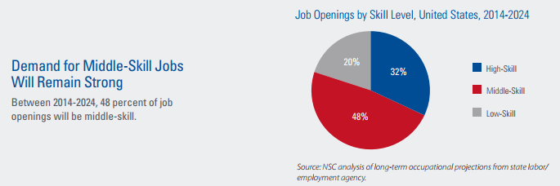
Adult Education is in high demand. National Skills Coalition

Slide 7
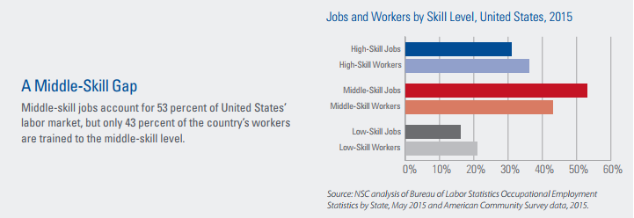
Current Issues for Continuing Education National Skills Coalition

Slide 8
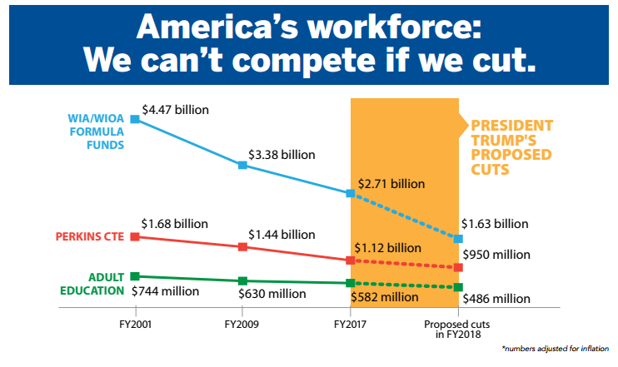
We need to fund adult education. National Skills Coalition

Slide 9
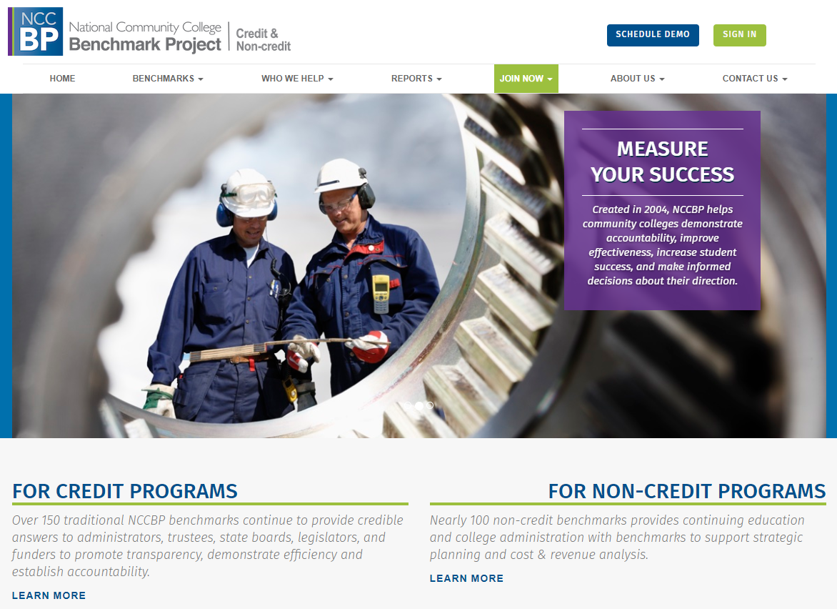

Slide 10
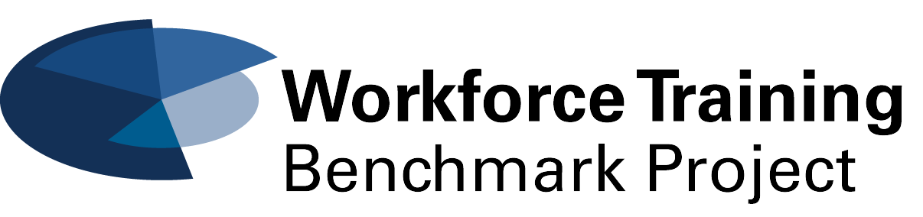

History of the Non-Credit Benchmark Project
Created in 2012-2013
Advisory board of over 20 community colleges across the country
Piloted in 2013
Data collection begin in 2014
Evolved and grew each year 2014-2016
Merged with the NCCBP: credit in 2017 as an separate opt-in module
Notes:
Mission: Improving higher education through benchmarking.
Vision: Impacting higher education to maximize student success.
In this case we are using data from the NCCBP. You could find this data from IPEDS or from your
.

Slide 11
Benchmark Categories
Student Enrollment
Workforce Training
Life & Leisure
Adult Basic Education
Corporate Client Enrollment/Contract Training
Course Information
Offered/Cancellation Rate
Retention
Financial Data
Staffing Data
Industry-recognized credentialing
Transition from non-credit to credit instruction
Student Satisfaction
Client Satisfaction
What are we missing?

Slide 12

As we look at NCCBP results I want you to share how continuing education programs might use the data.

Slide 13
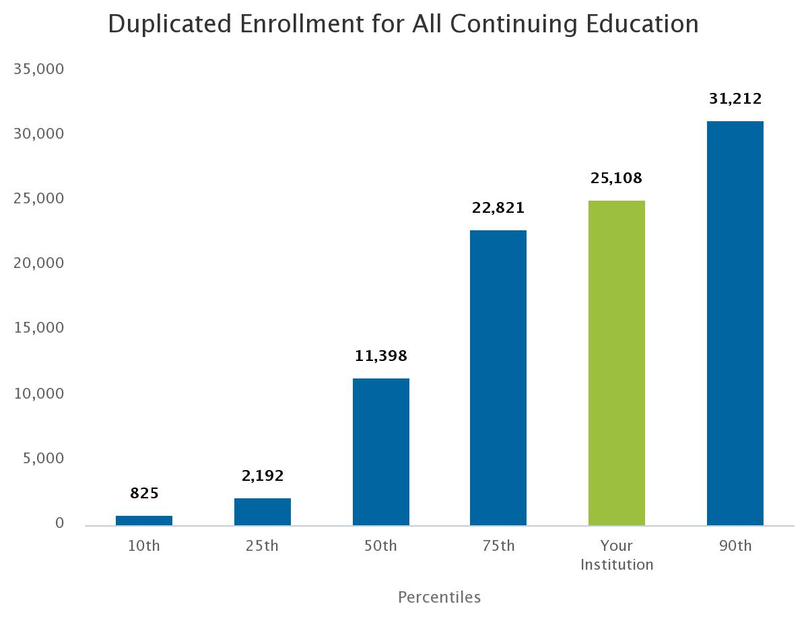
N=41
Duplicated non-credit continuing education student headcount (Workforce + Life/Leisure + Adult Basic Ed) for FY 2016.
Notes:
How would your college use this data.

Slide 14
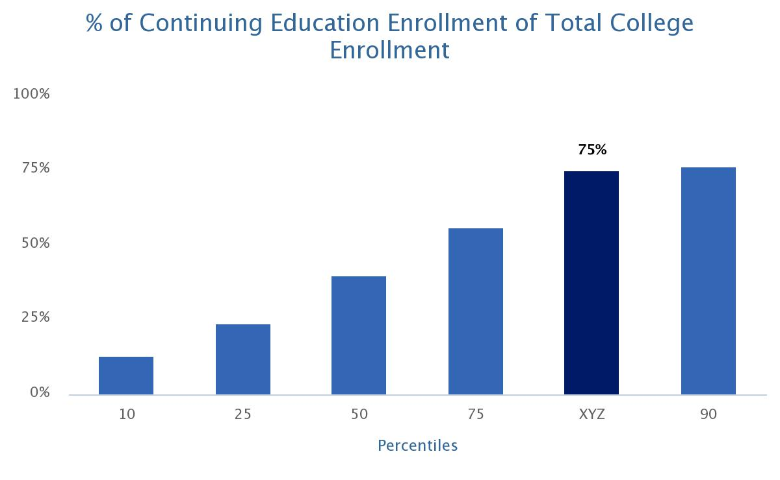
76%
56%
40%
24%
13%
Percentage of unduplicated continuing education enrollment of total college enrollment.
Notes:
How would your college use this data.

Slide 15
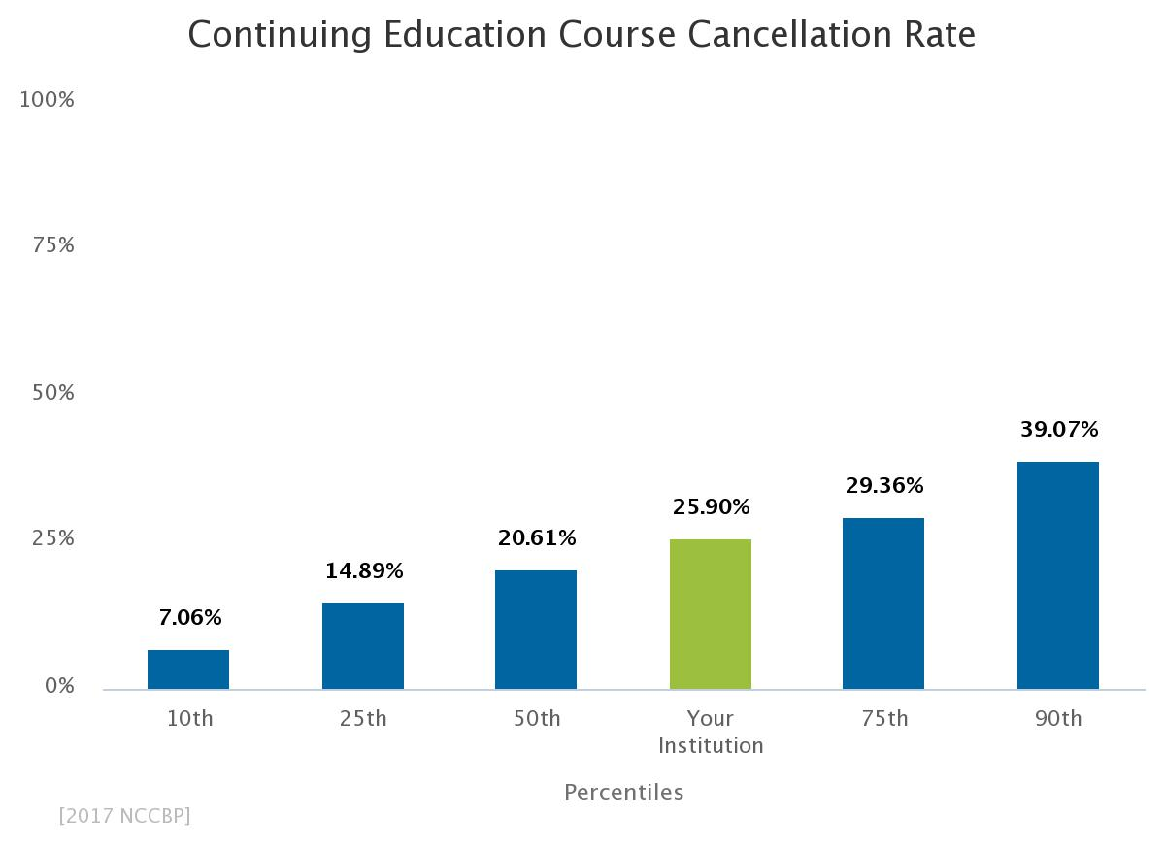
KEY
PERFORMANCE METRIC
Notes:
How would your college use this data.

Slide 16
What do continuing education divisions offer?
Credit vs Non-credit
Credit: Courses that apply towards an Associate degree or certificate
Non-credit courses typically have lower tuition and fees than credit classes.
Mission: Lifelong learning, professional development, GED
Noncredit Students are taking courses for personal or professional interest. These courses do not offer college credit, but in some cases students can earn continuing education units, certification or other evidence of class completion to meet personal or professional requirements.

Slide 17

What types of programs do continuing education divisions offer?
Life and Leisure: Refers to courses taken for personal enrichment.
Other specialized courses: Drivers’ Ed., Sports camps, programs for children

Slide 18

Workforce Training
Refers to courses that provide individuals with soft skills and/or technical skill-sets for the workplace. (Career Technical Education-CTE usually refers to credit courses.)

Slide 19

Adult Basic Education - ABE
Refers to GED and other high school equivalency programs, including English as a Second Language and other basic education courses.)

Slide 20
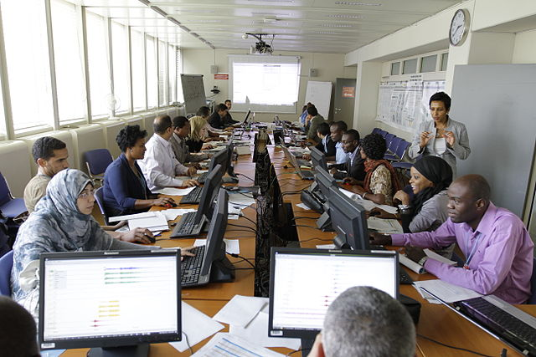
Contract Training
Refers to courses commissioned by a local business or industry for their employees.

Slide 21
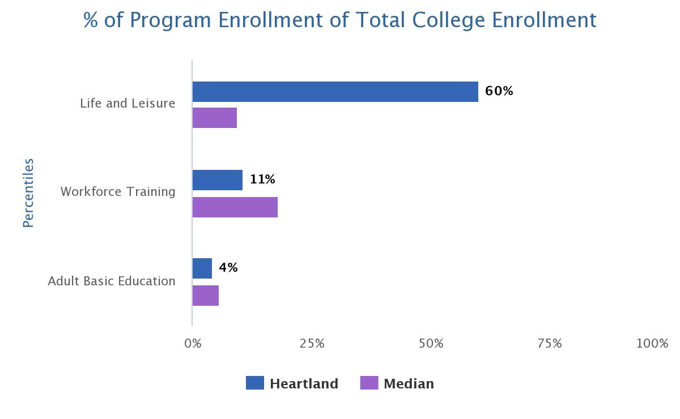
10%
18%
6%
XYZ
Percentage of unduplicated program enrollment of total college enrollment.
Notes:
How would your college use this data.

Slide 22
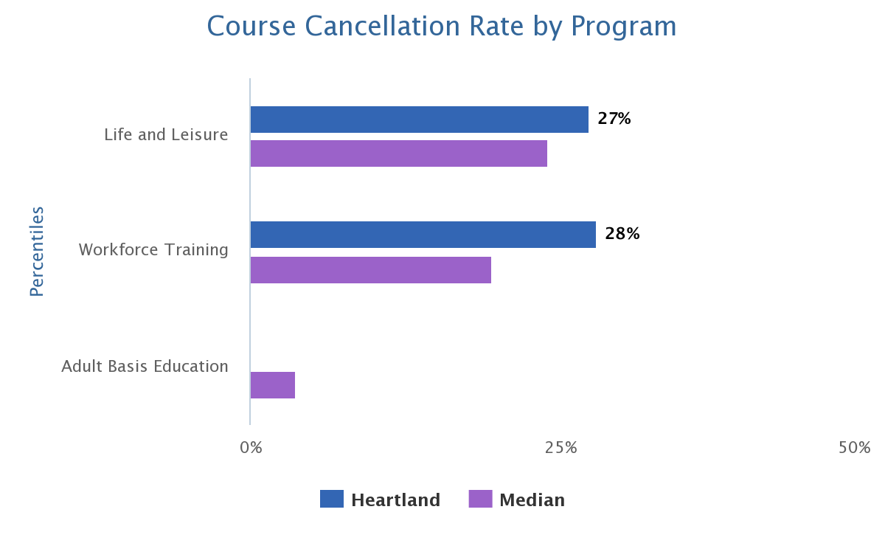
24%
20%
4%
XYZ
Percentage of courses cancelled of courses offered by program.
Notes:
How would your college use this data.

Slide 23
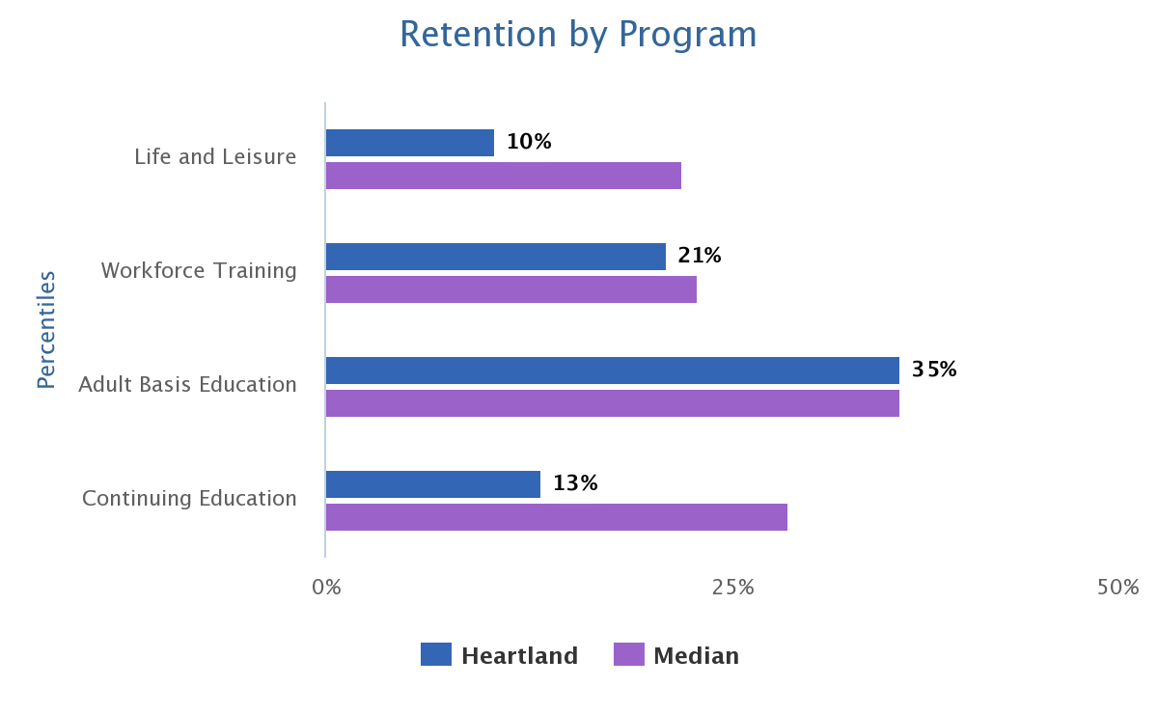
22%
23%
35%
29%
XYZ
Percentage of returning students of total enrolled CE students.
Notes:
How would your college use this data.

Slide 24
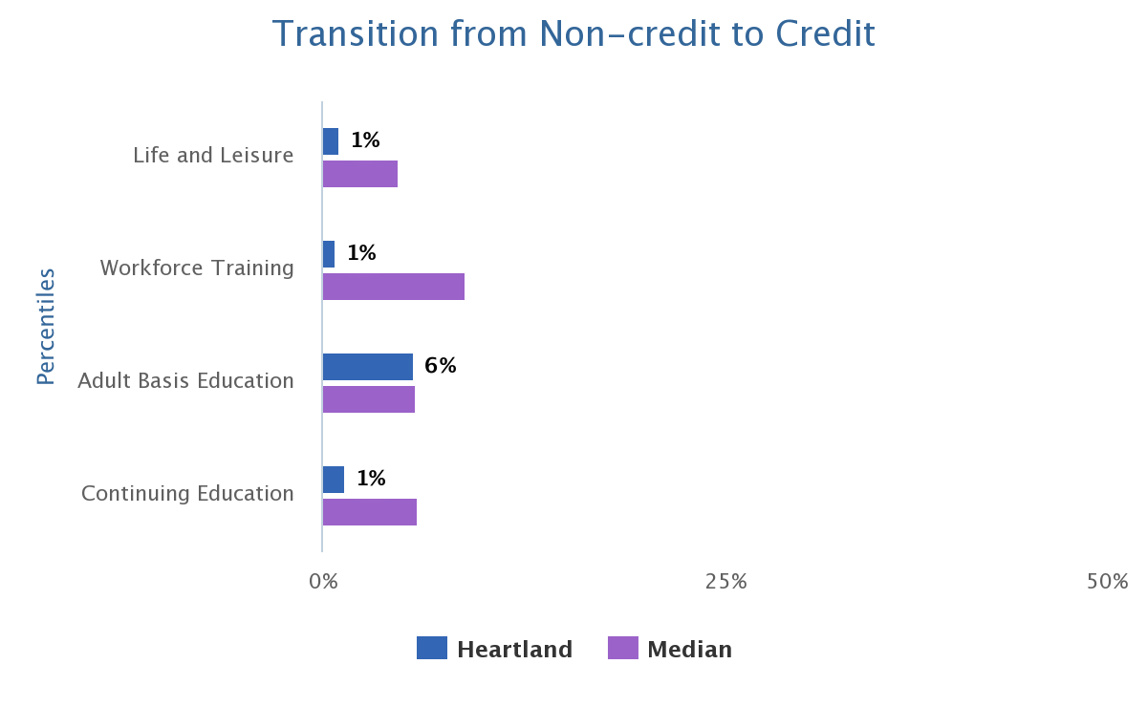
5%
Percentage of continuing education students who enroll in a credit course.
9%
6%
6%
XYZ
Notes:
How would your college use this data.

Slide 25
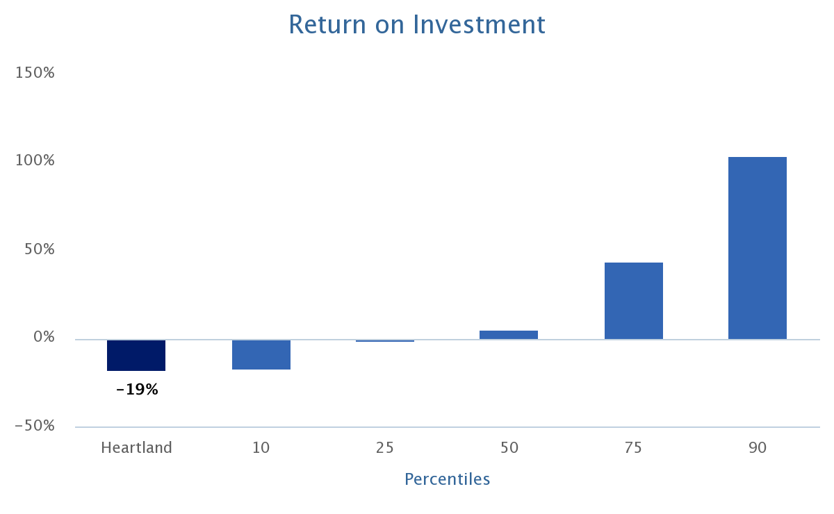
-2%
5%
44%
104%
-18%
XYZ
Total operating margins = total non-credit revenue minus total non-credit expenditures.
Notes:
How would your college use this data.

Slide 26
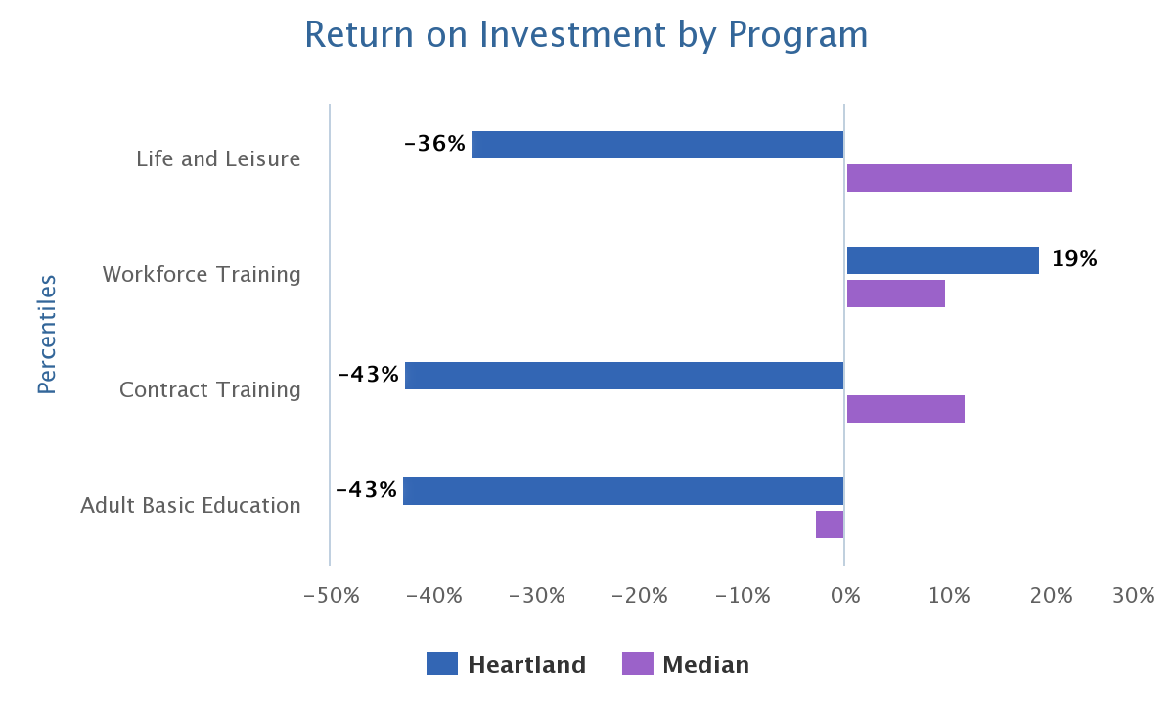
KEY
PERFORMANCE METRIC
22%
10%
12%
-3%
XYZ
Notes:
How would your college use this data.

Slide 27
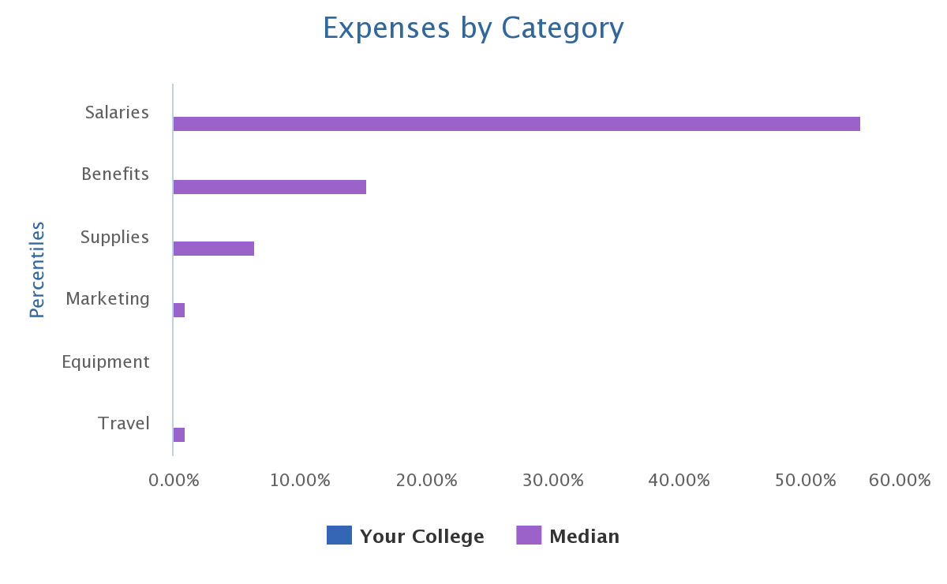
55%
15%
7%
1%
0%
1%
Notes:
How would your college use this data.

Slide 28
Revenue Sources
Notes:
How would your college use this data.

Slide 29
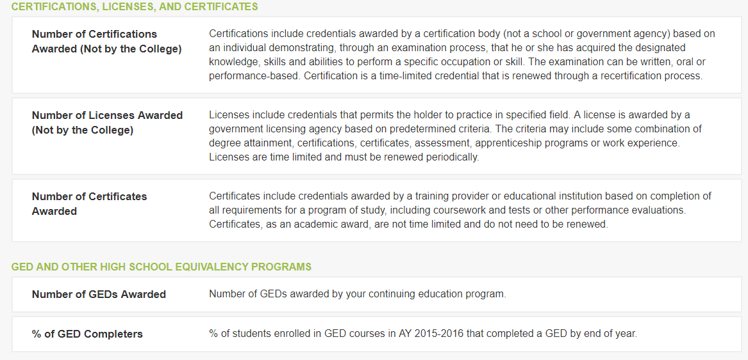
Non-credit Student Outcomes

Slide 30
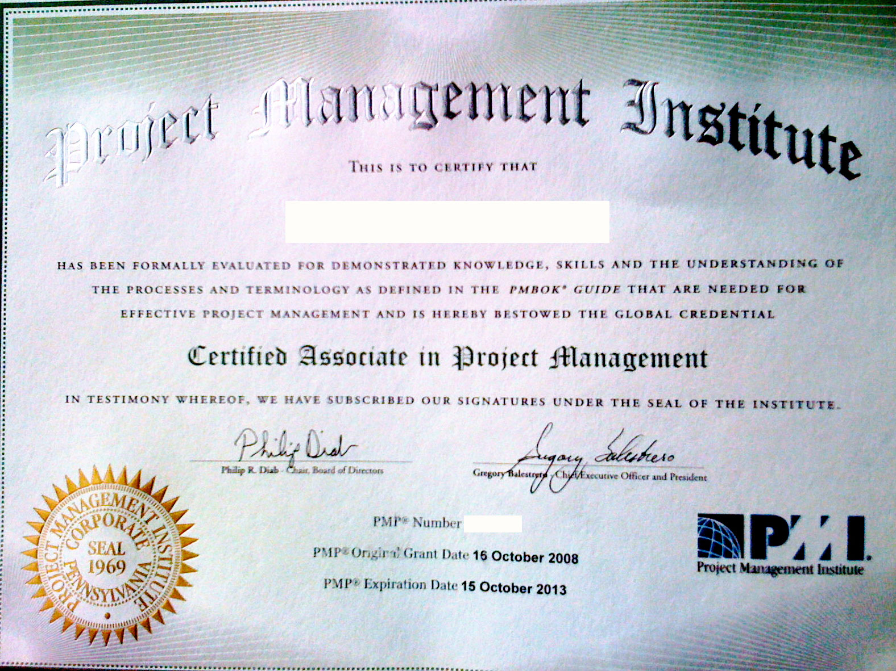
LERN – Certificates Offered by CE Programs
8% Offer no certificates
50% Offer between 1 and 10 certificates
29% Offer between 11 and 25 certificates
12% Offer over 26 certificates

Slide 31
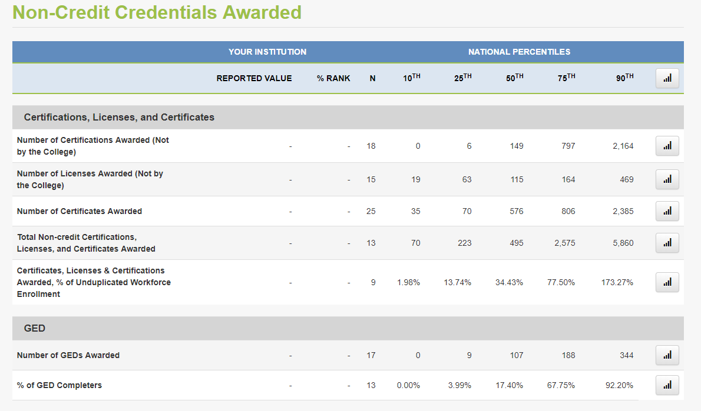
Notes:
How would your college use this data.

Slide 32


Progress on Counting Credentials Workforce Data Quality Campaign: Goals for States
Statewide Longitudinal Data System (SLDS)

Slide 33
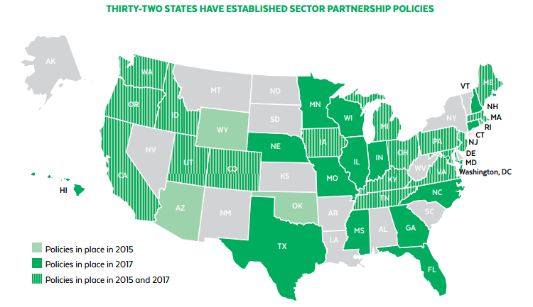
Sector Partnerships by State National Skills Coalition
Notes:
Sector partnerships bring together multiple employers within an industry to collaborate with colleges, schools, labor, workforce agencies, community organizations and other community stakeholders to align training with the skills needed for that industry to grow and compete. Sector partnerships can help facilitate the advancement of workers at all skill levels, including the least skilled.
Several states have invested in creating these partnerships in various industries. State policy can support the creation and maintenance of these partnerships and empower them to target education and training dollars from a variety of sources to the changing needs of local industries.

Slide 34
Using Benchmarking for Continuing Ed
Shows you where you need to improve the most
Helps you find good examples or colleges with programs that are contributing to success
Helps you focus on your KPI and mission
Helps set realistic goals
Provides data to use for strategic planning

Slide 35

Conclusion:
We need more and better continuing education data to help give a complete picture of adult education.

Slide 36

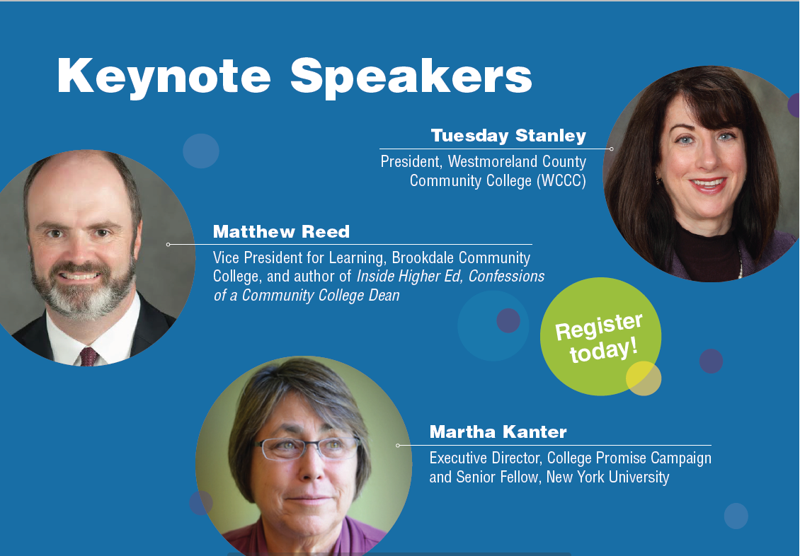

Slide 37


Keep up with the Benchmarking Institute and all of our projects by joining us on LinkedIn and following us on Twitter.
@EdBenchmark
Join the National Higher Education Benchmarking Institute Group

Slide 38


Lou Guthrie
913-469-8500, ext. 4019
louguthrie@jccc.edu

