Slide 1


Texas Community Colleges vs the World
Data from the NCCBP
TAIR 2017
Michelle Taylor | Senior Research Analyst
@EdBenchmark

Slide 2

Session outline
Background of the NCCBP
Trend Data from the NCCBP
Next Steps
Demo

Slide 3

NCCBP Started in 2004
Initial funding from Department of Education’s Fund for the Improvement of Postsecondary Education (FIPSE)
This funding established the “Kansas Study” – now Cost and Productivity
JCCC funded the NCCBP
NHEBI was established

Slide 4
NCCBP Today
Today the NHEBI is self-funded
NCCBP provides most of the revenue to keep us up and running
Last year we had 251 members
Over the years, 450+ community colleges have participated

Slide 5
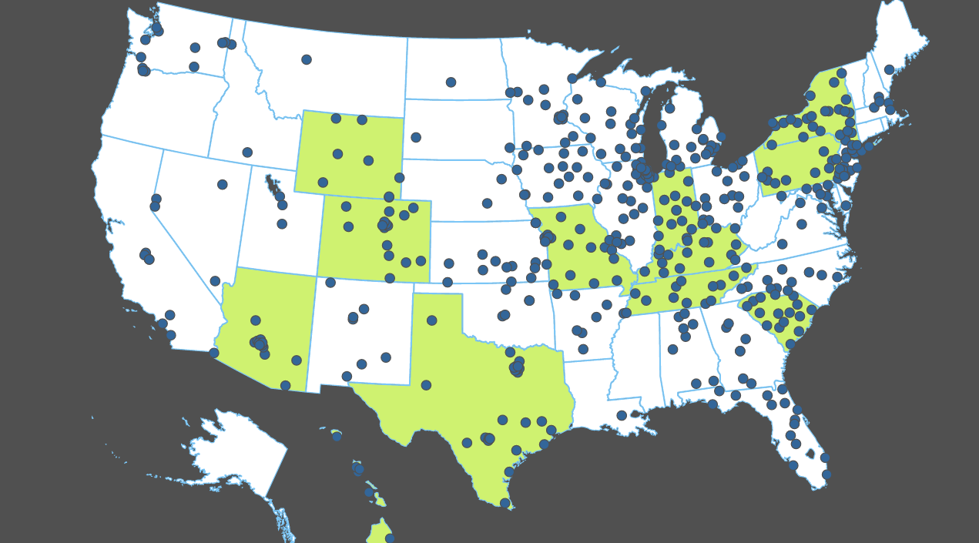
NCCBP Participants since 2004
A quarter of the nation’s community colleges participated in the NCCBP in 2016 (251).

Slide 6
Texas NCCBP Members

Slide 7
NCCBP Purposes
Provides a comprehensive set of benchmarks for core community college activities
  Completion & Transfer
  Retention & Persistence
  Student Performance
  Satisfaction and Engagement
  Job Market, Business and Industry
  Other Institutional Effectiveness Metrics

Slide 8

How the Benchmark Project Works
Data collection
  Data verification: logical errors, outlier checks
  Voluntary project: colleges provide only available data
  Confidentiality assured

Slide 9
REPORTS
National Report
Executive Report
Peer Comparison
Best Performers Report
Strengths/Opportunities Report
Custom Reports
Notes:
Show National, Executive, Best Performers, Strengths and Peer Comparison -- then back to slides

Slide 10
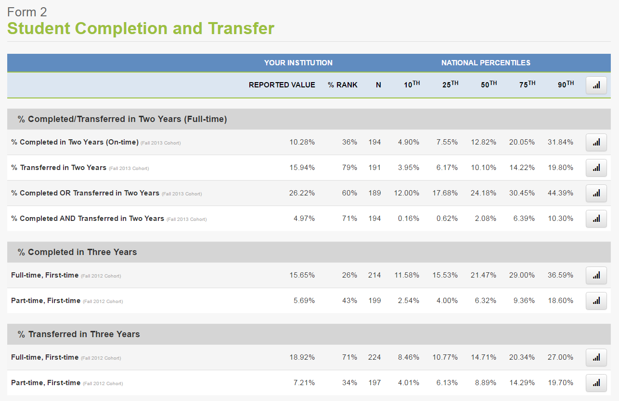
National Report

Slide 11
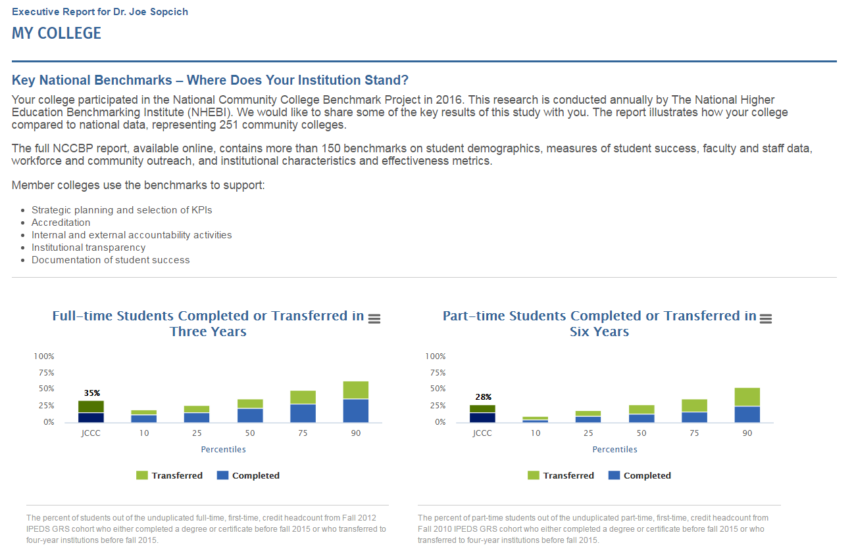
Executive Report

Slide 12
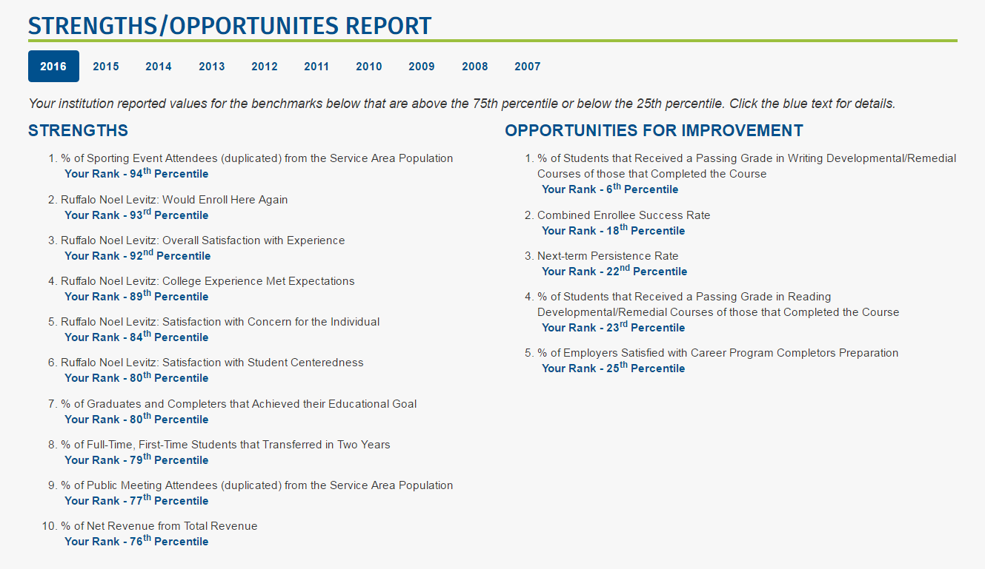
Strength/Opportunities Reports

Slide 13
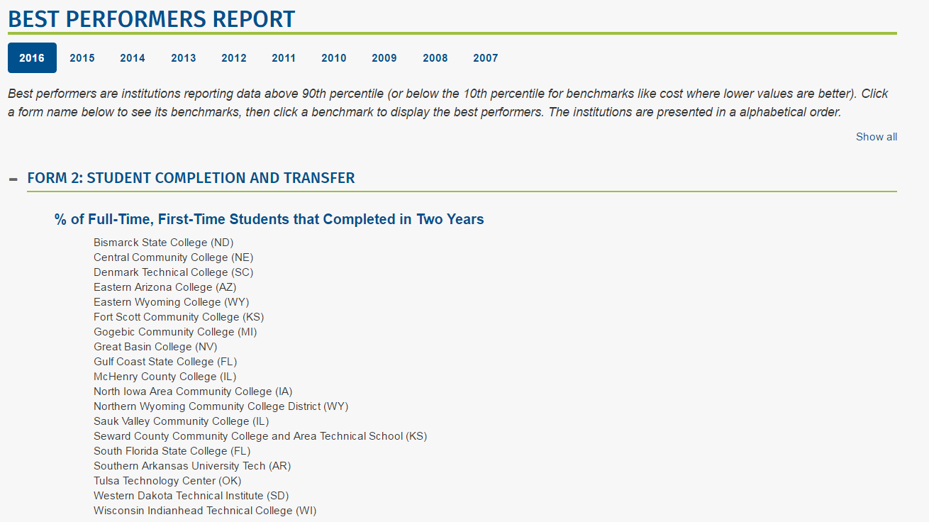
Best Performers Report

Slide 14
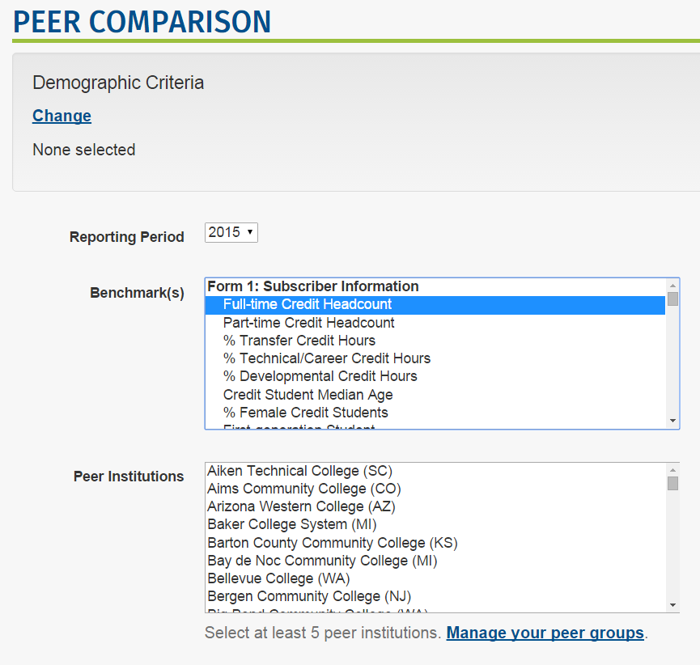
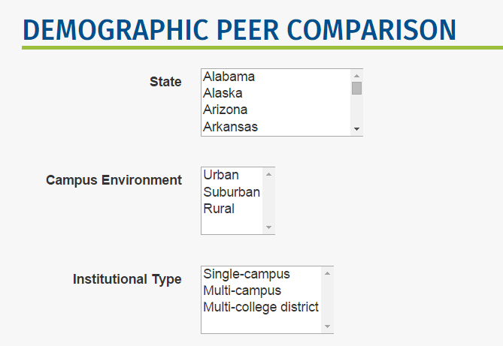
Peer Comparison Tool

Slide 15
Trends

Slide 16
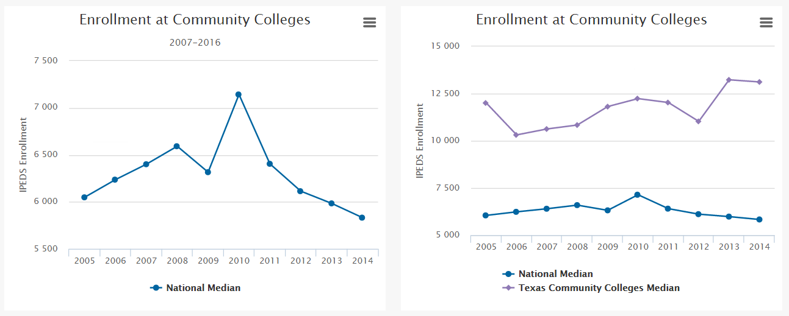
Enrollment Trends

Slide 17
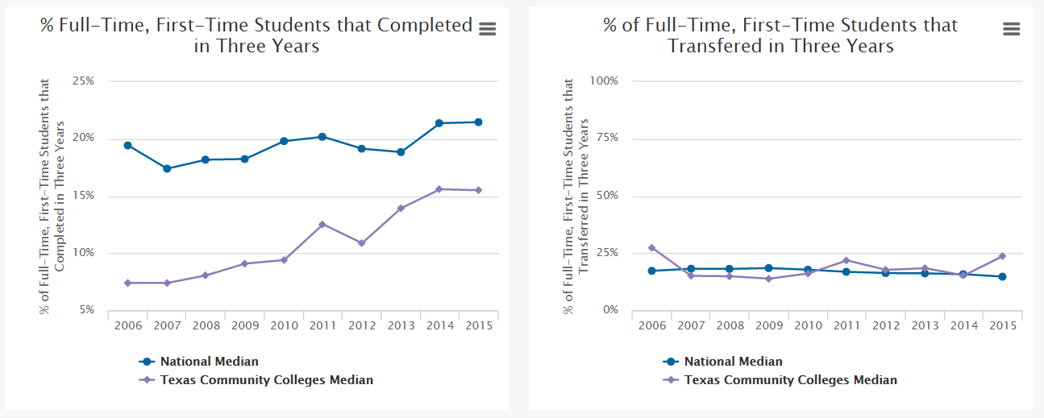
Graduation and Transfer Rate in Three Years
Full-time, First-time

Slide 18
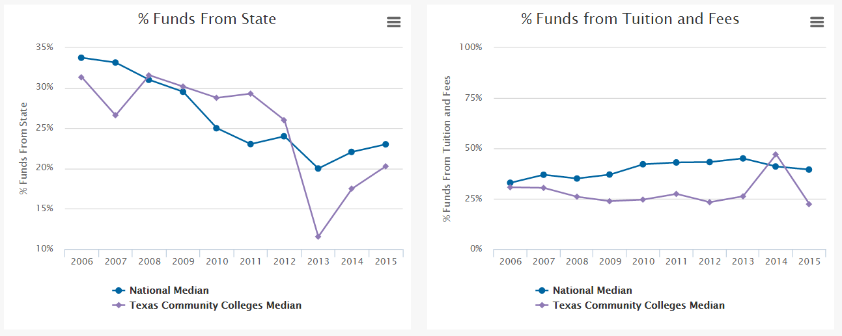
Funding Trends

Slide 19
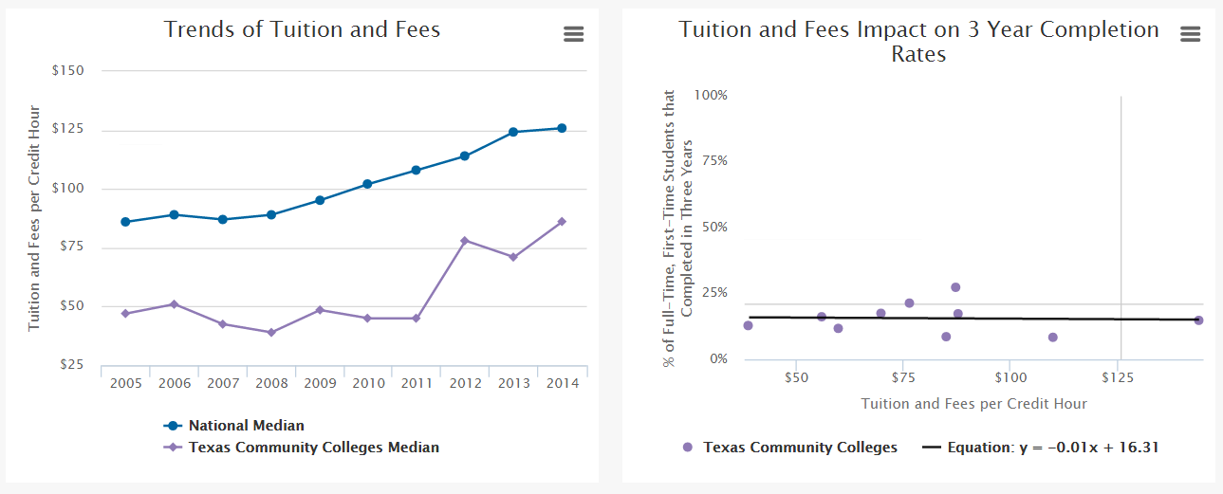
Cost of Tuition and Fees

Slide 20
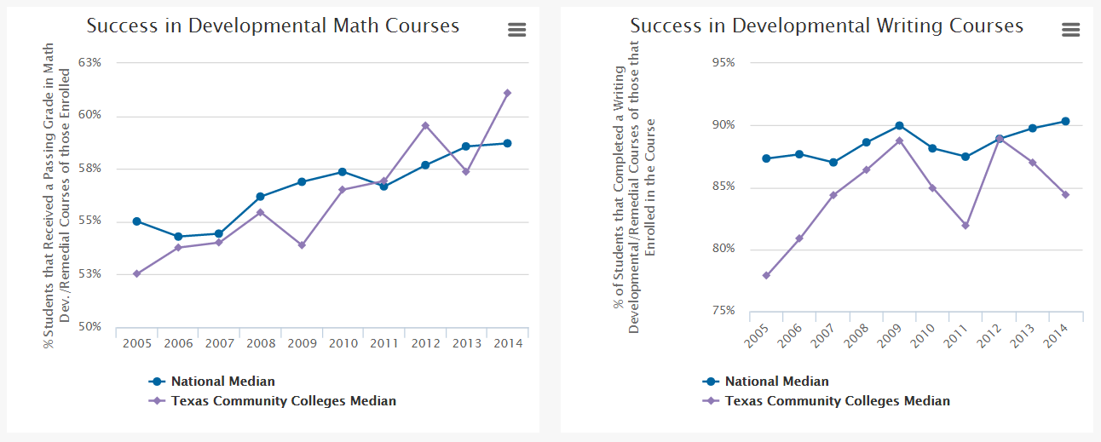
Trends in Developmental Education

Slide 21
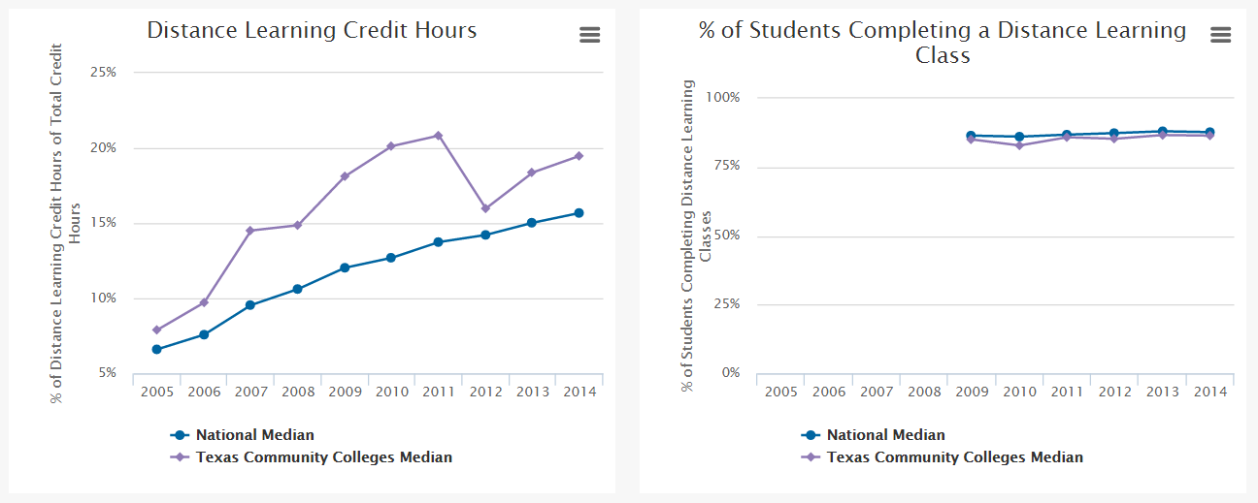
Online/Distance Learning Trends

Slide 22
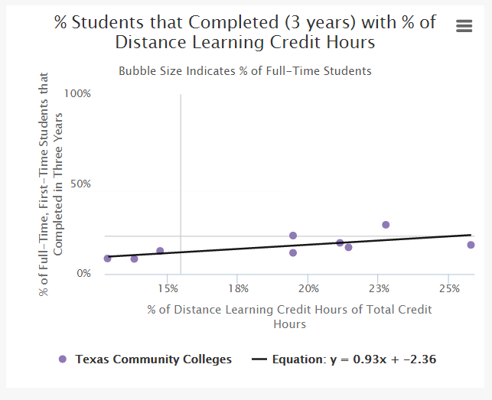
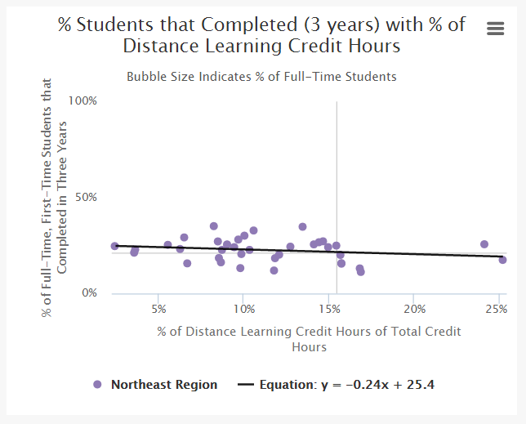
Impact of Online/Distance Learning on Graduation Rates

Slide 23
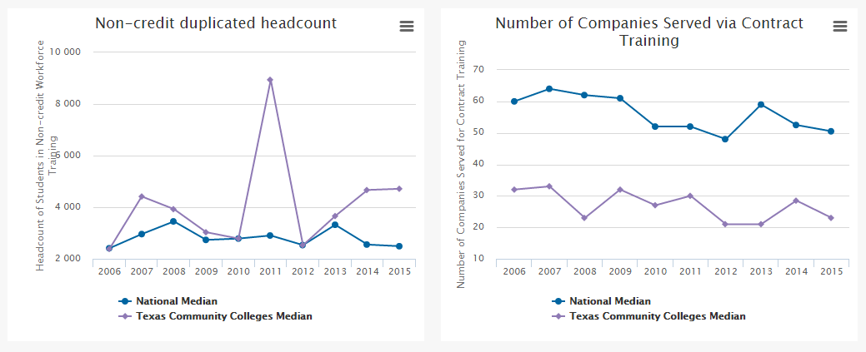
Non-credit

Slide 24
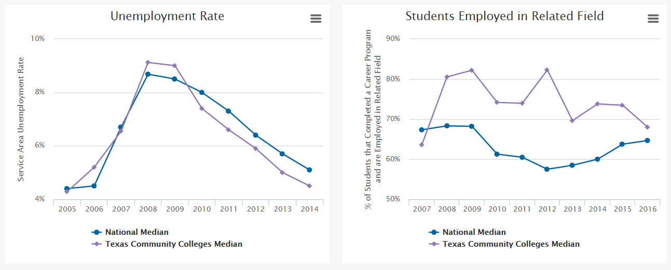
Employment Trends

Slide 25
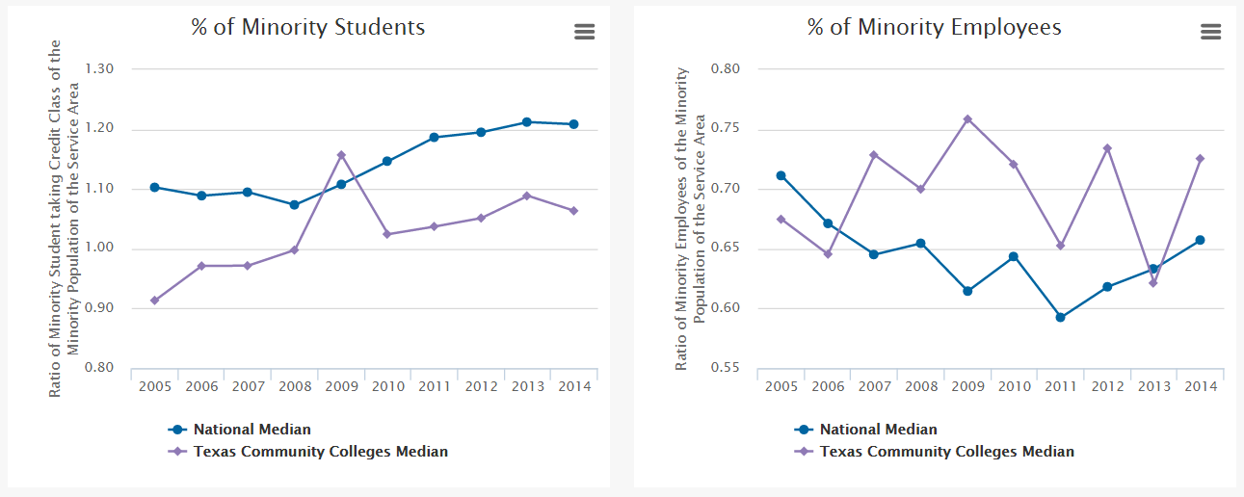
Diversity in Community Colleges

Slide 26

Learn More about Benchmarking and
Best Practices
JCCC.edu/Benchmark

Slide 27


Keep up with the Benchmarking Institute and all of our projects by joining us on LinkedIn and following us on Twitter.
@EdBenchmark
Join the National Higher Education Benchmarking Institute Group

