Slide 1
Adding Cost and Benchmarking to Your Program Review
Michelle Taylor| Senior Research Analyst
National Higher Education Benchmarking Institute

Slide 2
Program Review
The primary goals of program review are to:
  Enhance the resources and quality of academic programs by assessing programs strengths and challenges
  Align academic program needs and campus priorities with the planning and budgeting process and
  Ensure that program priorities are consistent with the college’s mission and strategic plan

Slide 3
Qualitative and Quantitative Data
Number of Faculty (Full Time; Part Time; Total)
Student Credit Hours by Faculty Type
Enrollment by Faculty Type
Faculty Name by Type
Average Class Size, Completion, and Attrition
Course Completion, Success and Attrition by Distance Learning v Face-to-Face
Number of Degrees/Certificates Awarded
Number of Graduates Transferring
Number of Graduates Working in Related Field
Expenditures and Revenues
Cost per Credit Hour

Slide 4
Why Benchmark Costs?
Understanding of costs – instructional
Align resources and ensure academic quality and fiscal soundness
Strategic management decisions
Accountability (Trustees, Taxpayers, Accreditors)

Slide 5




Sources of Benchmarks
Four sources of national benchmarks provided by the Benchmarking Institute
Notes:
Mission: Improving higher education through benchmarking.
Vision: Impacting higher education to maximize student success.
In this case we are using data from the NCCBP. You could find this data from IPEDS or from your
.

Slide 6

Cost and Productivity Project

Slide 7


Slide 8
Cost & Productivity Project
Provides presidents, chief academic officers, deans and institutional researchers with benchmarks at the discipline level
  Instructional costs (salaries and benefits)
  Faculty workload
  Class size
Notes:
Personnel costs account for approximately 85 percent of community college budgets

Slide 9


Cost & Productivity Project History
Summer 2002 |  | Department of Education FIPSE project approval and grant award for “The Kansas Study”
Fall 2002 – Fall 2003 |  | Advisory committee identified data elements, designs, processes, and conducted two pilot studies
2004 | Year 1 | Project implementation 50 institutions
2013 | Year 10 | New website: data collection, reporting
2016 | Year 13 | About 30 to 50 institutions

Slide 10
Cost & Productivity Project Timeline
March | Enrollment and data collection starts
June | Early bird registration closes June 1
July | Participant institutional data due on July 15; Outlier reports available
August | Verified and updated data due
September | New reports available; Peer Comparison Tool populated with most recent data

Slide 11

How Cost & Productivity Project Works
Data verification: logical errors, outlier checks
Voluntary project: colleges provide only available data
Confidentiality assured

Slide 12
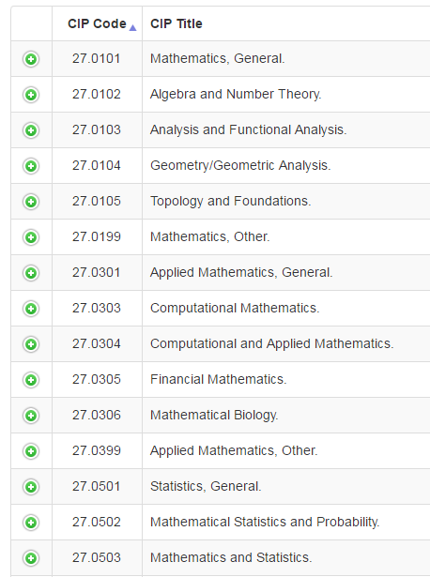
Data Entry

Slide 13
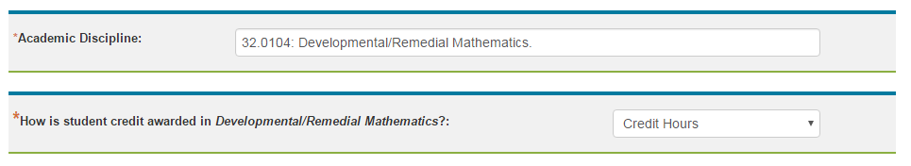
Data Entry

Slide 14
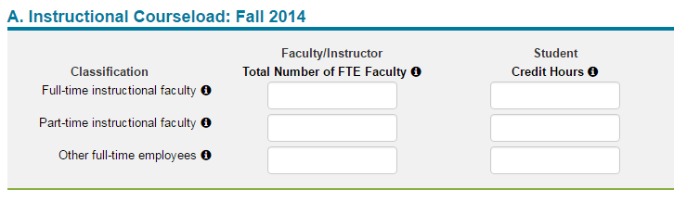
Data Entry

Slide 15
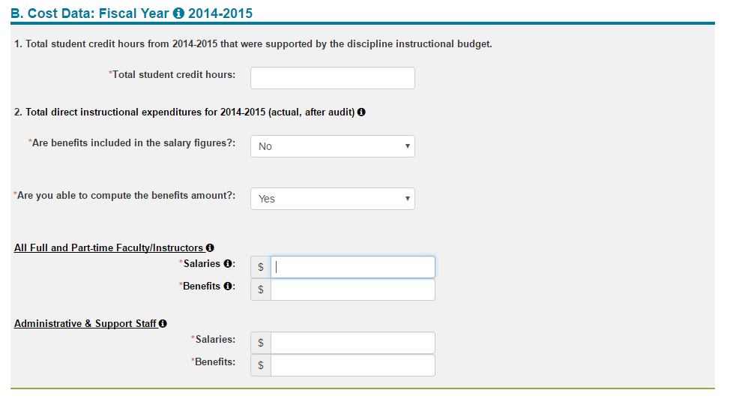
Data Entry

Slide 16
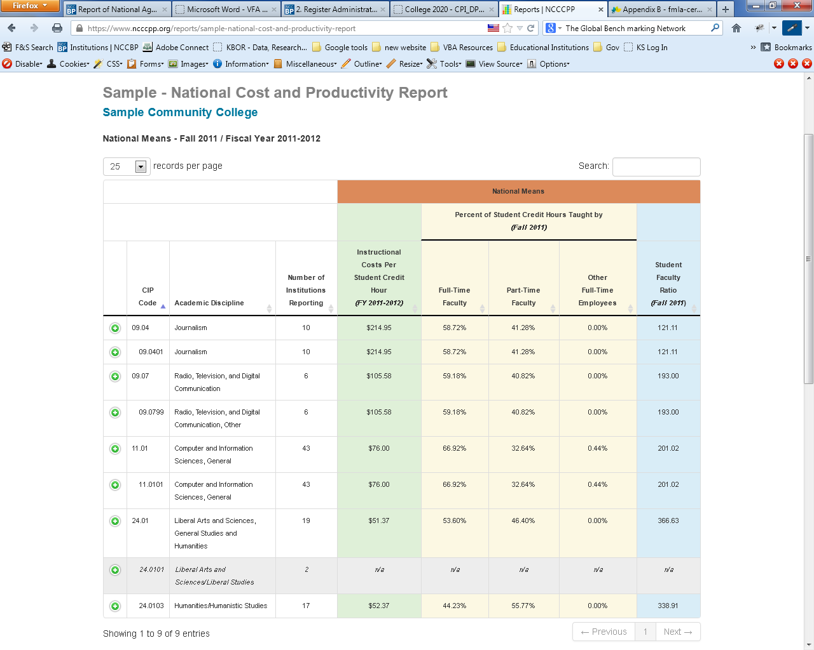
National Cost & Productivity Report Sample
Notes:
Political Science and Nursing

Slide 17
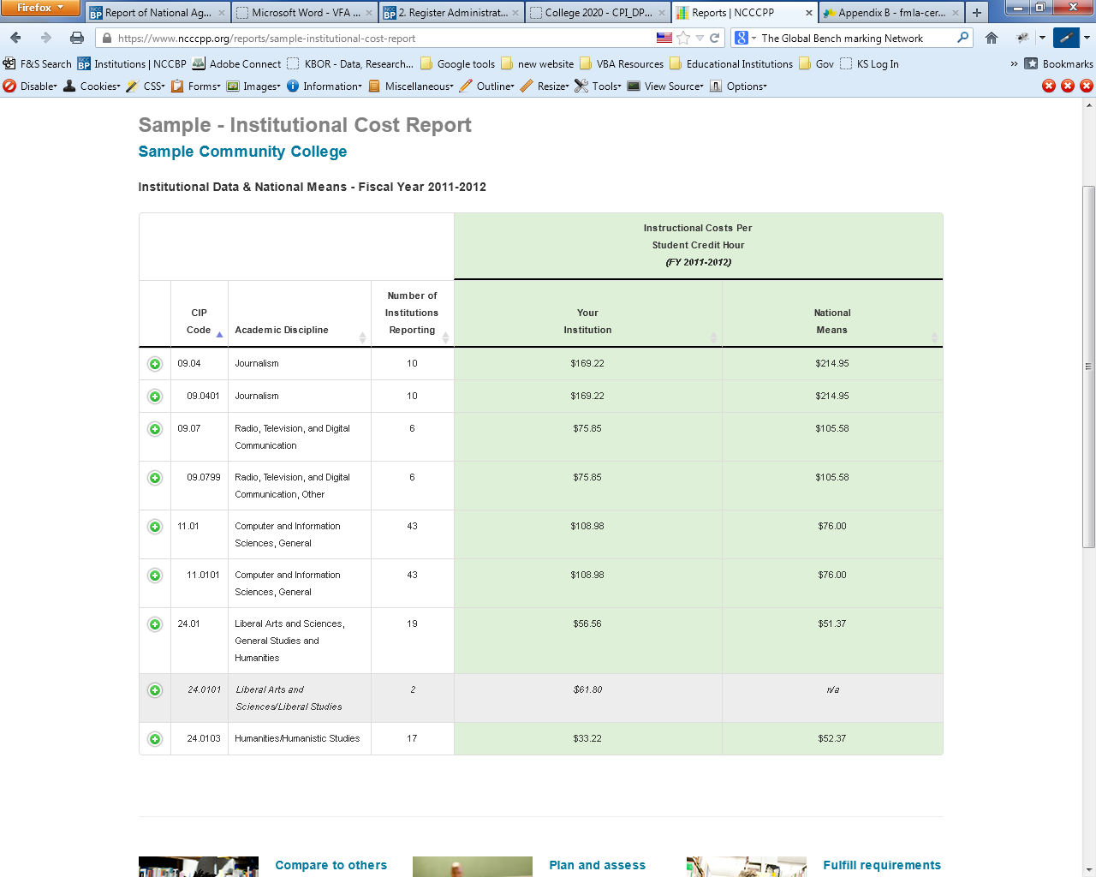
Institutional Cost Report Sample

Slide 18
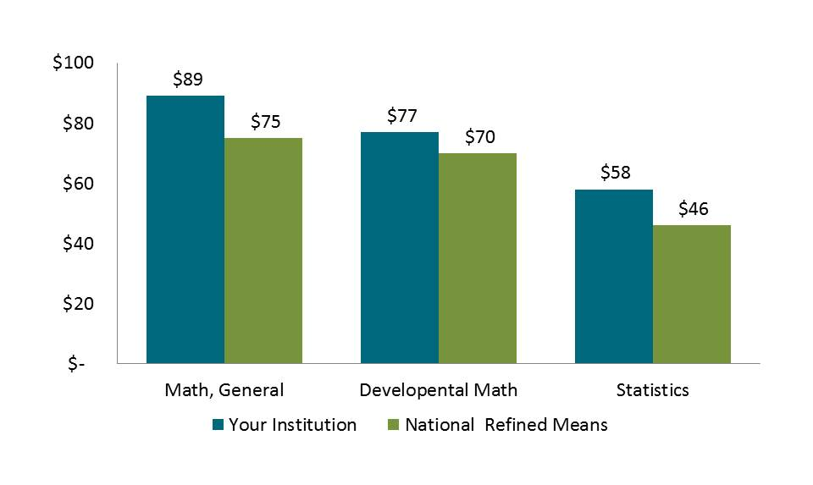
Benchmarks for Planning
Cost Per Credit Hour

Slide 19
Benchmarks for Planning
Full-time Part-time
Full-time Part-time

Slide 20
Benchmarks for Planning

Slide 21
Cost per Credit Hour
51.38 Registered Nursing

Slide 22

Learn More about Benchmarking and
Best Practices
JCCC.edu/Benchmark

Slide 23


Keep up with the Benchmarking Institute and all of our projects by joining us on LinkedIn and following us on Twitter.
@EdBenchmark
Join the National Higher Education Benchmarking Institute Group

Slide 24
Michelle Taylor
Senior Research Analyst | National Higher Education Benchmarking Institute
Johnson County Community College|12345 College Blvd. | Overland Park, KS 66210
Phone: 913-469-8500 Ext. 3831| michelletaylor@jccc.edu
http://www.nccbp.org/
https://costandproductivity.org/
http://maximizingresources.org/
http://workforceproject.org/
Notes:
Contact Info

