Slide 1

Data You Can Use for Accreditation

Slide 2


Lou Guthrie
Director, National Higher Education Benchmarking Institute

Slide 3
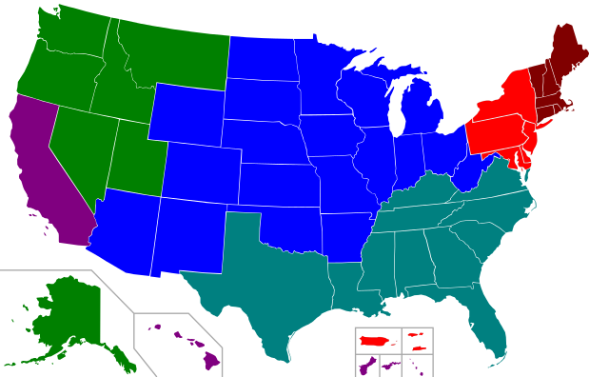
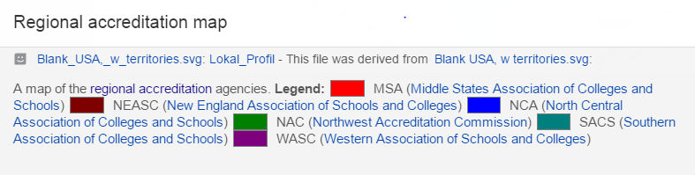
Northwest
Commission on Colleges and Universities (NWCCU)
Higher Learning Commission (HLC)

Slide 4
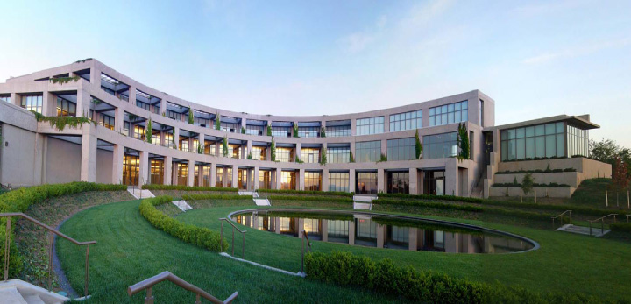
Accreditation Values/Principles

Slide 5
HLC Guiding Values
Focus on student learning
Education as a public purpose
Education for a diverse, technological, globally connected world
A culture of continuous improvement
Evidence-based intuitional learning and self-presentation
Integrity, transparency, and ethical behavior or practices
Governance for the well-being of the institution
Planning and management of resources to ensure institutional sustainability
Mission-centered evaluation
Accreditation through peer review

Slide 6
NWCCU Principles
foster excellence through the development of criteria and guidelines for assessing educational quality and institutional effectiveness;
encourage institutional improvement through continuous self-study and evaluation;
ensure the educational community, the general public, and other organizations that an institution has clearly defined and appropriate educational objectives, has established conditions under which their achievement can reasonably be expected, appears in fact to be substantially accomplishing them, and is so organized, staffed, and supported that it can be expected to continue to do so; and
provide counsel and assistance to established and developing institutions.

Slide 7

“We have found the NCCBP data to be most useful in preparing our Systems Portfolio for the Academic Quality Improvement Program (AQIP), our institutional accreditation pathway with the Higher Learning Commission (HLC). The HLC requires evidence not only of our own outcomes, but how we compare with other colleges. I know that our responses are complete because of the comparisons provided by the NCCBP.”
-- Dr. Jenifer A. Spielvoget, Vice President for Planning and Institutional Effectiveness at Cuyahoga Community College

Slide 8
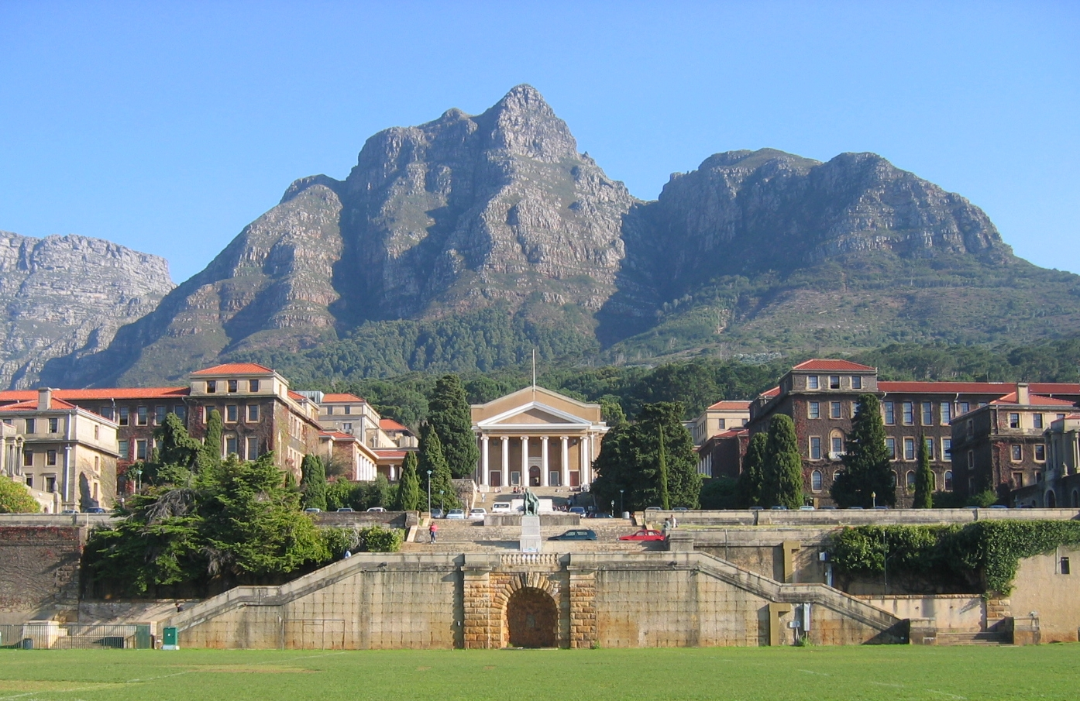
Accreditation Criteria/Standards

Slide 9
HLC’s Criteria for Accreditation
Mission
Integrity: Ethical and Responsible Conduct
Teaching and Learning: Quality, Resources and Support
Teaching and Learning: Evaluation and Improvement
Resources, Planning and Institutional Effectiveness

Slide 10
NWCCU Five Standards for Accreditation
“A recursive cycle of continuous improvement”
Mission, Core Themes, and Expectations
Resources and Capacity
Planning and Implementation
Effectiveness and Improvement
Mission Fulfillment, Adaptation, and Sustainability

Slide 11
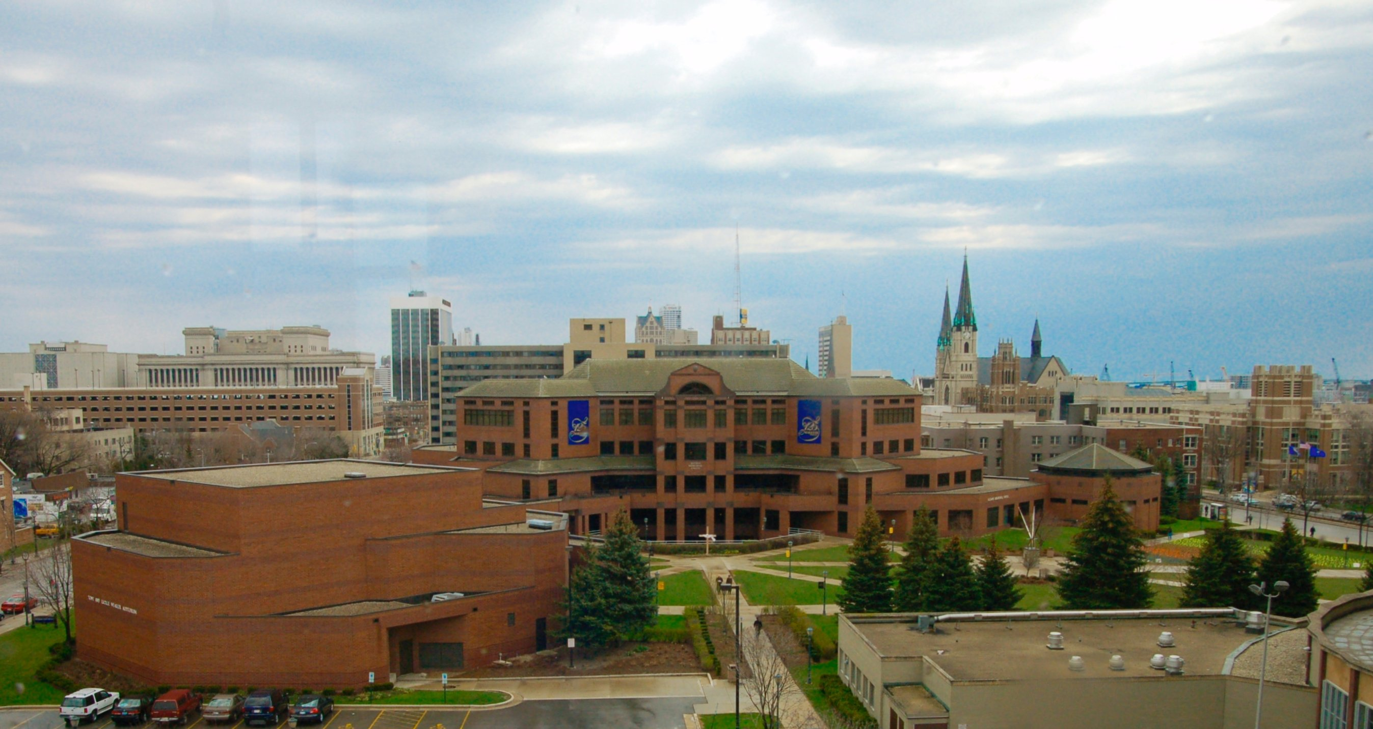
NCCBP

Slide 12
The NCCBP Reports You Can Use in Accreditation
National Data/Reports
Peer Reports
Best Performers Report
Custom Reports
  Trends

Slide 13
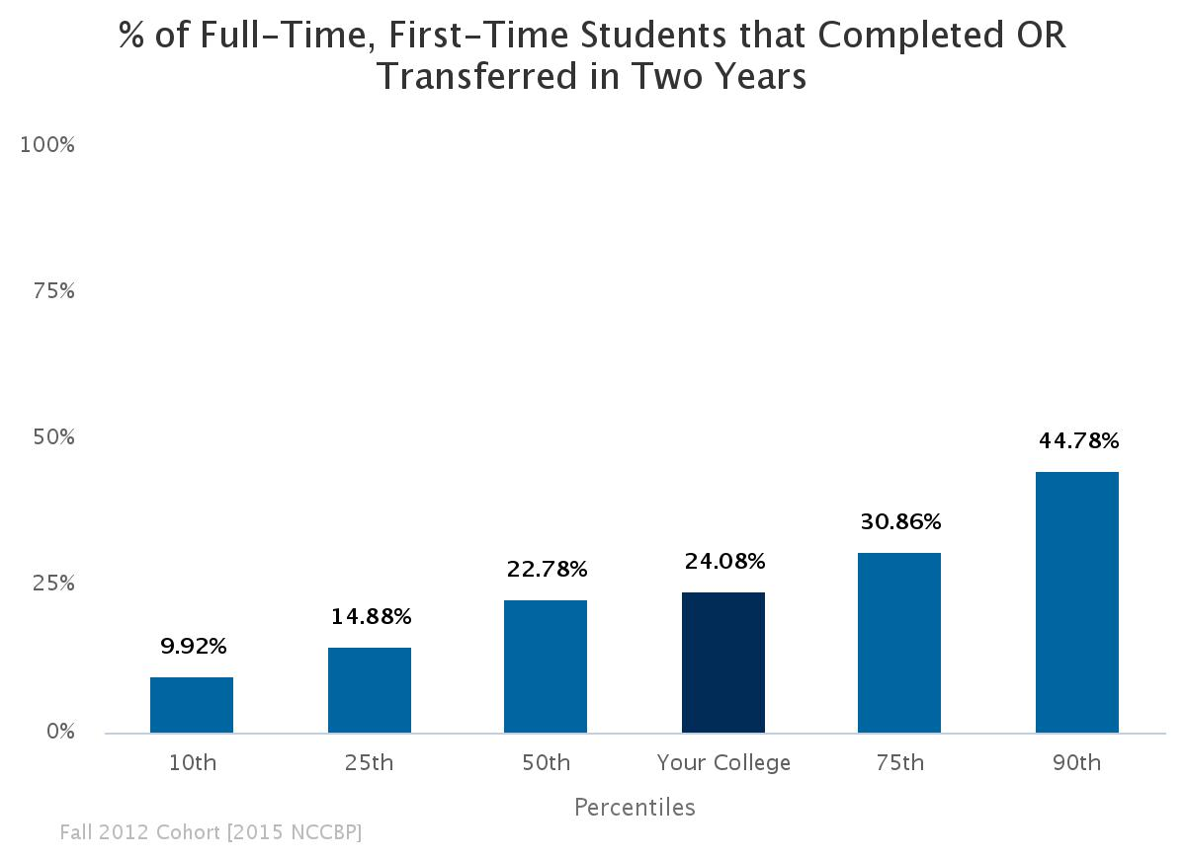
National Report: First-time, Full-time, On-Time Completions/Transfers

Slide 14
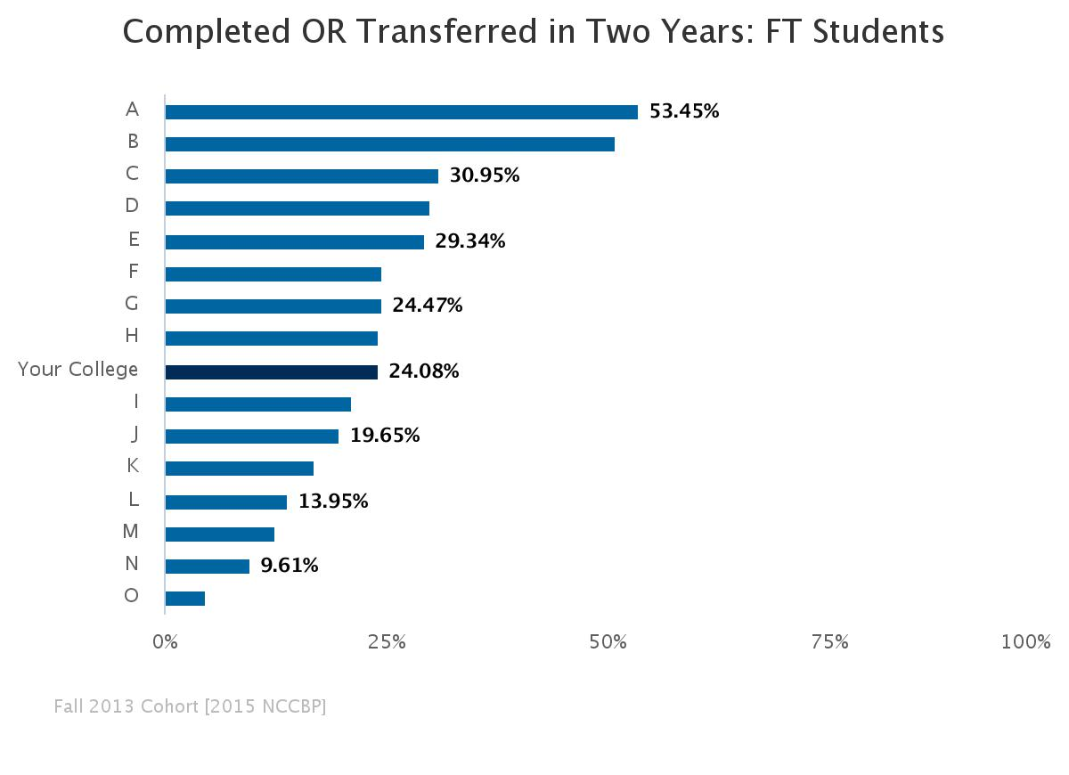
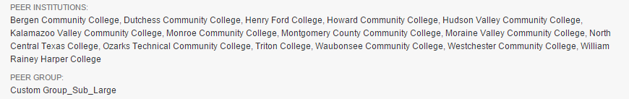
Peer Report

Slide 15
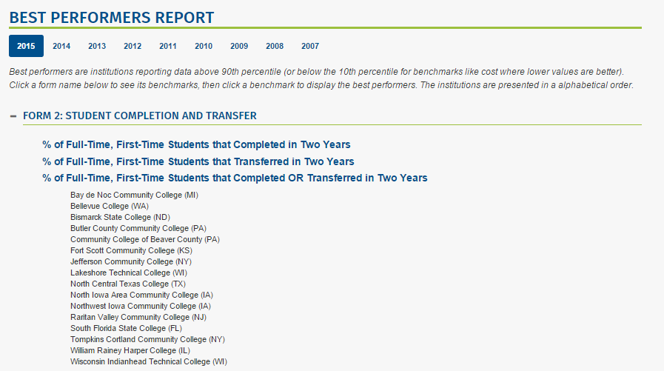
Best Performers Report

Slide 16
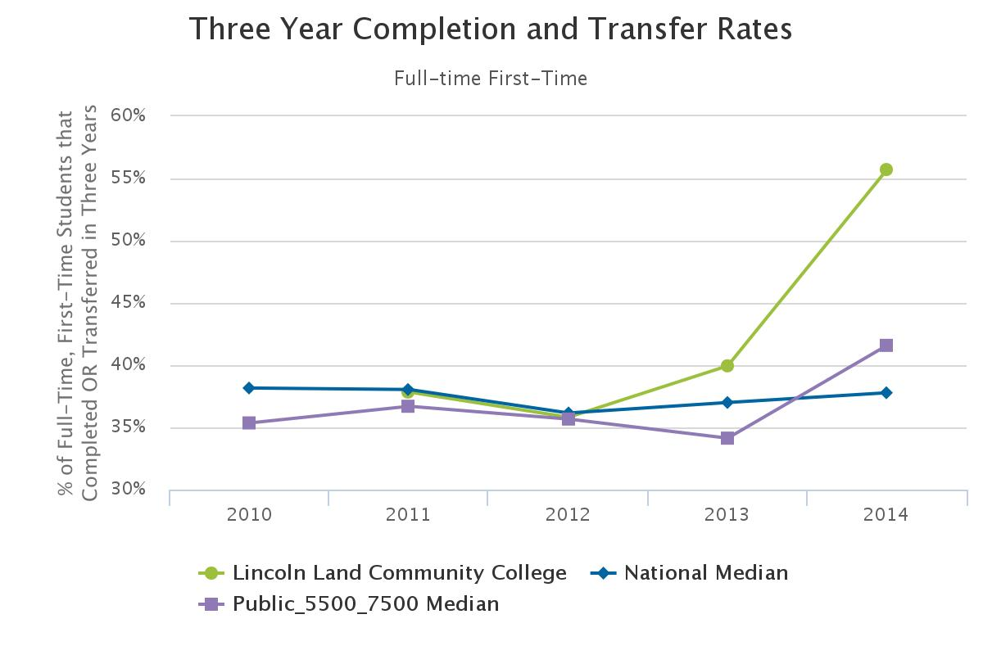
Custom Reports: Trends

Slide 17
Kankakee Community College
“NHEBI’s collaboration and what your team provides Kankakee with is amazing, and absolutely critical to the changes that have been made and continue to be made at my College!”
The college's senior leadership team has a scorecard for each area they lead with KPIs that align with the college scorecard. Data from the NCCBP is used to show their standing compared to National and Peer data. NCCBP Form 2. Student Completion and Transfer.
HLC 5 D 1. The institution develops and documents evidence of performance in its operations.
The scorecards are tracking Kankakee’s impressive progress, from 19.7% completion in 2014 (2010 cohort) to 26.9% completion in 2015 (2011 cohort).
Dr. Purva DeVol, Director of Institutional Research & Grants Development
Kankakee Community College, www.kcc.edu/data

Slide 18
Another Kankakee CC Examples
KCC compares their student satisfaction and engagement scores on national surveys with peers nationwide. They set aspirational satisfaction score goals and have developed AQIP improvement projects where scores dictate they need to improve.
NCCBP Form 5. Student Satisfaction and Engagement. Ruffalo Noel-Levitz Scale Items. Safety and Security.
HLC 5. A. 1. The institution has fiscal and human resources and physical and technological infrastructure sufficient to support its operations.
AQIP Projects: Kankakee added additional lighting to their campus and also increased the number of police officers and patrols.

Slide 19
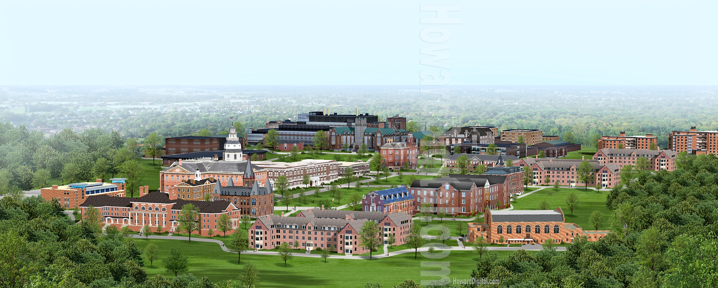
Where to Feature your Data in Accreditation Reports

Slide 20
HLC Criterion One Mission:
1.A. “The institution’s mission is broadly understood within the institution and guides the institution’s operations.”
1.A.2. The institution’s academic programs, student support services, and enrollment profile are consistent with its stated mission.”

Slide 21
XYX College is devoted to a statewide mission of preparing students for successful careers in veterinary technology, agriculture, culinary arts, and related industries.” 54% of their credit hours are technical/career credit hours. Presenting just that information doesn’t show HLC how truly devoted to career education XYZ is. Using the NCCBP benchmark data for % of technical/career credit hours shows that XYZ has a higher percentage of technical/career credit hours than 90% of community colleges.

Slide 22
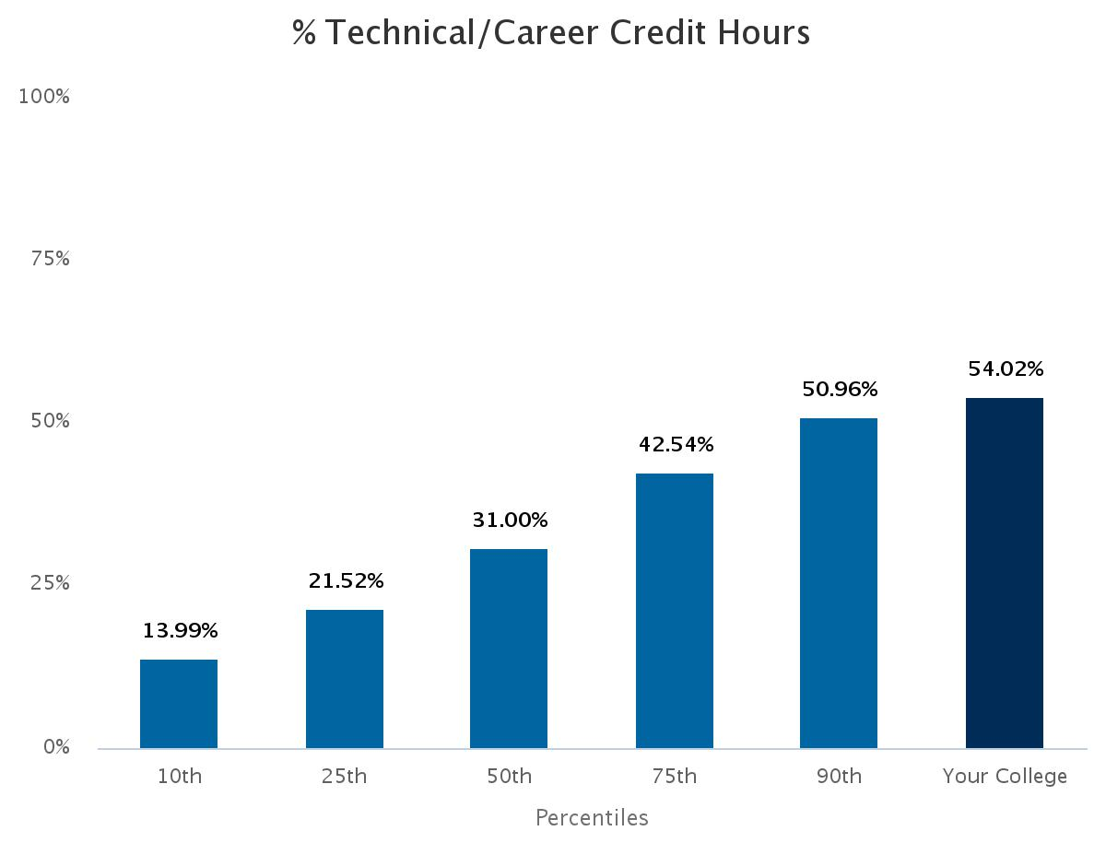

Slide 23
NWCCU Standard One –Mission, Core Themes, and Expectations
1.B.2.The institution establishes objectives for each of its core themes and identifies meaningful, assessable, and verifiable indicators of achievement that form the basis for evaluation accomplishment of the objectives of its core themes.
XYZ Community Colleges provide access to higher education for Hispanic students and communities (one of their core themes). Yet they report only 46% of their student enrollment is Hispanic. When you look at NCCBP benchmark data you realize that XYZ is in the 96th percentile in terms of minority enrollment. In addition, XYZ could report their benchmarked Ruffalo Noel-Levitz student satisfaction scores for Responsiveness to Diverse Populations, showing how they have increased their scores.

Slide 24
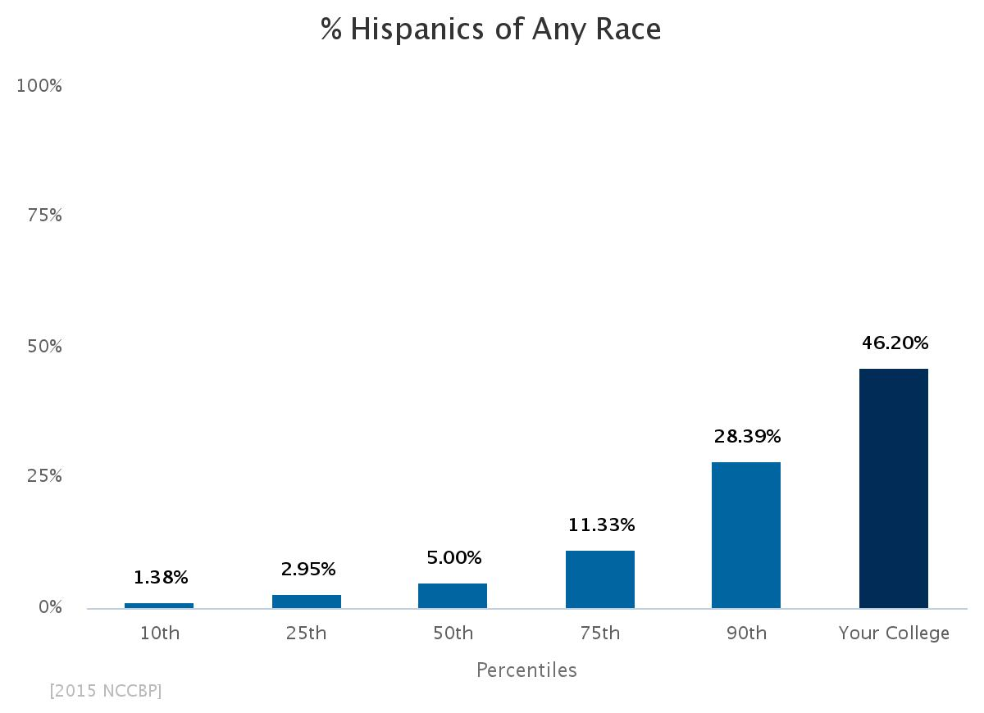

Slide 25
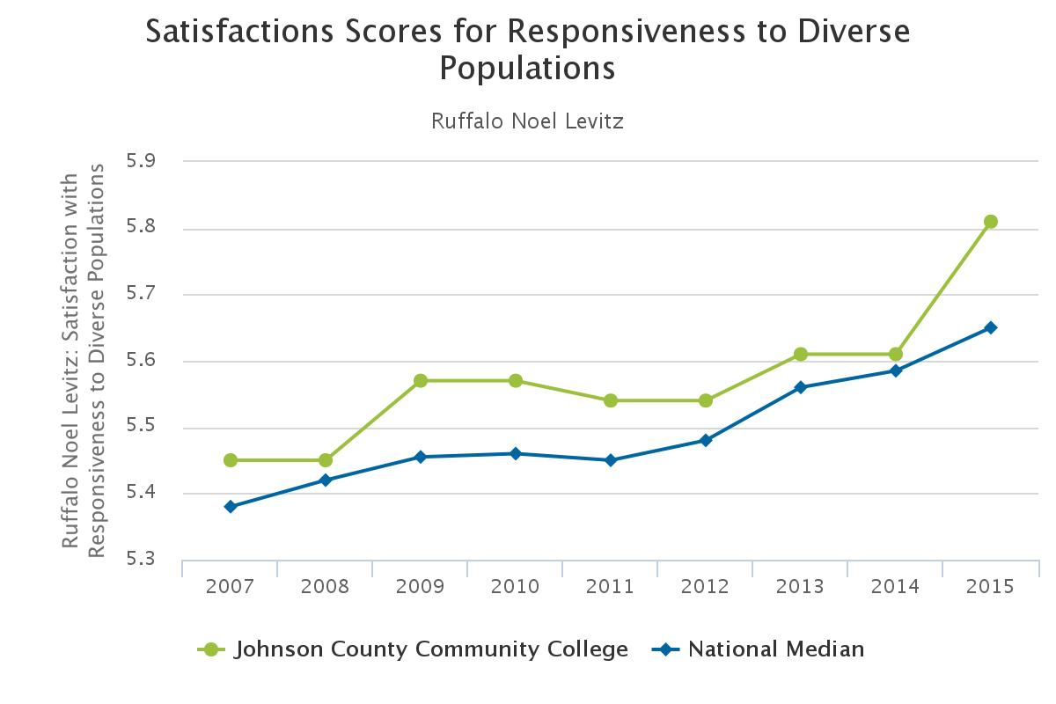
Your College

Slide 26
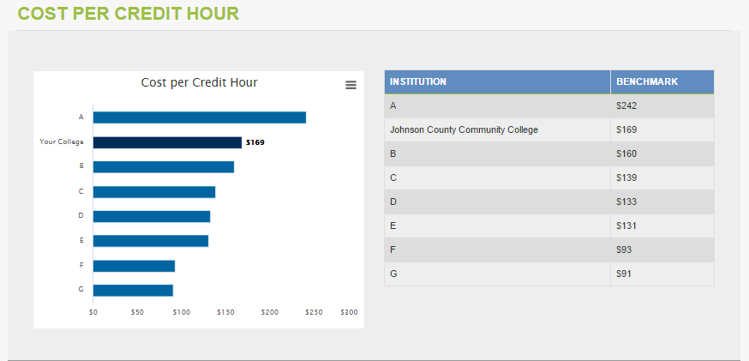
HLC Criterion Two. Integrity: Ethical and Responsible Conduct
2.B. The institution presents itself clearly and completely to its students and to the public with regard to …costs to students.

Slide 27
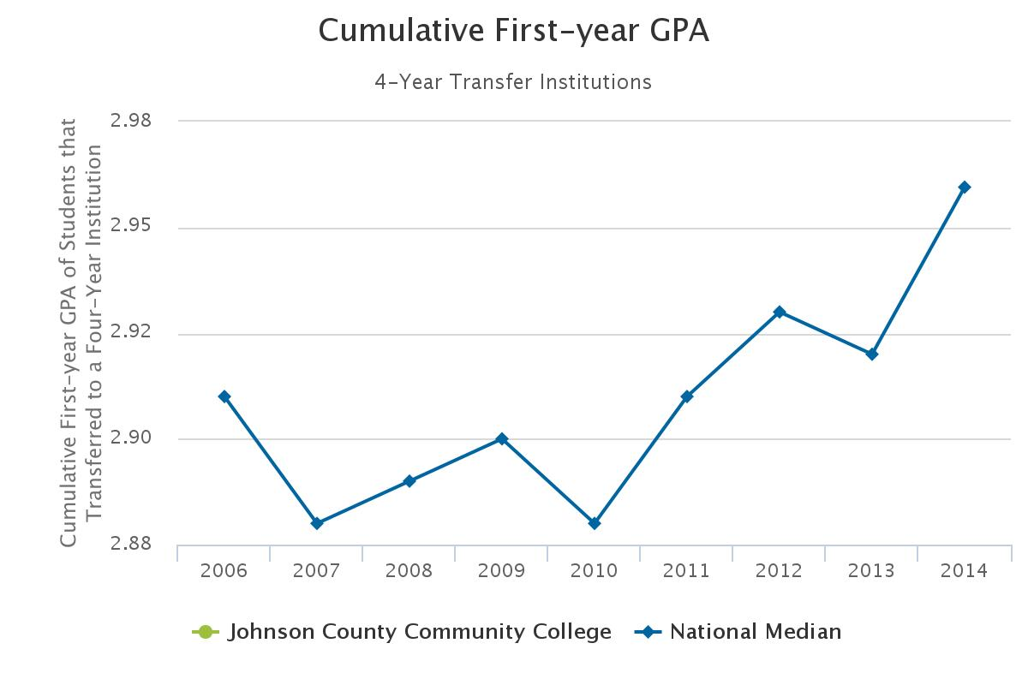
HLC Criterion Three. Teaching and Learning: Quality, Resources and Support
3.A. The institution’s degree programs are appropriate to higher education.

Slide 28
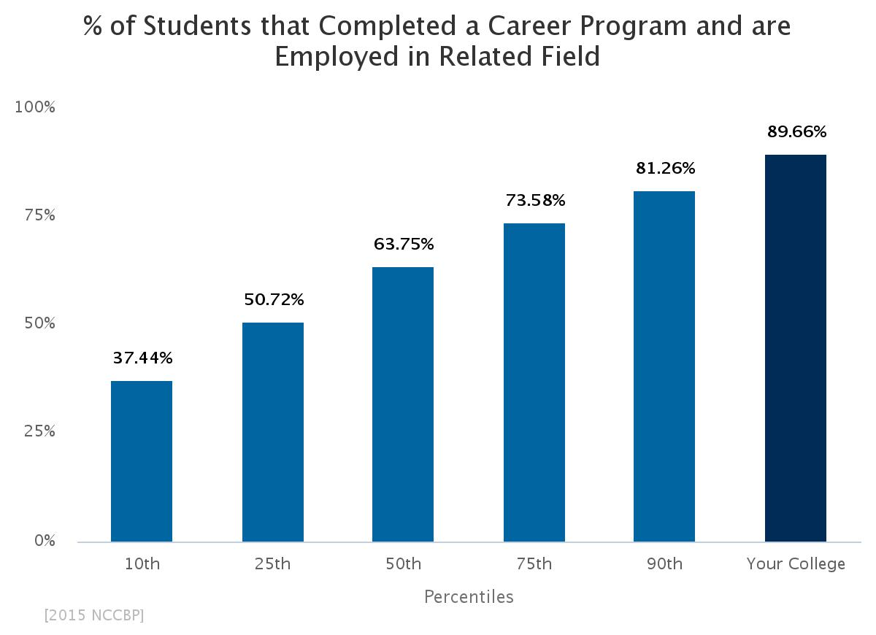
HLC Criterion Four. Teaching and Learning: Evaluation and Improvement
4.A.6 The institution evaluates the success of its graduates.

Slide 29
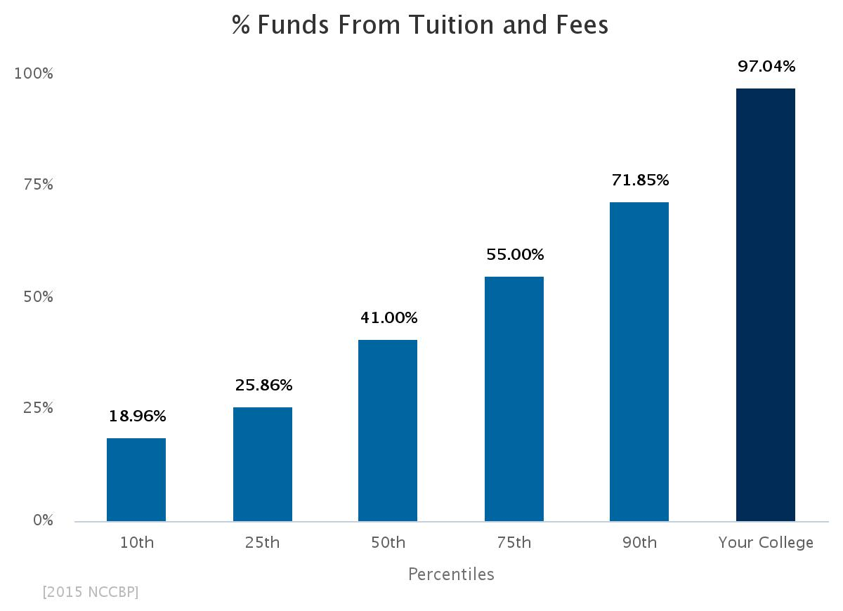
HLC Criterion Five. Resources, Planning, and Institutional Effectiveness
5.A. The institution’s resource base supports its current educational programs.

Slide 30
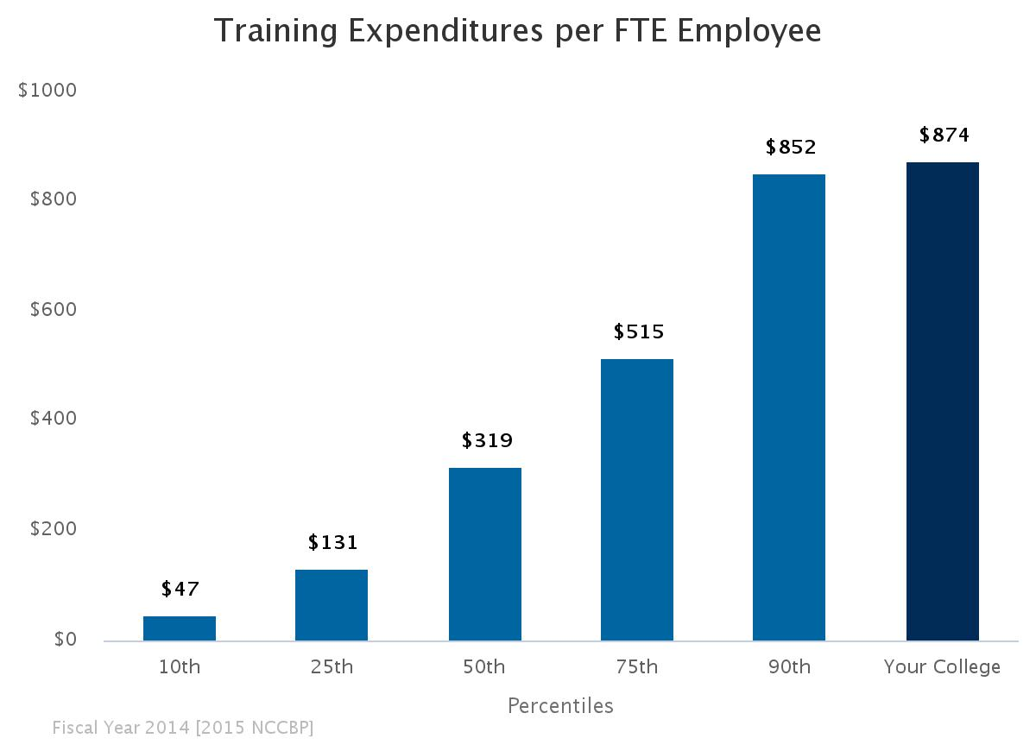
NWCCU Standard Two. Resources and Capacity
2.B.3. The institution provides faculty, staff, administrators…with appropriate opportunities and support for professional growth and development…

Slide 31
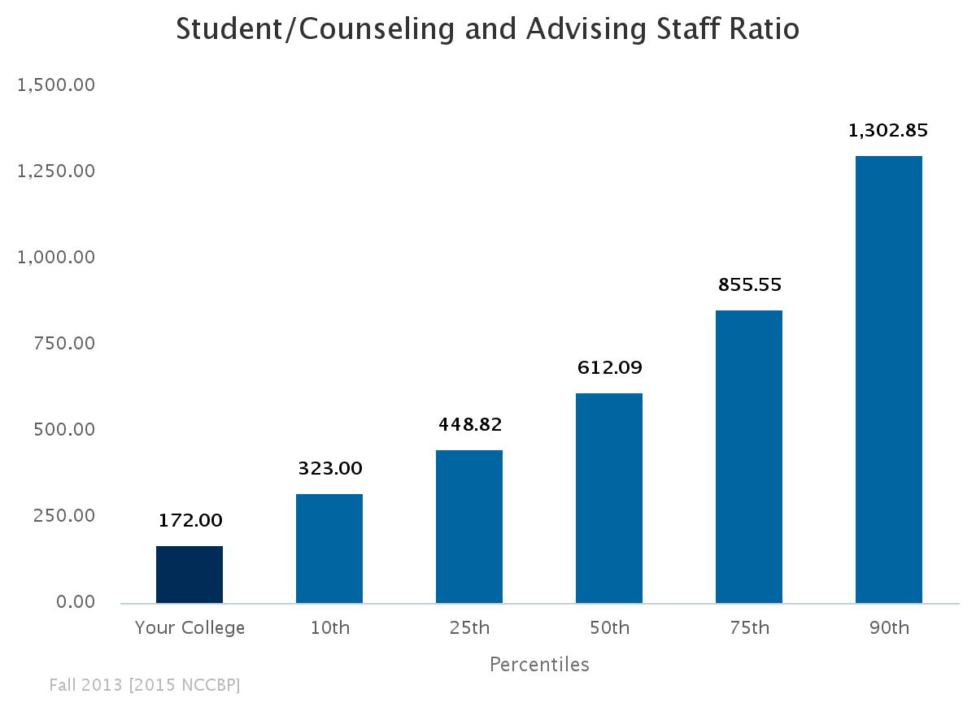
2.D10. Student Support Resources. The institution designs, maintains, and evaluates a systematic and effective program of academic advisement to support student development and success.
Shows a low student to staff ratio for counseling and advising.

Slide 32
NWCCU Standard Four. Effectiveness and Improvement
4.A.1. The institution engages in ongoing systematic collection and analysis of meaningful, assessable, and verifiable data.

Slide 33
What can you take back to your college and use?

