Slide 1
A Decade of Community College Data from the NCCBP
Florida AIR 2016

Slide 2

Session outline
Background of the NCCBP
Trend Data from the NCCBP
Next Steps
Demo

Slide 3


National Higher Education Benchmarking Institute
Michelle Taylor | Senior Research Analyst
@EdBenchmark

Slide 4

NCCBP Started in 2004
Initial funding from Department of Education’s Fund for the Improvement of Postsecondary Education (FIPSE)
This funding established the “Kansas Study” – now Cost and Productivity
JCCC funded the NCCBP
NHEBI was established

Slide 5
NCCBP Today
Today the NHEBI is self-funded
NCCBP provides most of the revenue to keep us up and running
Last year we had 250 members
Over the years, 450+ community colleges have participated

Slide 6
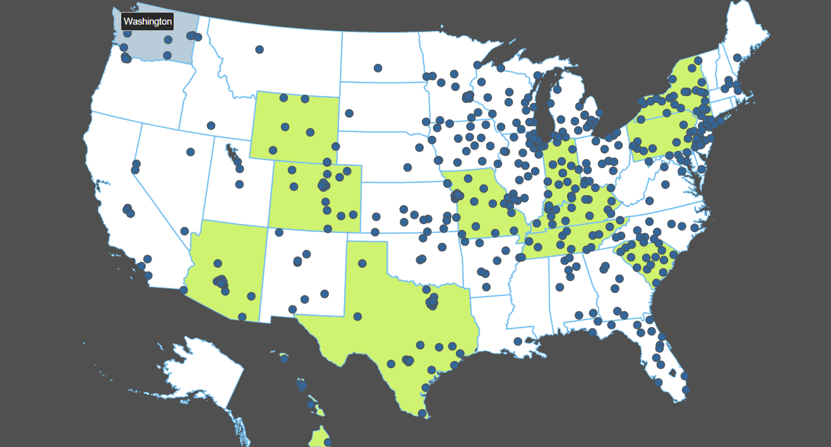
NCCBP Participants since 2004
A quarter of the nation’s community colleges participated in the NCCBP in 2015 (250).

Slide 7
NCCBP Purposes
Provides a comprehensive set of benchmarks for core community college activities
  Completion & Transfer
  Retention & Persistence
  Student Performance
  Satisfaction and Engagement
  Job Market, Business and Industry
  Other Institutional Effectiveness Metrics

Slide 8

How the Benchmark Project Works
Data collection
  Data verification: logical errors, outlier checks
  Voluntary project: colleges provide only available data
  Confidentiality assured

Slide 9
REPORTS
National Report
Executive Report
Peer Comparison
Best Performers Report
Strengths/Opportunities Report
Custom Reports
Notes:
Show National, Executive, Best Performers, Strengths and Peer Comparison -- then back to slides

Slide 10
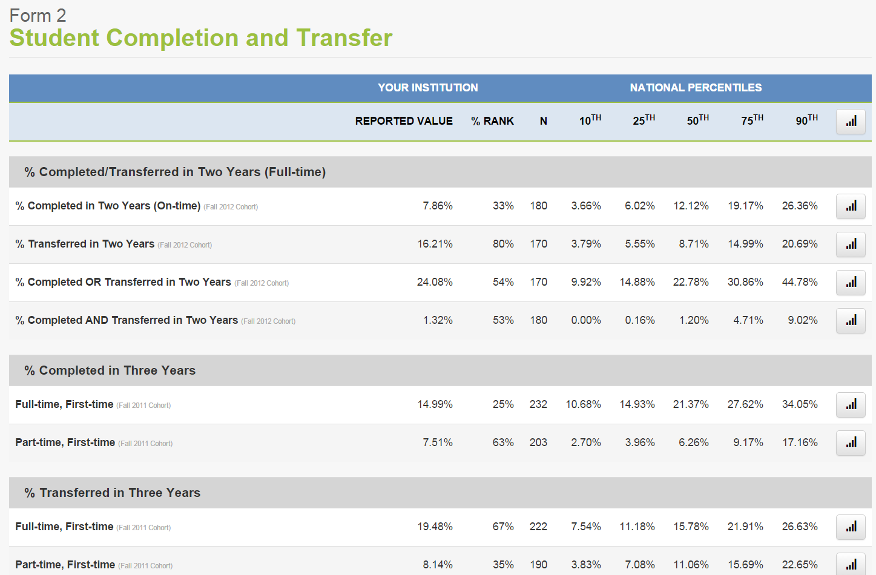
National Report

Slide 11
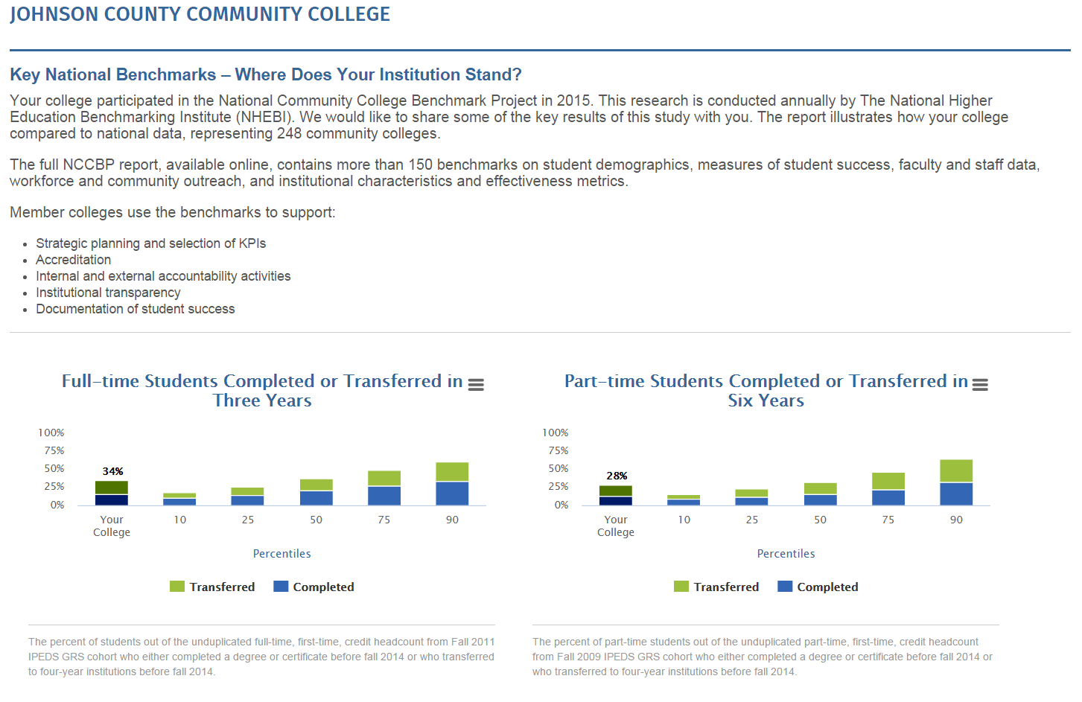
Executive Report

Slide 12
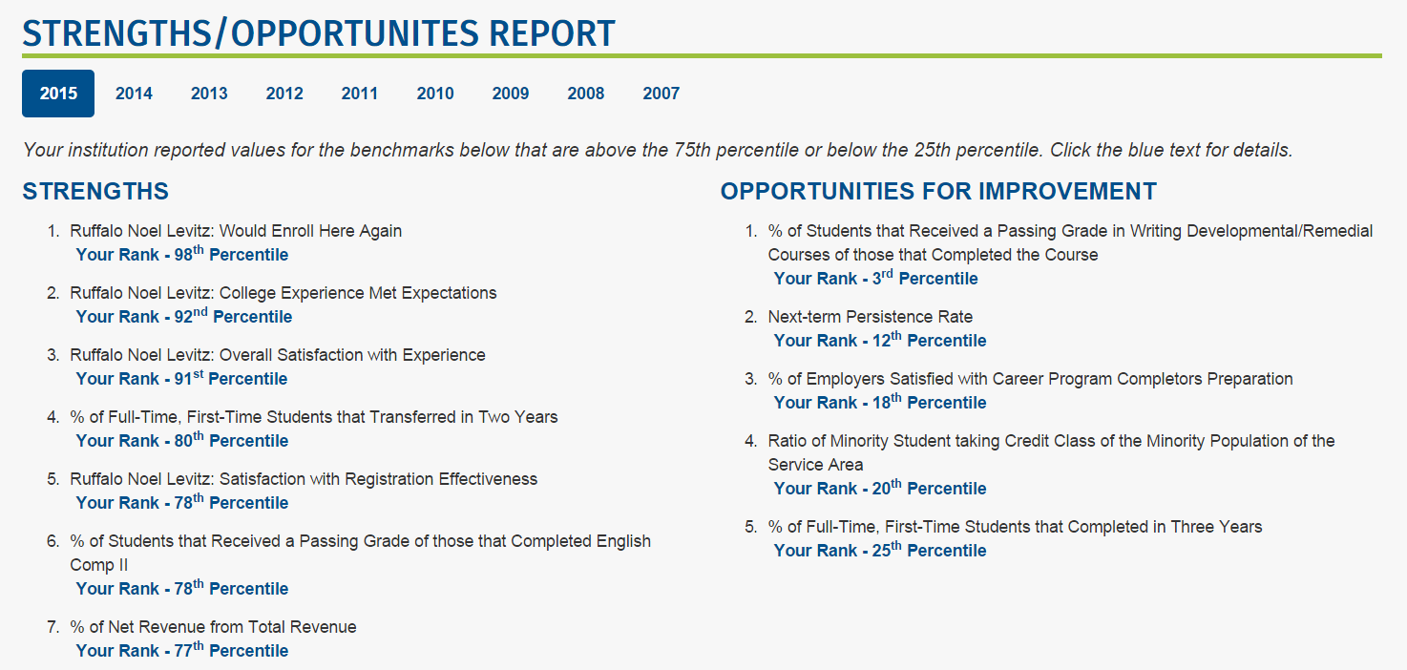
Strength/Opportunities Reports

Slide 13
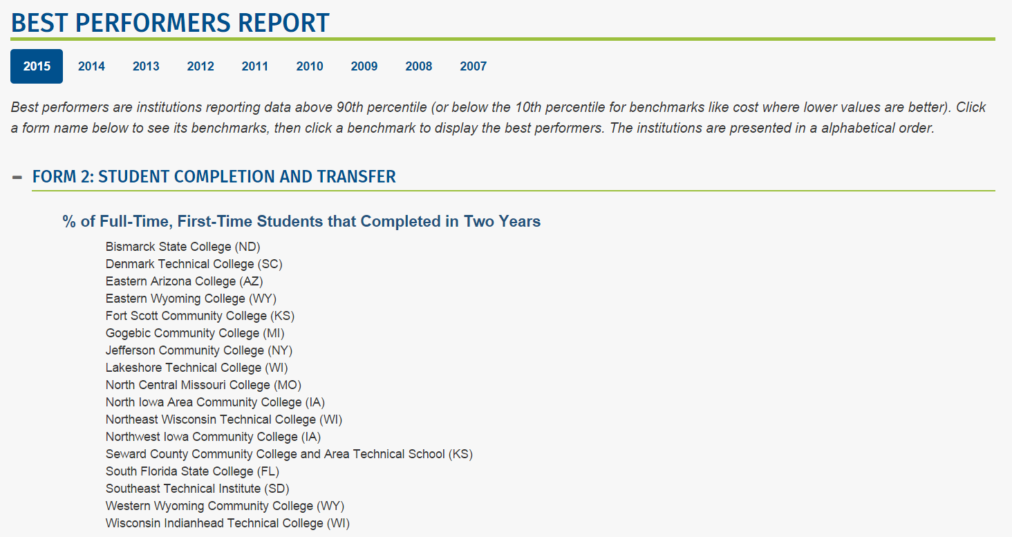
Best Performers Report

Slide 14
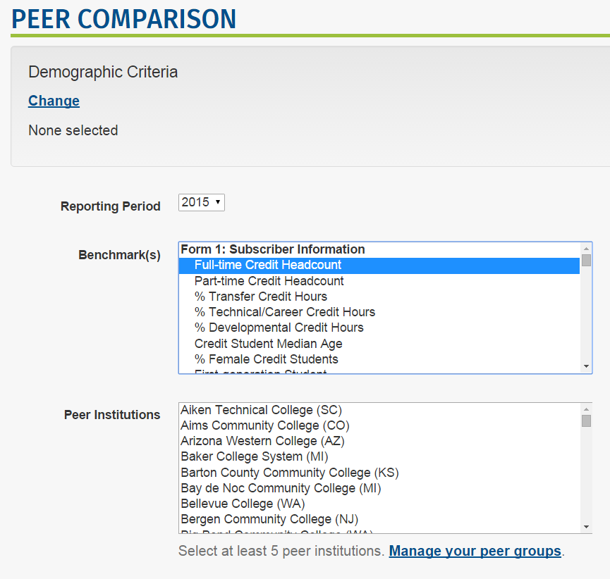
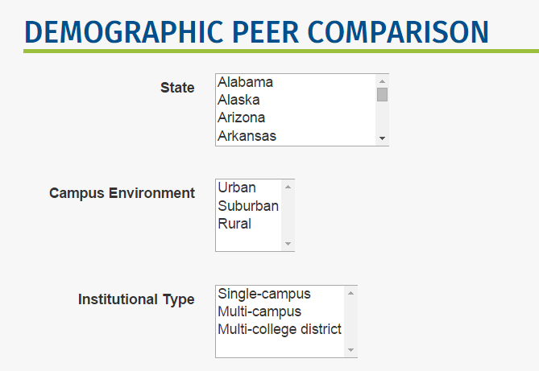
Peer Comparison Tool

Slide 15
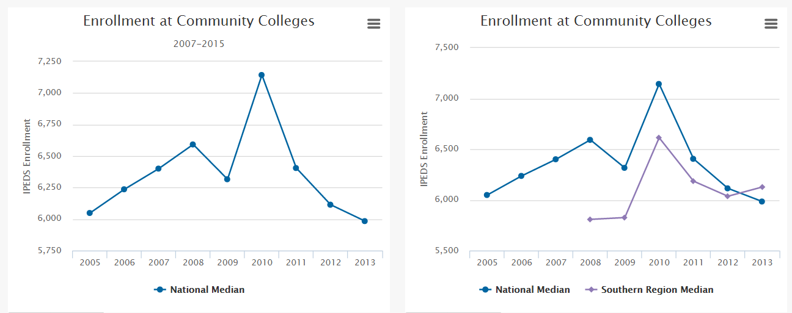
Enrollment Trends

Slide 16
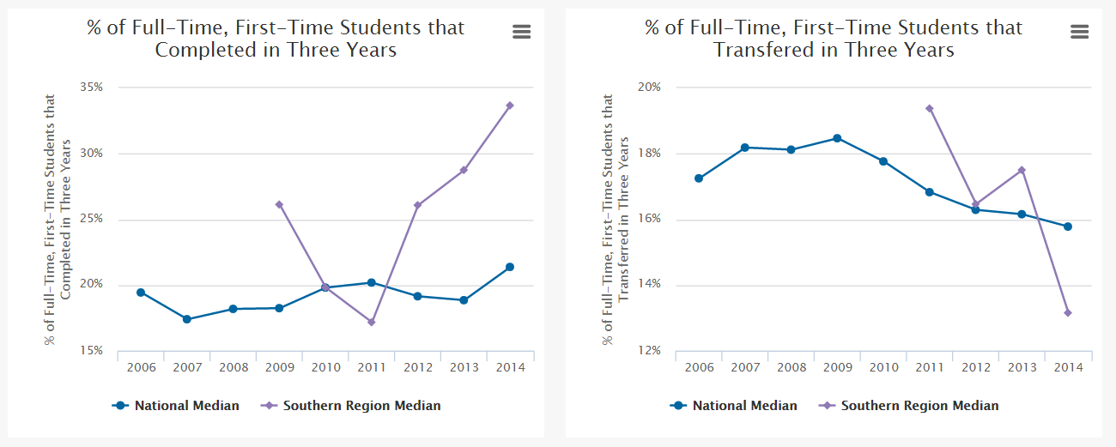
Graduation and Transfer Rate in Three Years
Full-time, First-time

Slide 17
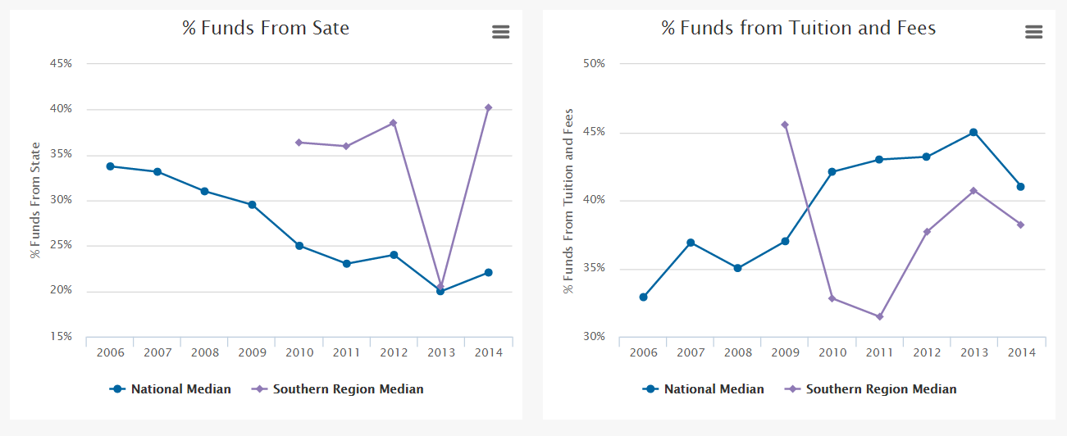
Funding Trends

Slide 18
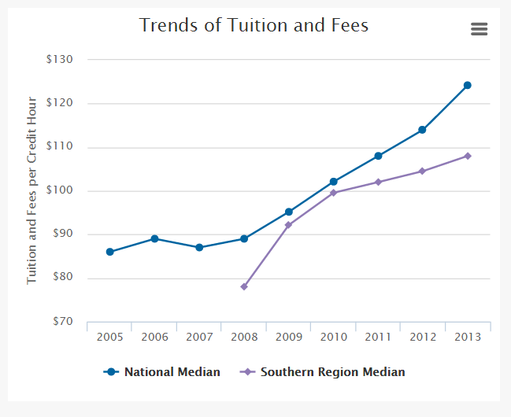
Cost of Tuition and Fees

Slide 19
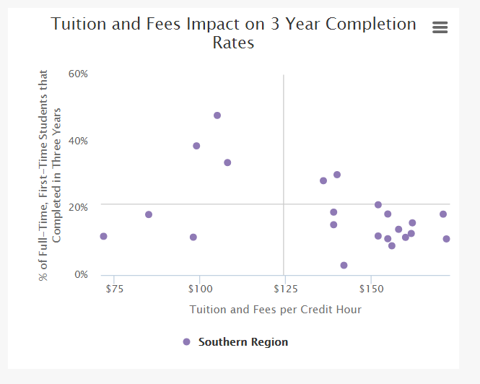
Impact of Cost on Graduation Rates

Slide 20
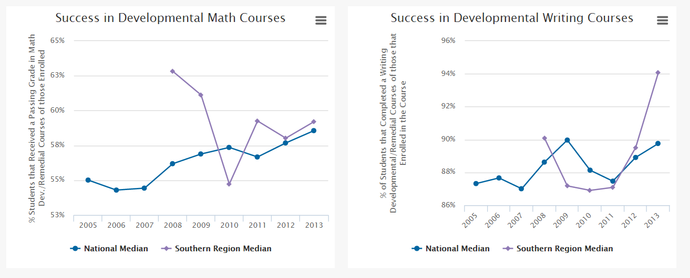
Trends in Developmental Education

Slide 21
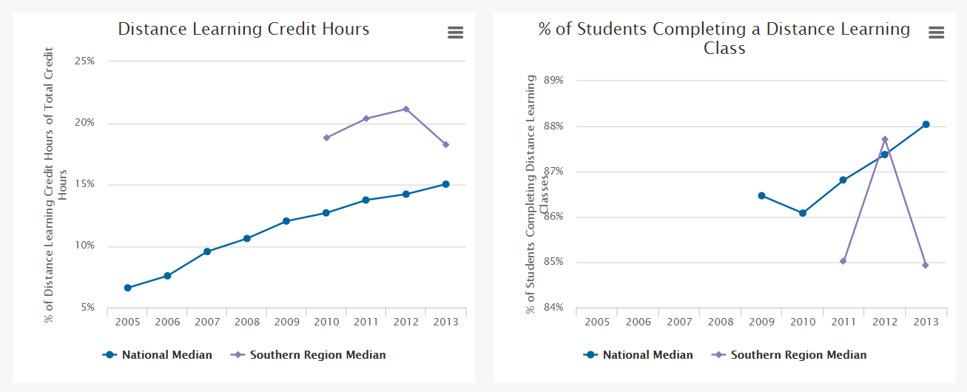
Online/Distance Learning Trends

Slide 22
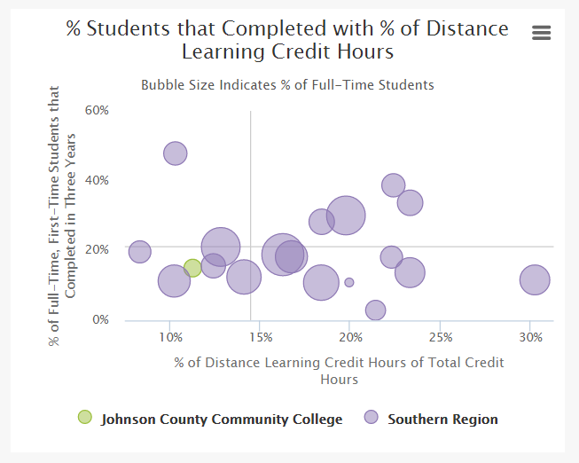
Impact of Online/Distance Learning on Graduation Rates

Slide 23
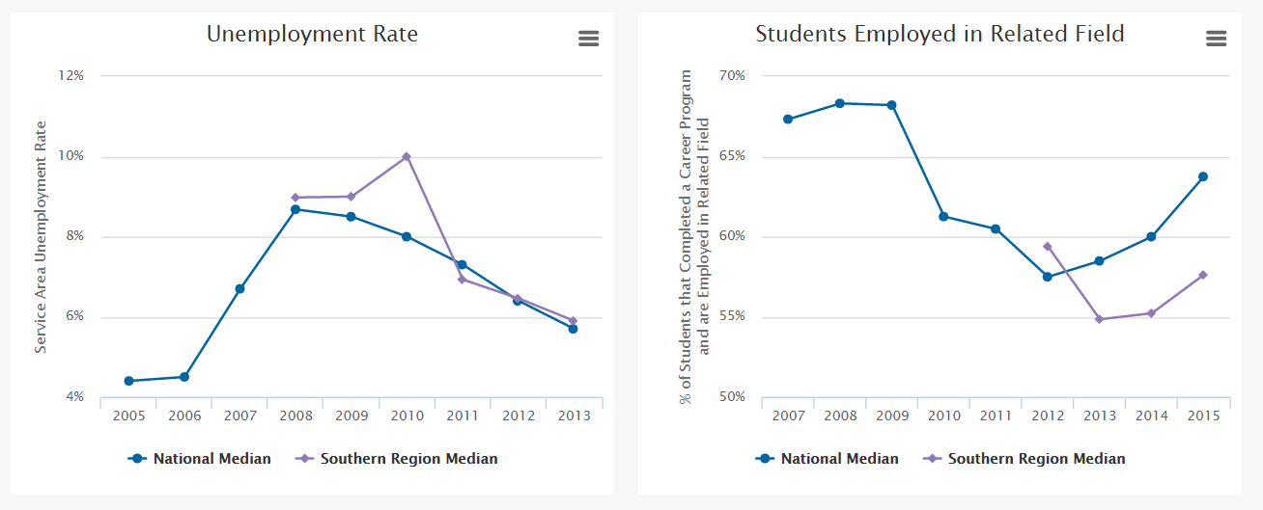
Employment Trends

Slide 24
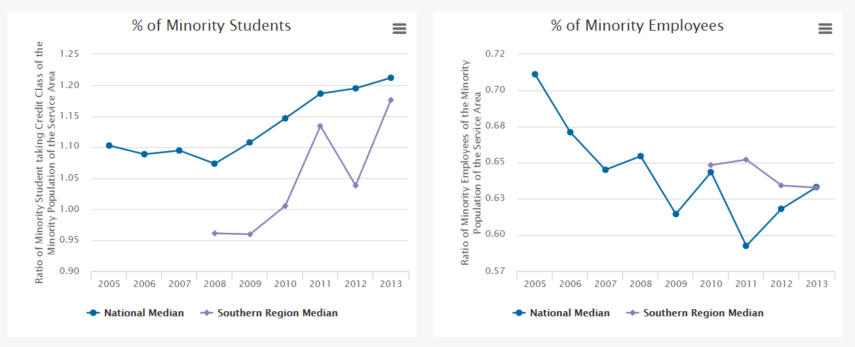
Diversity in Community Colleges

Slide 25


Choosing peers?
Notes:
One of our most widely used reports is the Peer Comparison Report. We always hear the phrase, I want Apple to Apple comparisons. I don’t know what this means. No two apples are the same, no two colleges are the same. But they do have lots of similarities in their missions, processes (such as admissions), and intended outcomes.

Slide 26
Peer Selection Criteria
  Do you have a list of peer colleges you use?
  Do you want to just look at colleges in your state?
  Do you want to look at colleges that will make your look good?
  Do you want to look at colleges that best “match” you?

Slide 27

Not having an identical twin is no excuse for not benchmarking.
Notes:
We also hear the excuse, there isn’t another college just like us.

Slide 28
How to Select Your Peer Comparison Group
Campus Environment
Institution Type
Institutional Control
Academic Calendar
Credit Enrollment
Minority Students
Percent State Revenue
Operating Budget
Faculty Unionized
Service Area Population
Unemployment Rate
Household Income
Service Area Percent Minority
Notes:
Recommend that your selection criterial match the benchmarking you are looking at.

Slide 29
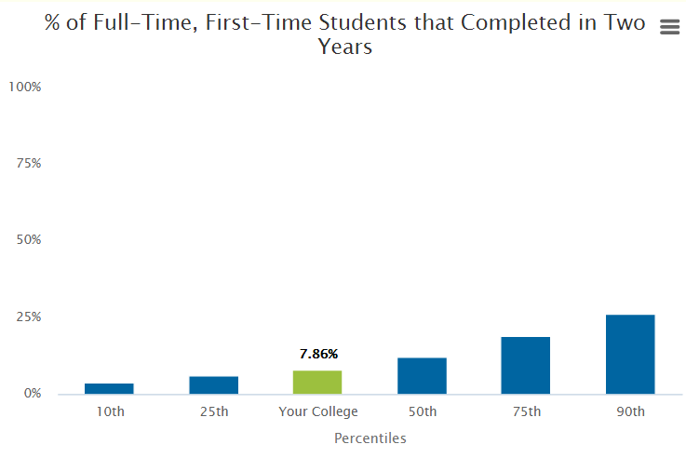

Slide 30
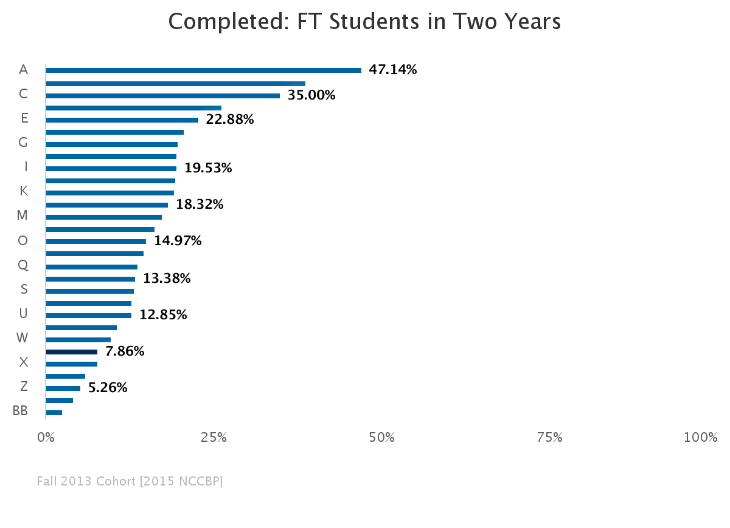
Notes:
What a difference peer selection can make – this is a peer group of all Kansas, Missouri and Illinois Colleges.

Slide 31
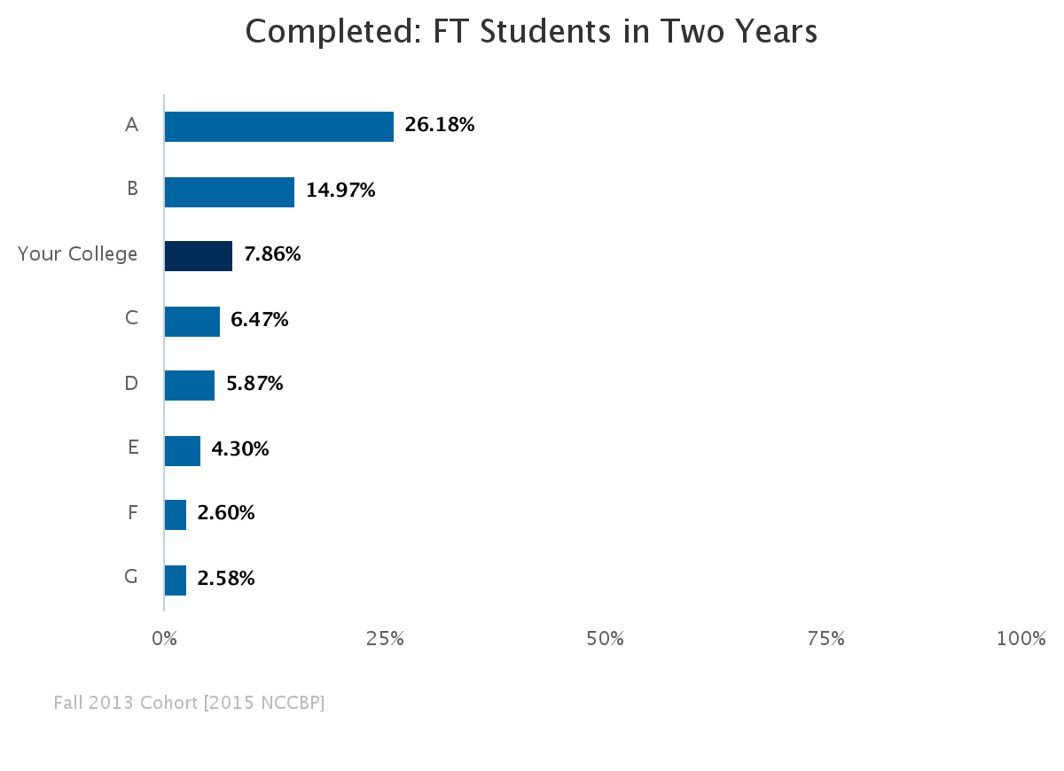
Notes:
Results looks different when peers are large, suburban, public colleges.

Slide 32
PEER Recommendations:
They don’t have to be identical.
Choose peers based on your situation, needs and goals.
Different peers for different benchmarks
Peer comparisons can help refine your results.
Peers make a gap analysis more relevant.
Notes:
Example: Use the same peer group for everything (Jeff’s example) Use JCCC example

Slide 33
Back to Demonstration
Custom Reports
  New in 2015
  Trends
  Scatter plots
  Bubble charts
Notes:
Go to A Decade of Data Custom Report.
Enrollment
Completion
Transfer
Operating Revenue
Developmental Success
Distance Learning & Employed
Scatterplot and Bubble chart
Moving the Needle Report has Persistence

Slide 34

Next steps to “move Your needle”

Slide 35
Use benchmarking
Helps set realistic goals
Shows you where you need to improve the most
Helps you find good examples or colleges with programs that are contributing to success
Helps you focus on your KPI and mission

Slide 36

Learn More about Benchmarking and
Best Practices
JCCC.edu/Benchmark

Slide 37


Keep up with the Benchmarking Institute and all of our projects by joining us on LinkedIn and following us on Twitter.
@EdBenchmark
Join the National Higher Education Benchmarking Institute Group

Slide 38
Take aways
What is one thing that you can take back to your college from this session?

