Slide 1
Performance Funding Dilemma: Developmental Education
38th Annual TAIR Conference February, 2016
Bret Appleton, Director Institutional Research and Data Analysis, State Fair Community College
Lou Guthrie, Director National Higher Education Benchmarking Institute

Slide 2
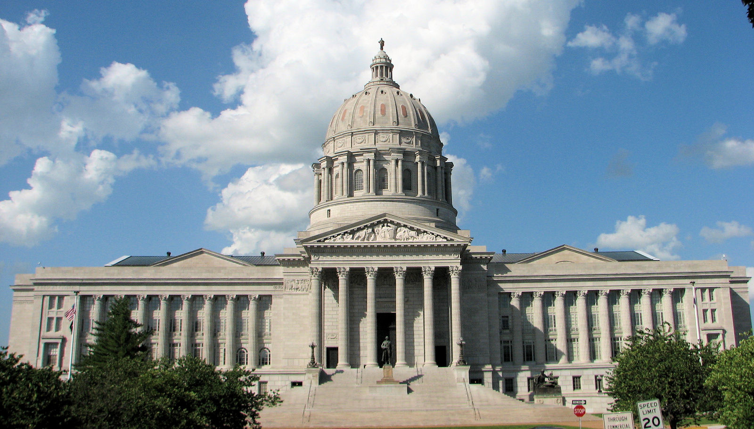
Questions to think about:
Is developmental education changing at your college?
What variables does your state use for performance funding?
Where does the state get its data for their performance funding formulas?
How are needed changes or updates to performance funding criteria and metrics accomplished?
Notes:
Missouri State Capital

Slide 3

Session Outline
History of Performance Funding in Missouri
Using Data from the NCCBP
Innovations in Developmental Education
Formation of the Developmental Education – Performance Funding Task Force
Suggested New Metrics
Testing of the Potential Metrics
Final Decisions
Notes:
Also included in this presentation is everything you didn’t want to know about Missouri, Starting with the State Flag

Slide 4

Performance Funding in MO
MO first explored performance funding in 1989.
First formal performance funding was done in FY 1993.
1993-2011 state funding situation characterized by core cuts in bad years and no increases in better years thus performance funding was essentially inactive.
Then in 2011, the MO Commissioner of Higher Education established the first Performance Funding Task Force.
Fall 2012 CCs reported on metrics.
Notes:
with the Funding for Results pro1993gram.
Performance funding is for “additional funds”
State flower of Missouri Hawthorn Blossom

Slide 5
Change in FY 2015
Efficiency measure
Request to add a 6th measure on Transfers
6th measure is on hold pending final approval and funding
FY2016 asked to propose changes to the Dev. Ed. measures

Slide 6
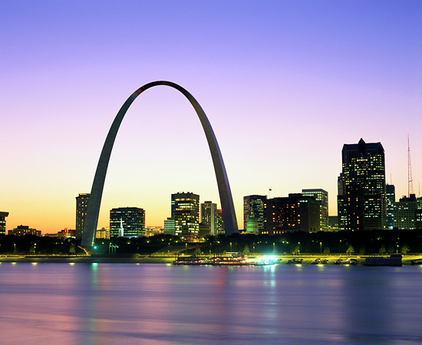

Key characteristics of MO performance measures:
Reliance on existing and externally validated data
Alignment with established statewide goals
Being straightforward in nature and easily understood
Notes:
St. Louis

Slide 7
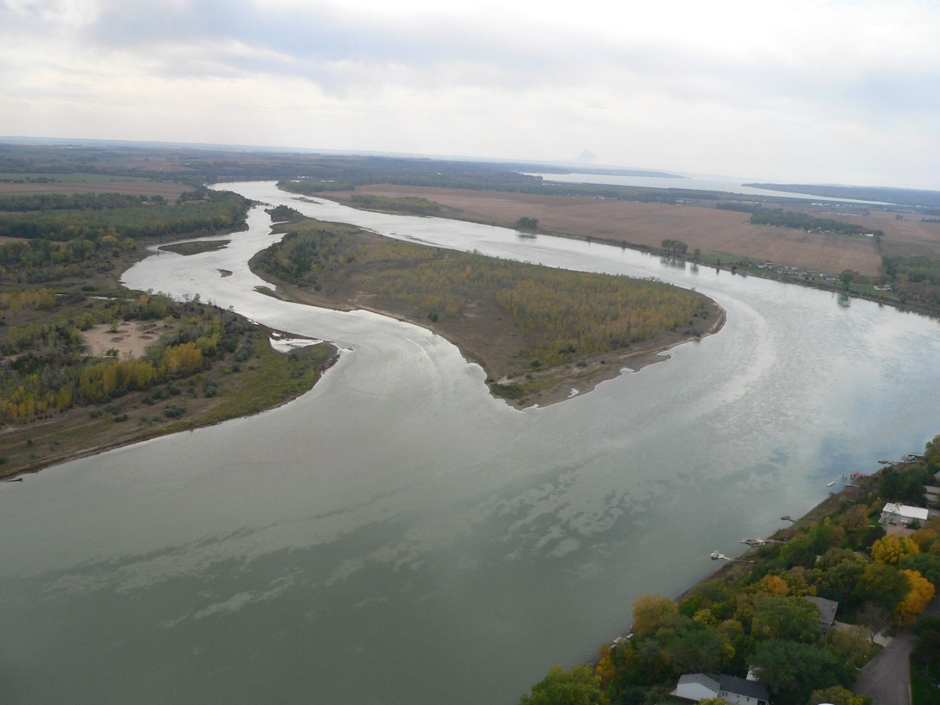
1. 5 Performance Indicators 2. Three-year rolling average used for metrics. 3. Success defined for each institution individually -improvement over that institution’s performance from previous year or maintenance of a high level of performance based on benchmarks
Final MO performance measures:
Notes:
Missouri River

Slide 8

Student Success and Progress Measures
1. Three-year completion rate
First-time, full-time students
Includes those that complete a certificate or degree of at least one year or longer
Transfers to a four-year institution
2. Developmental Ed – English
Percentage of developmental students who successfully complete their last developmental English course and then successfully complete their first college-level English course.
3. Developmental Ed – Math
Percentage of developmental students who successfully complete their last developmental math course and then successfully complete their first college-level math course.
Notes:
State Tree -- Dogwood

Slide 9

Increase Degree Attainment and Quality of Student Living
4. Percentage of career/technical graduates who pass their required licensure/certification examination.

Slide 10
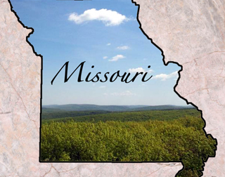
Financial Responsibility and Efficiency
5. Institution-specific measures.
Graduate Outcomes
6. TBD - Transfers
Notes:
The 5th measure allows colleges to choose their own. Some use Fall to Fall or Fall to Spring Persistence.

Slide 11
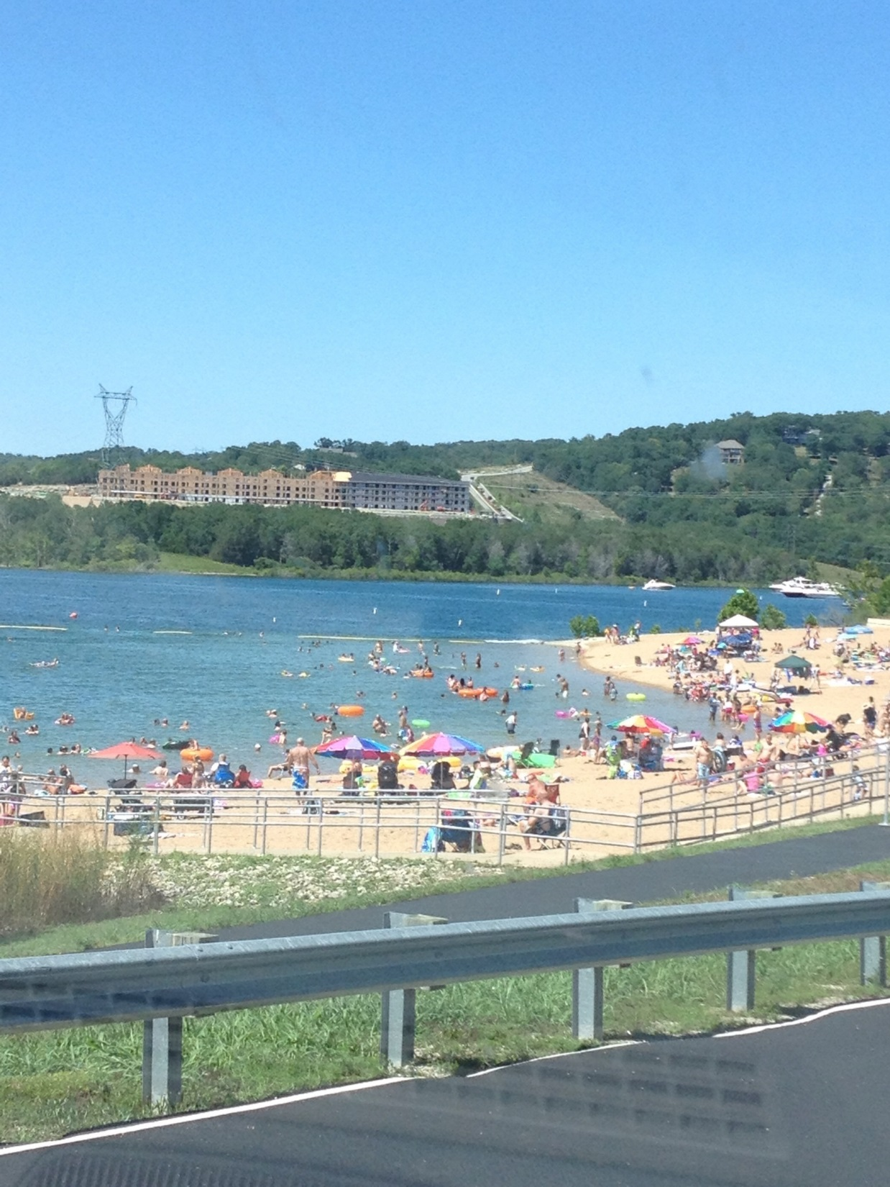
Why make changes so soon?
MO’s CC have implemented innovative instructional methods
Boot camps, on-line refreshers before testing, accelerated learning programs, dual credit and developmental courses or companion classes, modular courses
Goal to reduce the use of ineffective developmental education courses
Innovative approaches do not fit within the structure of the current performance funding model
“As a result, Missouri’s community colleges are financially penalized for implementing innovative programs that contribute to student success and help the state of Missouri achieve its higher education policy goals.”
Notes:
Moonshine Beach in Branson, MO

Slide 12
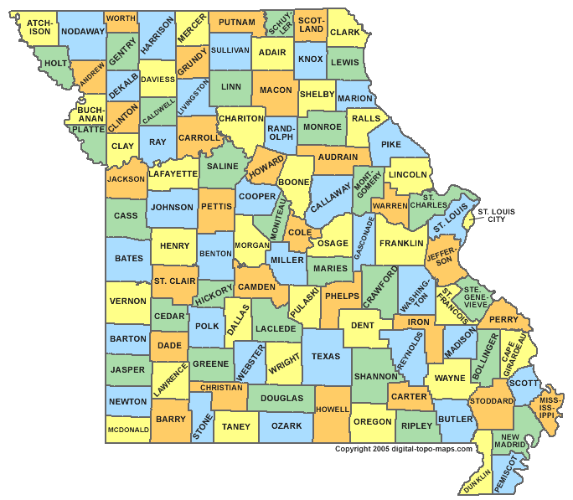
The Task Force
Key to the success of the Task Force was having participation from:
All twelve of Missouri’s Community Colleges
Missouri Department of Education
National Higher Education Benchmarking Institute
Notes:
Task Force formed and charged by the MCCA Presidents/Chancellors Council to provide recommendations on changes to the performance funding model that maintain an emphasis on accountability, while encouraging positive and needed innovations.
Missouri has 114 counties and one independent city (St. Louis) (seceded from St. Louis County in 1867. Other than the state of Virginia there are only 3 independent cities in the US – St. Louis, Baltimore and Carson City.
Cass county (was originally named Van Buren County but was changed to support Van Buren’s Democratic opponent Lewis Cass in the election of 1876.

Slide 13
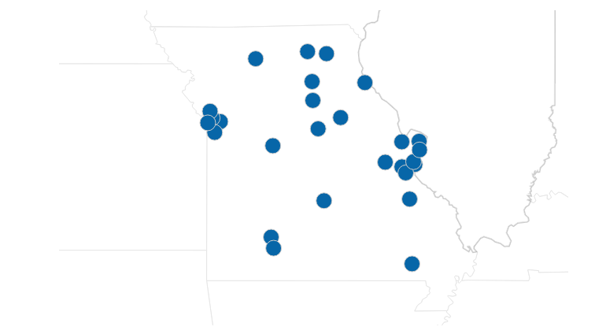

Process was facilitated by:
Notes:
Might spend some time discussing MCCA’s role in Missouri and ask if other states have an association.

Slide 14
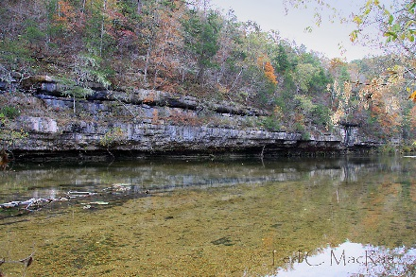
Philosophical Background Discussion
Dev. Ed. does not need to be a specific performance funding metric. The performance of students in dev. ed. is represented within broader metrics, such as success in gateway courses and persistence.
CCs have many other purposes and missions besides remediation, and significant numbers of students never enter remedial courses.
Broadening the performance measures beyond the current heavy emphasis on developmental education allows community colleges to target other areas for improvement.
Notes:
North Fork River
Task Force also discussed the philosophical underpinnings of basing a third of the existing performance measures on developmental education. The Task Force asked the MCCA Chief Academic Officers to discuss this topic as well. There was consensus among the CAOs that developmental education does not necessarily need to be a specific performance funding metric. The CAOs generally felt that the performance of students in developmental education is represented within broader metrics, such as success in gateway courses and persistence.
Additionally, community colleges have many other purposes and missions besides remediation, and significant numbers of students never enter remedial courses. Broadening the performance measures beyond the current heavy emphasis on developmental education allows community colleges to target other areas for improvement. Particularly in an era of changing perspectives on developmental education, performance measures should accommodate unforeseen future trends and encourage innovation.

Slide 15
Evaluated Several Benchmarks
1. Fall to fall persistence (NCCBP Form 4)*
2. Fall to spring persistence (NCCBP Form 4)*
3. Successful completion of all credit hours (NCCBP Form 12)
4. All student performance on gateway math course(s) (NCCBP Form 11)*
5. All student performance on gateway English course(s) (NCCBP Form 11)
6. All college-level course enrollee success rate (NCCBP Form 7)
7. All developmental-level course enrollee success rate (NCCBP Form 8)
8. Gateway English success rate of students who completed highest developmental English (NCCBP Form 9)
9. Gateway math success rate of students who completed highest developmental math (NCCBP Form 9)
Notes:
Items marked with asterisk (*) denote potential changes to the NCCBP forms, and further discussion is included below.
Bret, we will need to discuss these as they are covered – the rational behind them, etc.

Slide 16
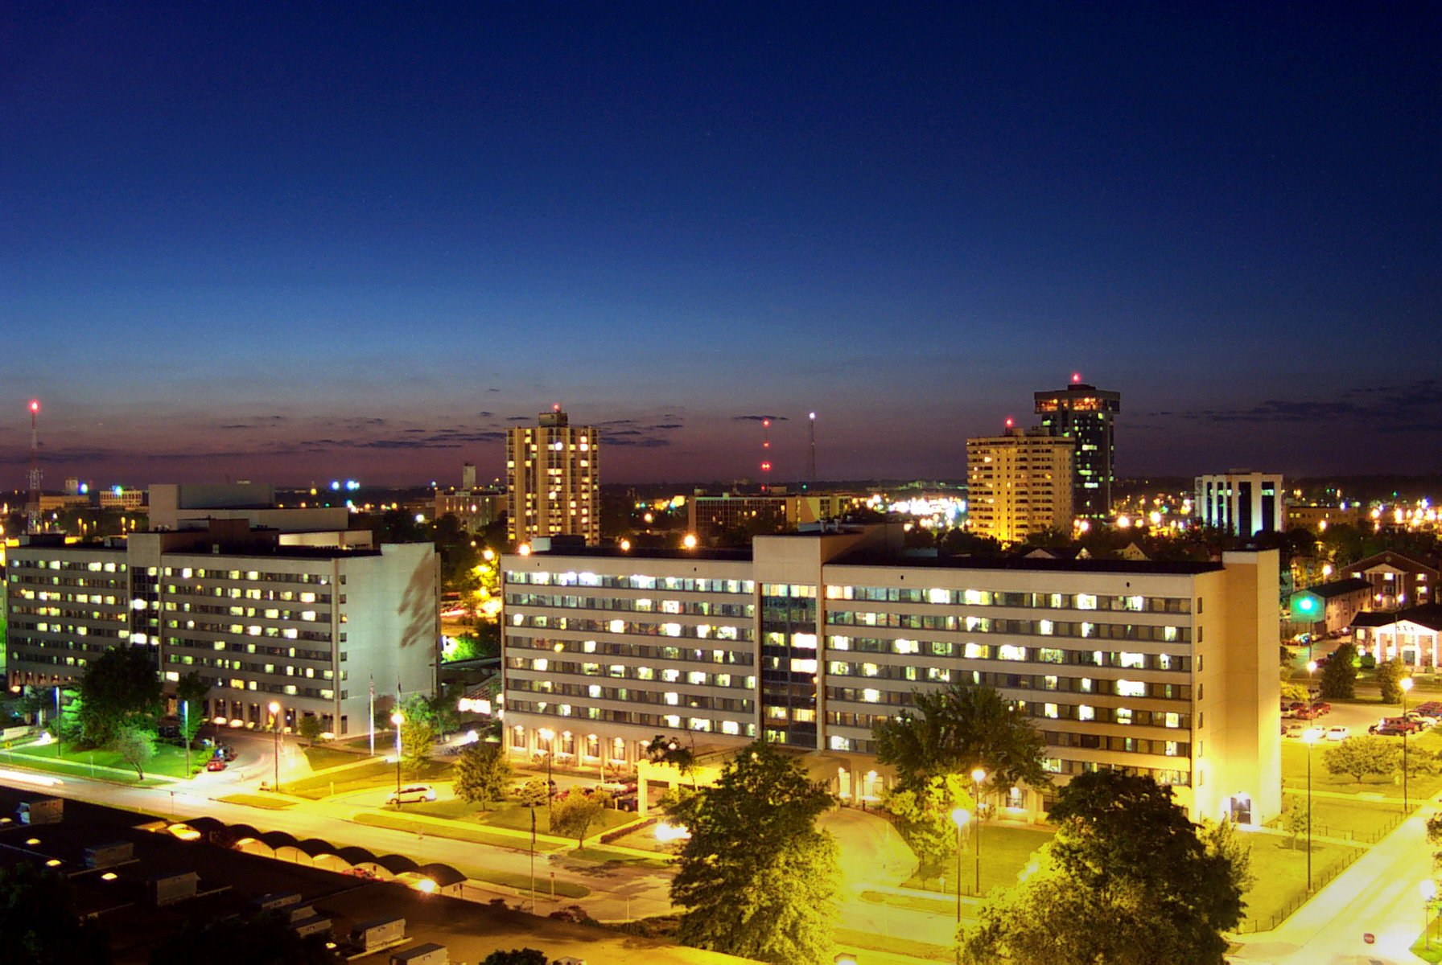
NCCBP: Potential Form Changes
Term to Term Persistence Rates (NCCBP Form 4)
Currently collects data on all students
Potential change to breakout full and part time students.
Student Performance in Gateway Math Course (NCCBP Form 11)
Currently measures College Algebra
Potential change to include other gateway math courses
Notes:
Both of these changes were implemented for the 2016 data collection cycle.
Springfield,MO

Slide 17
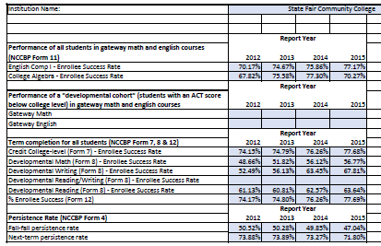
Testing
Before these recommendations were made the colleges tested them out.
Notes:
Each college completed a spreadsheet to see where they stood on the current performance measures and what their results would look like on some of the recommended performance measures.

Slide 18
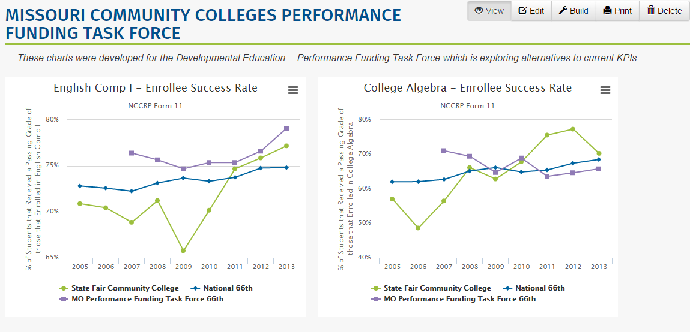
Notes:
The Benchmarking Institute, using the custom chart feature did some chars for each of the colleges showing where they stood on some of the proposed metrics.

Slide 19
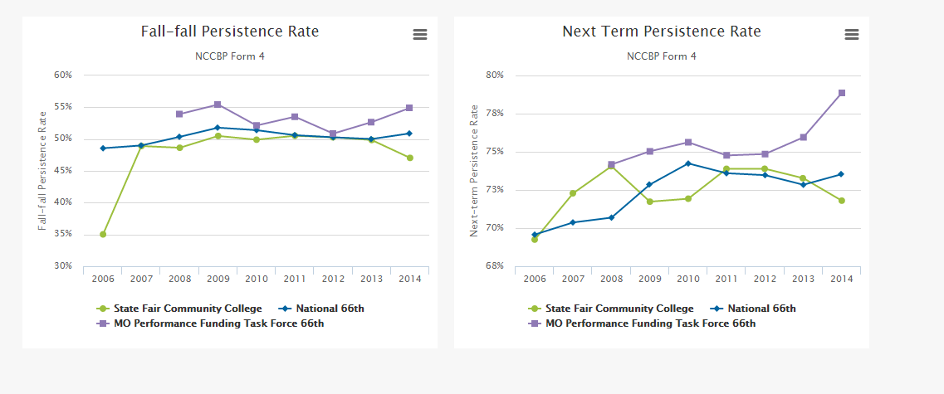

Slide 20
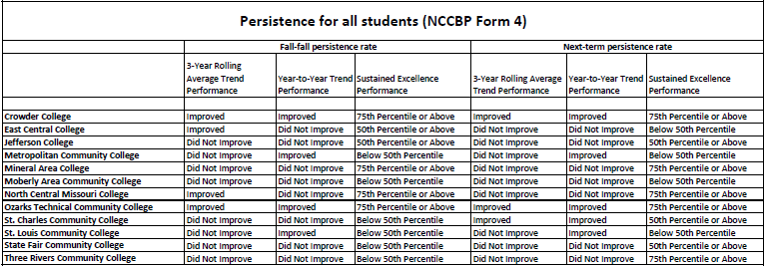
Summary Tables

Slide 21

Final Recommendations Made
Jan. 2016, the Missouri Community College Association presented the final report from the task force.
Recommending using a “menu” of performance funding measures, allowing each college to select the two which best suits them
Institutions can change metrics as early as July 1, 2016
Notes:
Rural MO

Slide 22
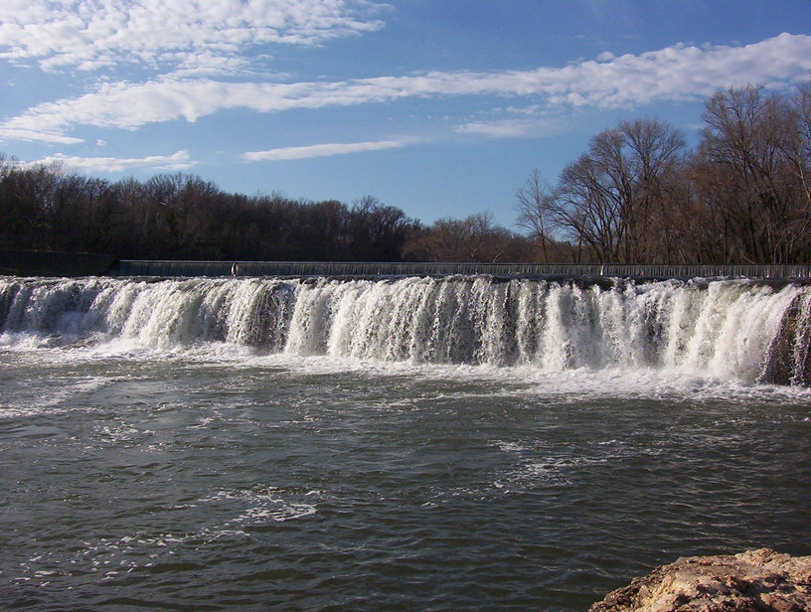
Final Recommendations Made
1. a.) Fall to fall persistence (NCCBP Form 4)* or b.) Fall to spring persistence (NCCBP Form 4)*.
2. a.) Successful completion of all credit hours (NCCBP Form 12) or b.) All college-level course enrollee success rate (NCCBP Form 7)
3. All student performance on gateway math course(s) (NCCBP Form 11)*.
4. All student performance on gateway English course(s) (NCCBP Form 11)*.
5. All developmental-level course enrollee success rate (NCCBP Form 8 combining math/English/reading).
Notes:
Items marked with asterisk (*) denote potential changes to the NCCBP forms
Largest waterfall in Missouri, Grand Falls, Joplin

Slide 23
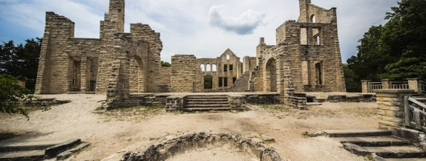
NCCBP
An important consideration in the accountability process is to measure Missouri colleges against national benchmarks.
Through their participation in this Task Force, the Benchmarking institute agreed to collect the suggested measures in the NCCBP.
These changes to NCCBP forms will facilitate additional innovation in the future, while continuing to provide reliable comparative benchmark data for Missouri’s colleges.
Notes:
Lake of the Ozarks State Park – Ha Ha Tonka State Park

Slide 24
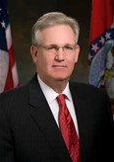

Results
The MCCA has sent the final report from the task force to the Commissioner of the Missouri Department of Higher Education for approval in Jan. 2016
The changes were presented Feb. 4, open now for a comment period, to be voted on in April.
Notes:
Missouri’s current governor is Jay Nixon (no relation to Tricky Dick) and a Democrat.
Dr. David Russell is Commissioner of Higher Education

Slide 25
Conclusions
State performance funding criteria need to be flexible to keep up with community college’s transformations
Having a state community college association to facilitate performance funding issues is very helpful.
Partnering with the NHEBI helped get changes to the benchmarking to support MO’s performance funding metrics.
Performance funding works best when colleges have input in the criteria.
A “menu” of measures helps make performance funding more equitable for colleges.

Slide 26
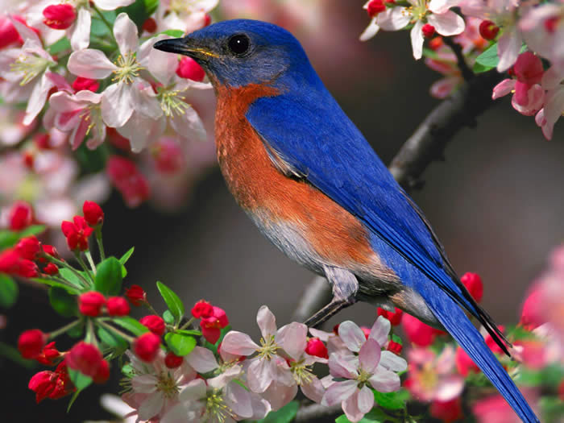
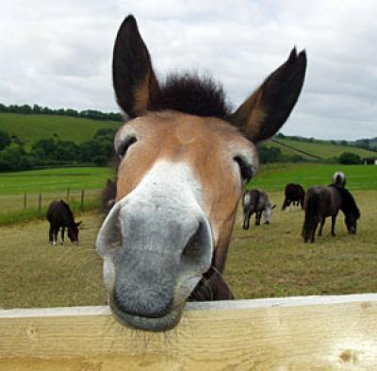
Last tidbits about Missouri
Notes:
State Bird: Bluebird State Animal: Mule

