Slide 1


How Much Does Student Success Cost?
Dr. Lou Guthrie| Director
National Higher Education Benchmarking Institute
Johnson County Community College
Innovations Conference 2016

Slide 2


Slide 3
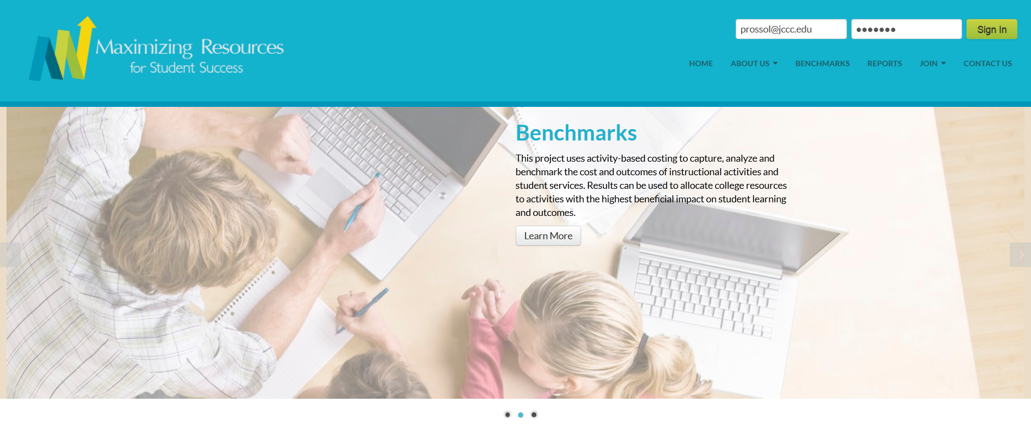
Maximizing Resources Website
www.MaximizingResources.org
Notes:
Here to talk specifically about Maximizing Resources for Student Success. Excited about the prospects for this project. The “wave of the future”. Colleges not quite ready to embrace the concept yet.

Slide 4
Session Outline
Challenges that CC’s face today
ABC: An innovation financial framework
The cost of instructional activities
The cost of student services
Tying the finances to the outcomes
Benchmarking community college costs

Slide 5
Community College Finance Challenges
How do we best serve our students?

Slide 6
External Challenges
Stagnant/declining funding
Declining enrollment
Pressure to increase student success
Diverse students with varying
educational needs
Notes:
Performance funding, college rating system,
The community college environment is changing and it is going to require that we change the way we manage our colleges. Colleges have traditionally been reluctant and slow to change. With today’s challenges they need to be transparent, agile and accountable

Slide 7

Presidents’ Perspective
Inside Higher Ed’s 2016 Survey of College and University Presidents
  68% of the Presidents of public, associate degree-granting institutions do not agree that the business model for cc’s is sustainable over the next 10 years
Notes:
Reallocated dollars – no more shaking the piggy bank for more money – that means no longer being able to raise tuition and fees, no more raising taxes, going to the legislature, etc.

Slide 8

Internal Challenges
“Reallocation” of resources = layoffs
While community colleges have changed, their budgeting and accounting practices have not
Notes:
Resistance to change. Don’t want to be the ones to deliver the message. Tenure and union issues. Xerox-based budgeting. Across the board cuts.

Slide 9

How to Control the Costs of Higher Education?
Start by asking the question: If we make a budget adjustment how will it affect student outcomes?
Changing the Way We Manage
Notes:
How do we allocate our dwindling dollars to best serve our students?
Start by asking the questions: If we make a budget adjustments how will it affect student outcomes?
Answer: start by changing the way we manage our community colleges

Slide 10
Activity-Based Costing
Defining and Describing ABC
An analytical framework for better information
Notes:
So how do we find the answers to questions like: What does it cost to educate a biology major? What does it cost to run English 101? What does it cost to add 100 additional welding majors? How much less does a hybrid course cost compared to a 100% face-to-face course? If we change to 50% distance learning course what will that do to our student outcomes.

Slide 11
“
Without knowing the cost of educational activities, there is no way to improve productivity in a systematic and sustainable manner.
Maria Anguiano
Vice Chancellor of Planning and Budget
UC Riverside
“
Notes:
And there is no way to tie costs to student success. If you increase the budget for experiential education will that increase graduation rates? If you decrease your library budget will that decrease retention rates?

Slide 12
ABC Costing
Allows colleges to:
  Target cost reductions to specific activities
  Calculate the effect of innovations and their
  cost structure
  Reward effective and efficient departments
  Provide incentives for inefficient departments
  to improve
Notes:
Example: When budget goes down 10% everybody receives an across the board cut.
Increase teaching. Which cost center do you increase? How do you know that the increase will be spent on teaching?

Slide 13
Activity-Based Costing Framework
Activity-based costing:
  A costing methodology that identifies activities in an organization
  Assigns all related costs to activities
  Relates the cost to cost driver
  Direct costs roll-up, they are not allocated down
Notes:
Activity-based costing framework can more accurately describe how funds are used
Connect student outcomes to activity costs

Slide 14
Activity-Based Costing Framework
ABC systems focus on the work activities of people and the associated costs
ABC recognizes the equipment and materials required to provide each service or accomplish each activity
ABC includes the space and costs of that space that is required to provide an activity

Slide 15
Example: Activity-Based Costing Framework
Activity
% of
Costs
Cost driver
Teaching
Salaries and benefits
# of students
Classroom / office spaces
Advising
Materials
Grading
Etc.
Costs for teaching
Cost of activity per student
# of students

Slide 16
Challenges to Full Scale ABC Implementation
Requires integration of financial and non-financial systems
Needs extensive buy-in
Not a quick fix
Time, money and resources required for implementation.
Requires keeping old system for compliance and adding new on top
Notes:
Now, I am not going to try to tell you t go out and implement a whole-scale ABC accounting system. Buy-in from top management and faculty, staff. JCCC is going through the process now thanks to this project. Working with Pilbara.

Slide 17



Maximizing Resources for Student Success
Notes:
This is where Maximizing Resources for Student Success steps in. Uses a simplified version of ABC that can answer many of those questions that are needed to make strategic financial decisions.
How much do you spend on instruction, student services, academic support. How do these costs compare with other peer institutions? Where do you overspend? Where are you underfunded?

Slide 18
Maximizing Resources For Student Success
Grant from the Bill & Melinda Gates Foundation to research costs
National fiscal benchmark project for community colleges
Teaches how to implement a simplified version of ABC
Pilot study completed in fall 2013
First year of data collection in 2015

Slide 19
Tremendous Amount of Useful Data
Minimal data collection burden
Members can be on the leading edge of this new trend
IR offices can provide key financial metrics to their executive leadership
Gives us the ability to look at costs and outcomes and tie them together

Slide 20
The Cost of Student Services
The Cost of Instructional Activities
Notes:
So how do we find the answers to questions like: What does it cost to educate a biology major? What does it cost to run English 101? What does it cost to add 100 additional welding majors? How much less does a hybrid course cost compared to a 100% face-to-face course? If we change to 50% distance learning course what will that do to our student outcomes.

Slide 21

Instructional Activities
Program Development
Course Development
Teaching
Faculty Tutoring
Faculty Advising
Academic Service
Assessment and Grading
Professional Development

Slide 22
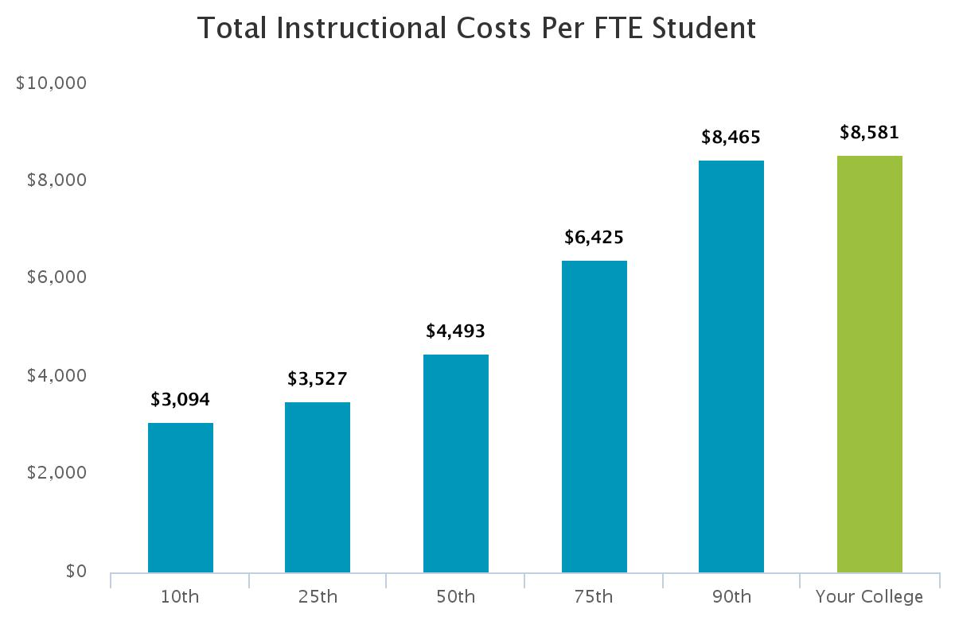
Notes:
No impact on persistence or 3-year completion and transfer rates.

Slide 23

Student Services
Student Services
Admissions
Recruitment
Advising
Counseling
Career Services
Financial Aid
Registrar / Student Records
Tutoring
Testing Services
Co-curricular Activities
Veterans Services
Disability Services

Slide 25
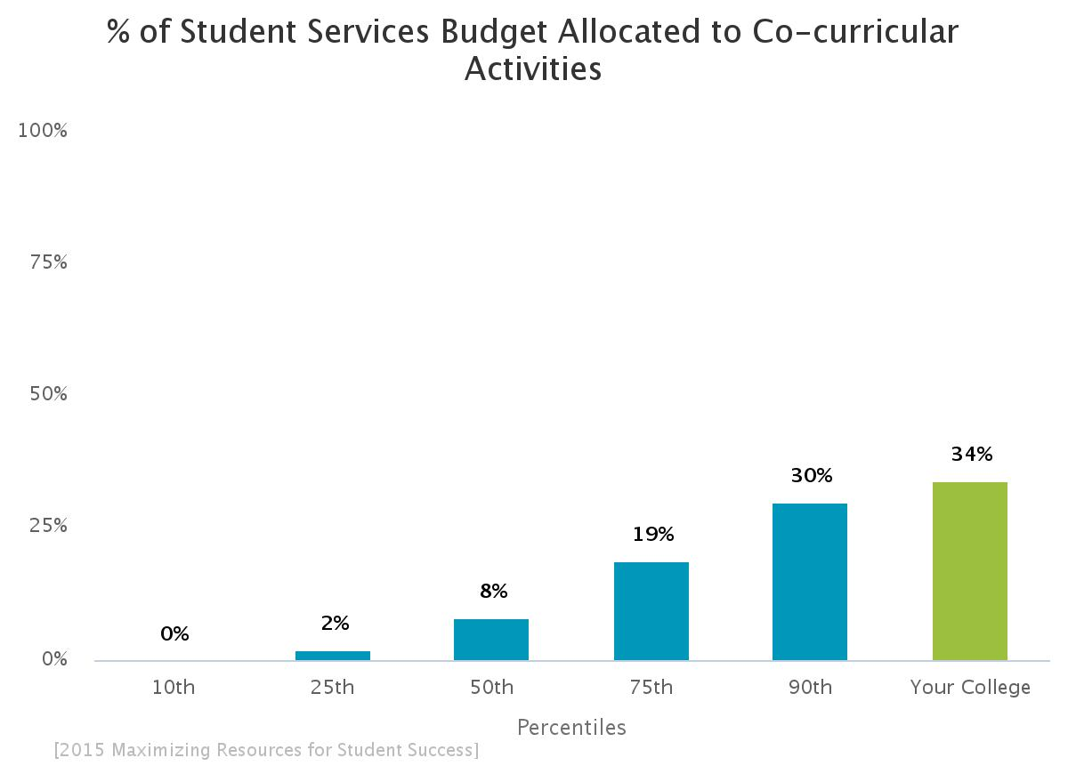
Some Surprises
$369 per FTE student.
$64 per FTE student.
Notes:
JCCC very high when it comes to co-curricular ativities.

Slide 26
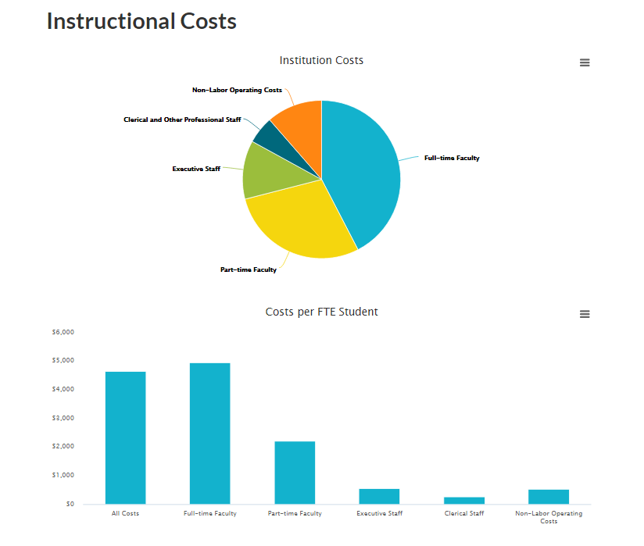

Slide 27
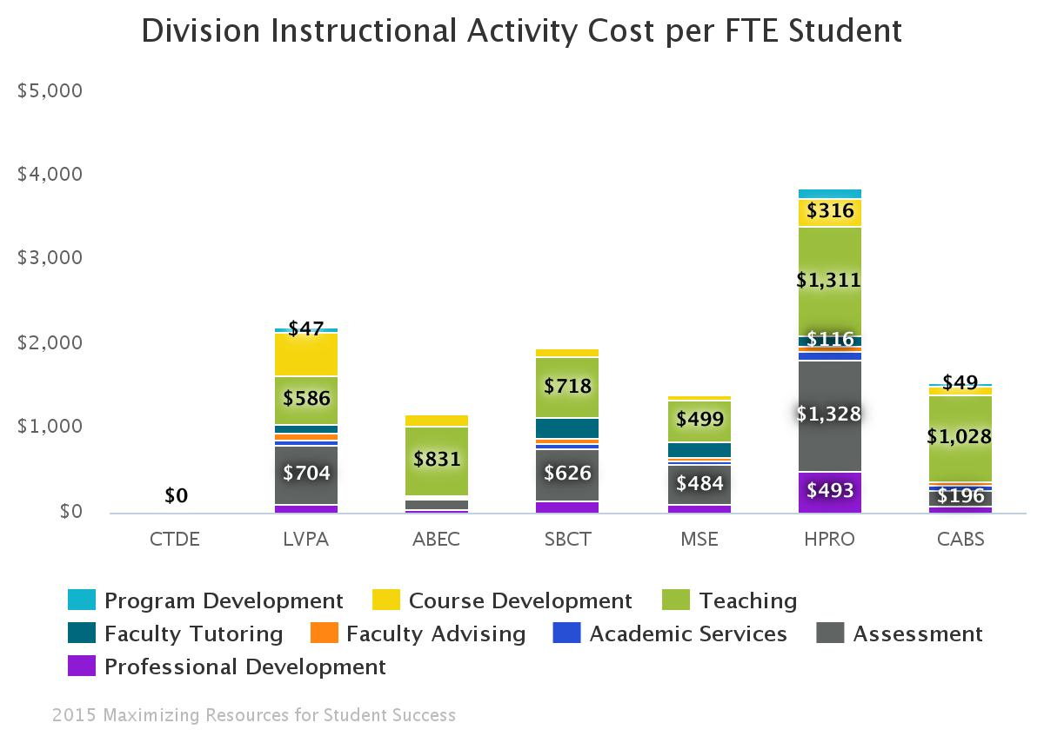
Notes:
An example of one of the institutional reports that illustrates how different divisions at the college spend their instructional dollars.

Slide 28
Impact of the Cost of Instructional Activities and Student Services on Measures of Student Success
Notes:
So how do we find the answers to questions like: What does it cost to educate a biology major? What does it cost to run English 101? What does it cost to add 100 additional welding majors? How much less does a hybrid course cost compared to a 100% face-to-face course? If we change to 50% distance learning course what will that do to our student outcomes.

Slide 29
Looked at 3 measures of success
3-Year Completion (Graduation plus Certificates) and Transfer Rates for Full-time, First-time, Degree-seeking Students
Fall to Fall Persistence
% of Students that Received a Passing Grade in College-level Courses of those that Enrolled in the Course
Notes:
Results for Fall- to Fall Persistence and Fall to next term (Fall to spring) were about the same.

Slide 30
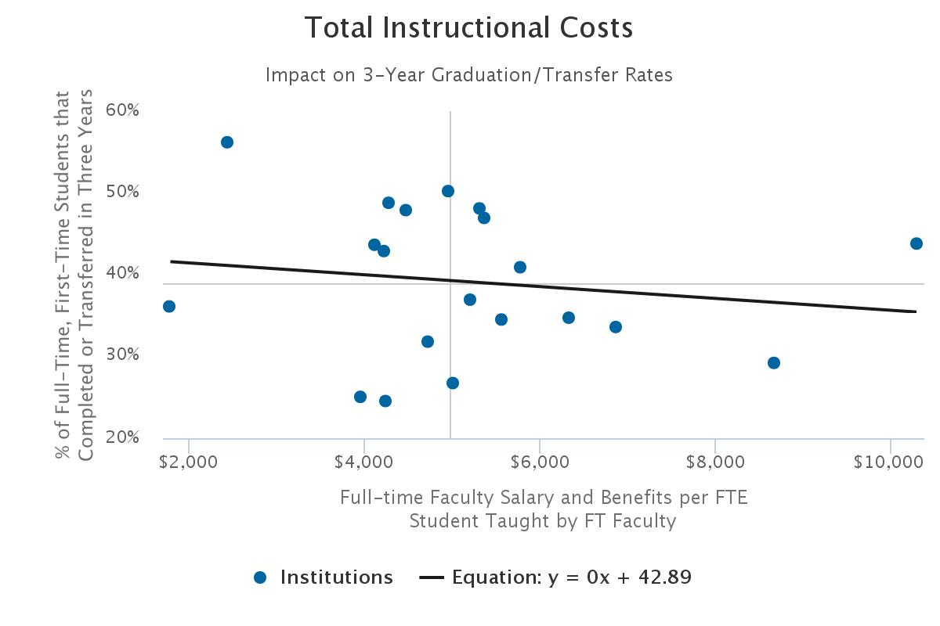
Notes:
The more you spend the lower your graduation rates!

Slide 31
The amount spent on any of the individual instructional activities had no impact on 3-year graduation/transfer rates and no impact on persistence.
Only exception was the cost per FTE student for course development which had a slight positive relationship with Fall to Fall persistence.
Pearson = .43

Slide 32
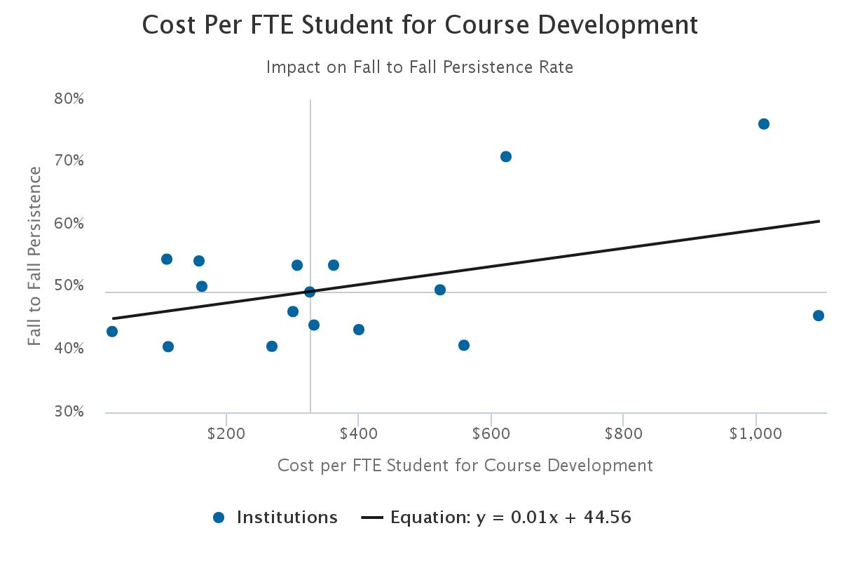

Slide 33
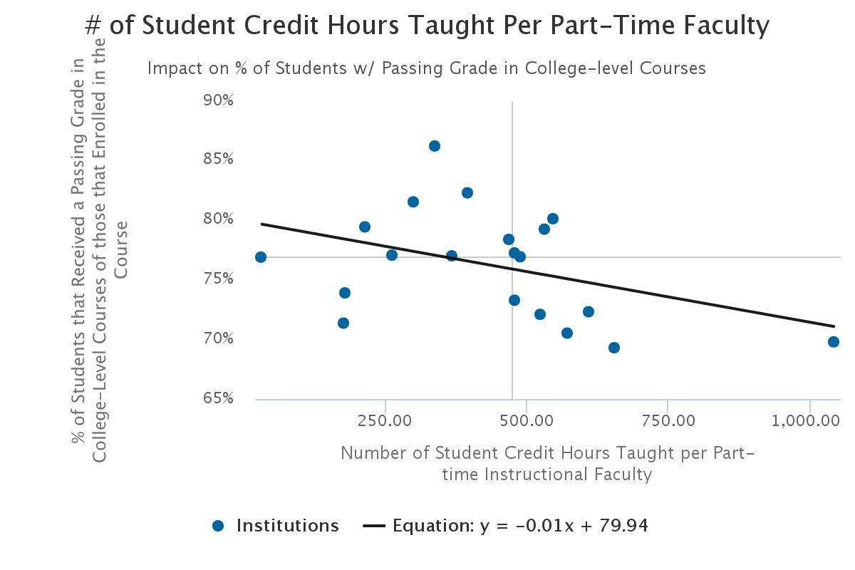
Notes:
One other relationship found. The impact of part-time faculty on the % of passing grades.
Proxie for class size?

Slide 34

Student Services
The % of the total student services budget spent on individual activities had more impact on measures of success than did the cost of the activity per FTE student

Slide 35
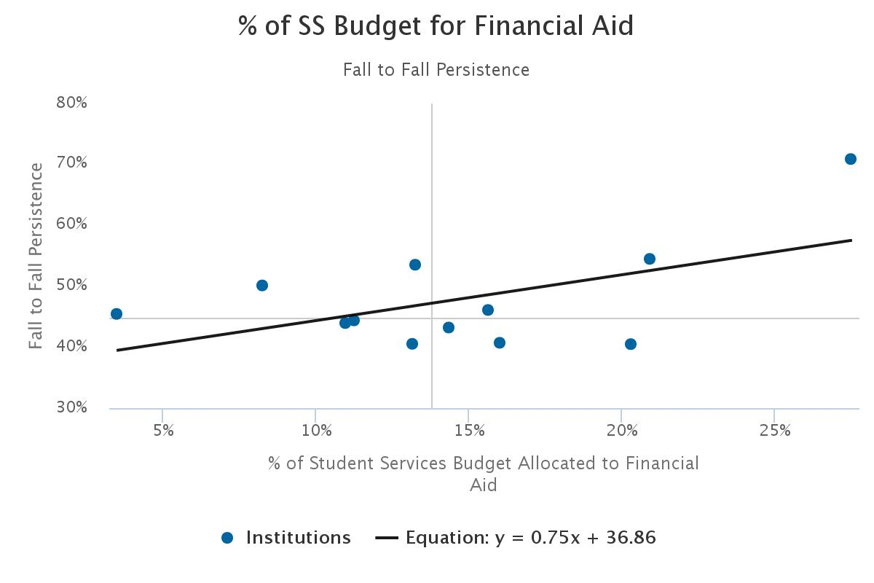
Notes:
The budget for financial aid does not reflect the amount of aid. It is the running of the office of financial aid. But it would indicate that having a strong financial aid office helps with persistence. Also had an impact on Fall to Spring persistence. No impact on graduation rates.

Slide 36
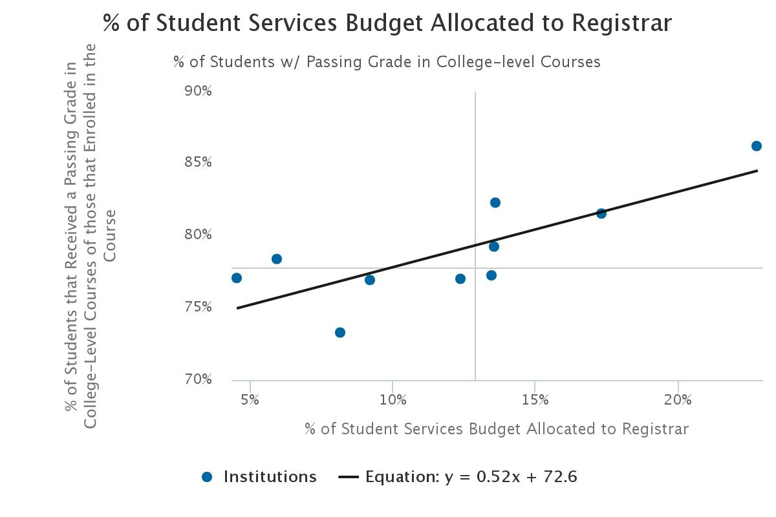

Slide 37
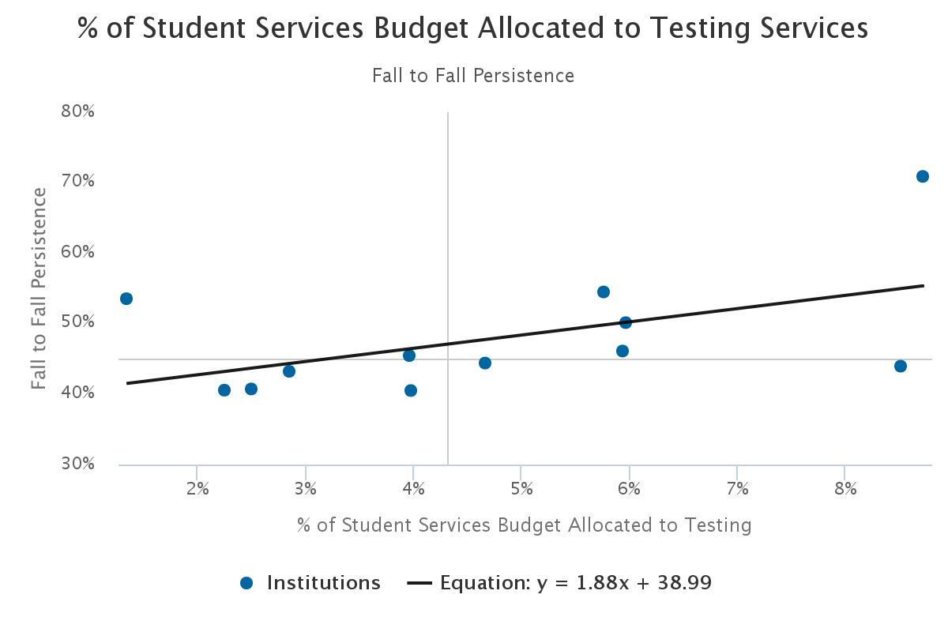

Slide 38
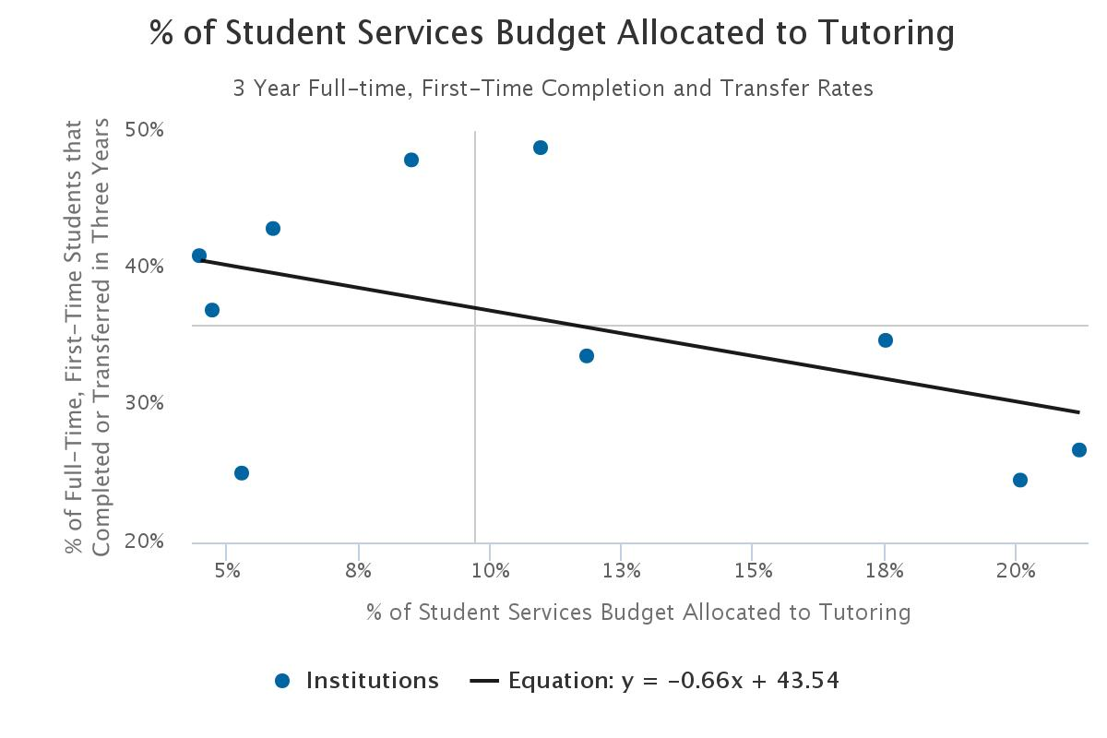
Notes:
A few strange results. The % of the budget spent on Tutoring had a negative impact on persistence and completion rates. May be a reflection of the student population – the more tutoring you need at your college the lower your graduation rates will be.
By the way, there the % of your budget or the amount per student spent on co-curricular activities did not impact any of the measures of student success..

Slide 39
Cautions
Small sample
Only showed small impacts
Data illustrates the type of analysis that could be done with a larger sample
Shows how this data could be used to help make financial allocation decisions
Project has potential, but not yet ready to provide actionable data

Slide 40
Conclusions
Colleges need data to establish relationship between costs and student outcomes
Internal data provided by project very valuable
ABC moves colleges from budgeting to strategic finance
Relatively easy to implement a barebones
version of ABC
Benchmarking provides
  Information on the cost / quality relationship
  Opportunities to increase efficiencies
  The ability to spend funds on activities that have
  the greatest impact on student success
Notes:
ABC can move your organization from a cost focus to continuous improvement

Slide 41
Changing the Finance Conversation
Spending
Inputs
Investing
Outcomes
Current
Future
Notes:
Goal of the project is to change the finance conversation at colleges. Bring it out in the open and talk about not spending but investing with the idea that the college is investing in activities that will increase student success.

Slide 42

Contact Information
Lou Guthrie
louguthrie@jccc.edu | @LouAGuthrie
www.JCCC.edu
www.MaximizingResources.org
@EtdBenchmark

